Slide 1


Kidney Dialysis Technique Department
Prof. Dr. Younis A. Alkhafaji
Biology Lecture 2 - 2nd course
Cell organelles
cell is the fundamental structural and functional unit of all living organisms.
- The cells of the human have an outer membrane as the delimiting structure of the cell. - - Inside each cell is a dense membrane bound structure called nucleus. This
nucleus contains the chromosomes which in turn contain the genetic material, DNA.
-Cells that have membrane bound nuclei are called eukaryotic whereas cells that lack a membrane bound nucleus are prokaryotic.
-The cytoplasm is the main arena of cellular activities in both the plant and animal cells. Various chemical reactions occur in it to keep the cell in the ‘living state’.
- Besides the nucleus, the eukaryotic cells have other membrane bound distinct structures called organelles like the endoplasmic reticulum (ER), the Golgi complex, lysosomes, mitochondria, microbodies and vacuoles.

Slide 2
- The prokaryotic cells lack such membrane bound organelles.
**Ribosomes are non-membrane bound organelles found in all cells both eukaryotic as well as prokaryotic. Within the cell, ribosomes are found not only in the cytoplasm but also within the two organelles chloroplasts (in plants) and mitochondria and on rough ER.
- Animal cells contain another non-membrane bound organelle called
centrosome which helps in cell division.
- Cells differ greatly in size, shape and activities. For example,
Mycoplasmas, the smallest cells, are only 0.3 µm in length while bacteria
could be 3 to 5 µm.
The four basic shapes of bacteria are bacillus (rod like), coccus (spherical), vibrio (comma shaped) and spirillum (spiral).
- prokaryotes have a cell wall surrounding the cell membrane except in mycoplasma. The fluid matrix filling the cell is the cytoplasm.

Slide 3
In addition to the genomic DNA (the single chromosome/circular DNA), many bacteria have small circular DNA outside the genomic DNA. These smaller DNA are called plasmids. Nuclear membrane is found in eukaryotes. No organelles, like the ones in eukaryotes, are found in prokaryotic cells except for ribosomes.
In eukaryotic cells there is an extensive compartmentalization of cytoplasm through the presence of membrane bound organelles. Eukaryotic cell possess an organized nucleus with a nuclear envelope.
-In addition, eukaryotic cells have a variety of co In
eukaryotic cells there is an extensive compartmentalisation of cytoplasm
through the presence of membrane bound organelles. Eukaryotic cells
possess an organised nucleus with a nuclear envelope. In addition,
eukaryotic cells have a variety of complex locomotory and cytoskeletal
structures. Their genetic material is organised into chromosomes.
All eukaryotic cells are not identical. Plant and animal cells are different
as the former possess cell walls, plastids and a large central vacuole which
are absent in animal cells. On the other hand, animal cells have centrioles
which are absent in almost all plant cells complex locomotory and cytoskeletal structures. Their genetic material is organized into chromosomes.

Slide 4
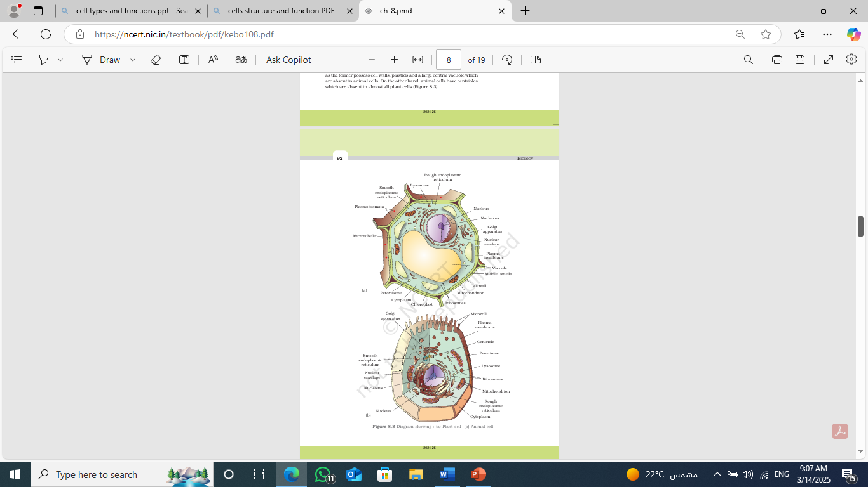
All eukaryotic cells are not identical. Plant and animal cells are different as the former possess cell walls, plastids and a large central vacuole which are absent in animal cells. On the other hand, animal cells have centrioles which are absent in almost all plant cells

Slide 5
Let us now look at individual cell organelles to understand their structure and functions
Cell Membrane
the cell membrane is mainly composed of
lipids and proteins. The major lipids are phospholipids that are arranged in a bilayer. Also, the lipids are arranged within the membrane with the polar head towards the outer sides and the hydrophobic tails towards the inner part. This ensures that the nonpolar tail of saturated hydrocarbons is protected from the aqueous environment.
phospholipids membrane also contains cholesterol. the cell membranes also possess protein and carbohydrate. The ratio of protein and lipid varies considerably in different cell types. In human beings, the membrane of the erythrocyte has approximately 52 per cent protein and 40 per cent lipids.
membrane proteins can be classified as integral and peripheral. Peripheral proteins lie on the surface of membrane while the integral proteins are partially or totally buried in the membrane.

Slide 6
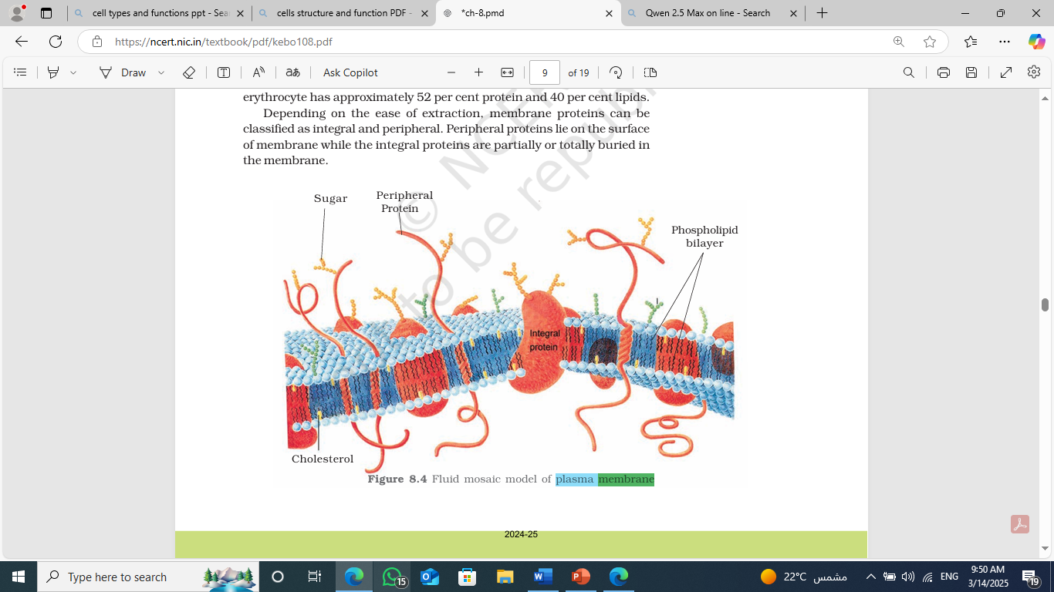

Slide 7
One of the most important functions of the plasma membrane is the transport of the molecules across it. The membrane is selectively permeable to some molecules present on either side of it. Many molecules can move briefly across the membrane without any requirement of energy and this is called the passive transport.
Neutral solutes may move across the membrane by the process of simple diffusion along the concentration gradient, i.e., from higher concentration to the lower. Water may also move across this membrane from higher to lower concentration. Movement of water by diffusion is called osmosis.
***As the polar molecules cannot pass through the nonpolar lipid bilayer, they require a carrier protein of the membrane to facilitate their transport across the membrane. A few ions or molecules are transported across the membrane against their concentration gradient, i.e., from lower to the higher concentration. Such a transport is an energy dependent process, in which ATP is utilized and is called active transport, e.g., Na+/K+ Pump.
Cell Wall
a non-living rigid structure called the cell wall forms an outer covering for the plasma membrane of fungi and plants. Cell wall not only gives shape to the cell and protects the cell from mechanical damage and infection, it also helps in cell-to-cell interaction and provides
barrier to undesirable macromolecules. Algae have cell wall, made of
cellulose, galactans, mannans and minerals like calcium carbonate, while
in other plants it consists of cellulose, hemicellulose, pectin's and proteins.

Slide 8
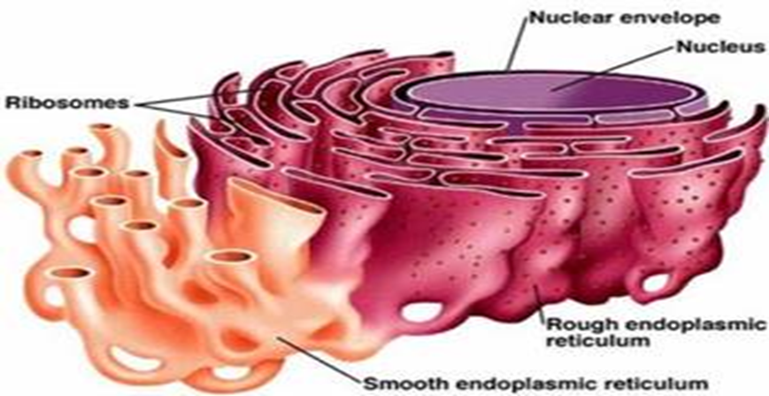
Endomembrane System
The endomembrane system include endoplasmic reticulum (ER), Golgi complex, lysosomes and vacuoles. Since the functions of the mitochondria, chloroplast and peroxisomes are not coordinated with the above components, these are not considered as part of the endomembrane system.
The Endoplasmic Reticulum (ER) tiny tubular structures scattered in the cytoplasm that is called the endoplasmic reticulum (ER). Hence, ER divides the intracellular space into two distinct compartments, i.e., luminal (inside ER) and extra luminal (cytoplasm) compartments.
The ER often shows ribosomes attached to their outer surface. The endoplasmic reticulum bearing ribosomes on their surface is called rough endoplasmic reticulum (RER). In the absence of ribosomes they appear smooth and are called smooth endoplasmic reticulum (SER).
***RER is frequently observed in the cells
actively involved in protein synthesis and secretion.
They are extensive and continuous with the outer
membrane of the nucleus.
*** The smooth endoplasmic reticulum is the major
site for synthesis of lipid. In animal cells lipid-like steroidal
hormones are synthesized in SER.

Slide 9
Golgi apparatus
Camillo Golgi (1898) first observed densely stained reticular structures near the nucleus. These were later named Golgi bodies after him. They consist of many flat, disc-shaped sacs or cisternae of 0.5µm to 1.0µm diameter. These are stacked parallel to each other.
* Varied number of cisternae are present in a Golgi complex. The Golgi cisternae are concentrically arranged near the nucleus with distinct convex cis or the forming face and concave trans or the maturing face.
The cis and the trans faces of the organelle are entirely different, but interconnected.
The Golgi apparatus principally performs the function of packaging materials, to be delivered either to the intra-cellular targets or secreted outside the cell. Materials to be packaged in the form of vesicles from the ER fuse with the cis face of the Golgi apparatus and move towards the maturing face. This explains, why the Golgi apparatus remains in close association with the endoplasmic reticulum.
A number of proteins synthesized by ribosomes on the endoplasmic reticulum are modified in the cisternae of the Golgi apparatus before they are released from its trans face. Golgi apparatus is the important site of formation of glycoproteins and glycolipids.

Slide 10
Lysosomes: These are membrane bound vesicular structures formed by the process of packaging in the Golgi apparatus. The isolated lysosomal vesicles have been found to be very rich in almost all types of hydrolytic enzymes (hydrolases – lipases, proteases, carbohydrase's) optimally active at the acidic pH. These enzymes are capable of digesting carbohydrates, proteins, lipids and nucleic acids.
The vacuole: is the membrane-bound space found in the cytoplasm. It contains
water, sap, excretory product and other materials not useful for the cell. The vacuole is bound by a single membrane called tonoplast. In plant cells the vacuoles can occupy up to 90 per cent of the volume of the cell.
-In plants, the tonoplast facilitates the transport of a number of ions and other materials against concentration gradients into the vacuole, hence their concentration is significantly higher in the vacuole than in the cytoplasm.
الفجوة هي مساحة محاطة بغشاء توجد في السيتوبلازم. تحتوي على الماء، والعصارة، والمواد الإخراجية، ومواد أخرى غير مفيدة للخلية. يُحيط بالفجوة غشاء مفرد يُسمى التونوبلاست. في الخلايا النباتية، يمكن أن تشغل الفجوات ما يصل إلى 90% من حجم الخلية.في النباتات، يسهل التونوبلاست نقل عدد من الأيونات والمواد الأخرى ضد تدرج التركيز إلى داخل الفجوة، ولذلك يكون تركيزها داخل الفجوة أعلى بكثير منه في السيتوبلازم.
In Amoeba the contractile vacuole is important for osmoregulation and excretion. In many cells, as in protists, food vacuoles are formed by engulfing the food particles.

Slide 11
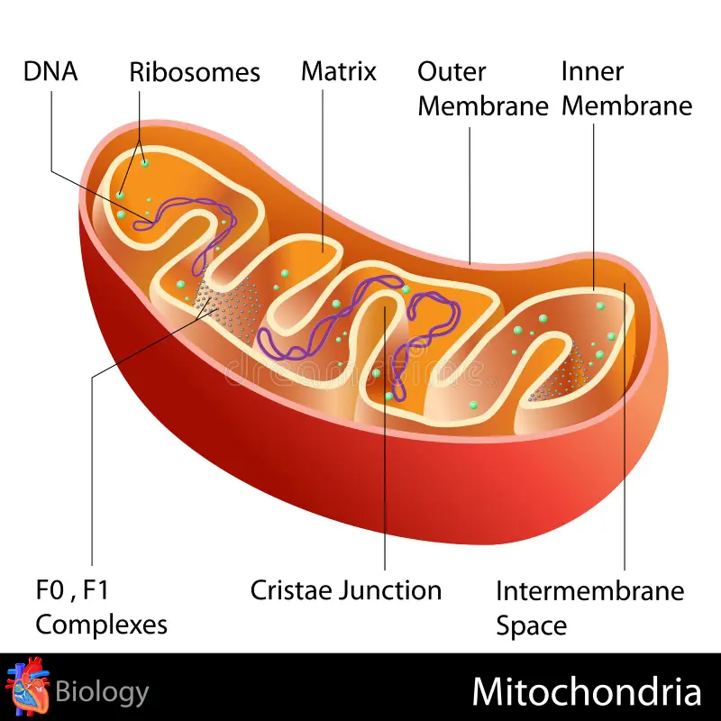
Mitochondria: Typically, it is sausage-shaped or cylindrical having a diameter of 0.2-1.0µm (average 0.5µm) and length 1.0-4.1µm. Each mitochondrion is a double membrane-bound structure with the outer membrane and the inner membrane dividing its lumen distinctly into two aqueous compartments, i.e., the outer compartment and the inner compartment. The inner compartment is filled with a dense homogeneous substance called the matrix.
The outer membrane forms the continuous limiting
boundary of the organelle. The inner membrane forms
a number of infoldings called the cristae (sing.: crista)
towards the matrix. The cristae increase
the surface area. The two membranes have their own
Specific enzymes associated with the mitochondrial
function. Mitochondria are the sites of aerobic respiration. They produce cellular energy in the form of ATP, hence they are called ‘power houses’ of the cell. The matrix also
possesses single circular DNA molecule, a few RNA molecules, ribosomes (70S) and the components required for the synthesis of proteins. The mitochondria divide by fission.

Slide 12
Plastids: Plastids are found in all plant cells and in euglenoids. These are easily observed under the microscope as they are large. They bear some specific pigments, thus imparting specific colors to the plants. Based on the type of pigments plastids can be classified into chloroplasts, chromoplasts and leucoplasts.
- The chloroplasts contain chlorophyll and carotenoid pigments which are responsible for trapping light energy essential for photosynthesis.
-In the chromoplasts fat soluble carotenoid pigments like carotene, xanthophylls and others are present. This gives the part of the plant a yellow, orange or red color.
-The leucoplasts are the colorless plastids of varied shapes and sizes with stored nutrients: Amyloplasts store carbohydrates (starch), e.g., potato; elaioplasts store oils and fats whereas the aleuroplasts store proteins.
Majority of the chloroplasts of the green plants are found in the mesophyll cells of the leaves. These are lens-shaped, oval, spherical, discoid or even ribbon-like organelles having variable length (5-10µm) and width (2-4µm). Their number varies from 1 per cell of the Chlamydomonas, a green alga to 20-40 per cell in the mesophyll.
Like mitochondria, the chloroplasts are also double membrane bound. Of the two, the inner chloroplast membrane is relatively less permeable. The space limited by the inner membrane of the chloroplast is called the stroma. A number of organized flattened membranous sacs called the

Slide 13
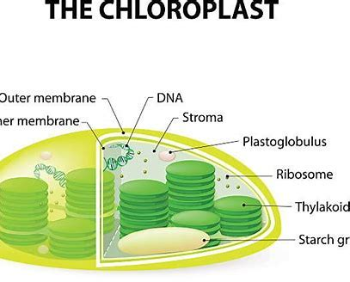
thylakoids, are present in the stroma (Figure).
Thylakoids are arranged in stacks like the piles of coins called grana (singular: granum) or the intergranal thylakoids. In addition, there are flat membranous tubules called the stroma lamellae connecting the thylakoids of the different grana. The membrane of the thylakoids enclose a space called a lumen. The stroma of the chloroplast contains enzymes required for the synthesis of carbohydrates and proteins. It also contains small, double stranded circular DNA molecules and ribosomes. Chlorophyll pigments are present in the thylakoids. The ribosomes of the chloroplasts are smaller (70S) than the cytoplasmic ribosomes (80S).

Slide 14
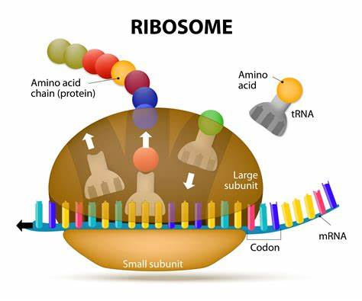
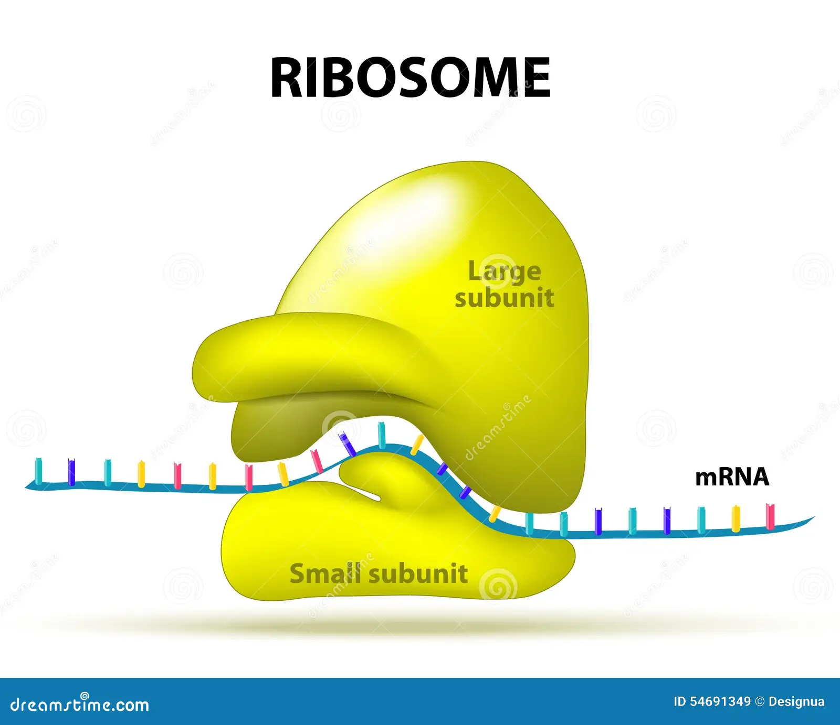
Ribosomes:
Ribosomes are the granular structures first observed under the electron microscope as dense particles by George Palade (1953). They are composed of ribonucleic acid (RNA) and proteins and are not surrounded by any membrane.
The eukaryotic ribosomes are 80S while the prokaryotic ribosomes are 70S.
Each ribosome has two subunits, larger and smaller subunits. The two subunits of 80S ribosomes are 60S and 40S while that of 70S ribosomes are 50S and 30S. Here ‘S’ (Svedberg’s Unit) stands for the sedimentation coefficient; it is indirectly a measure of density and size. Both 70S and 80S ribosomes are composed of two subunits.

Slide 15
Cytoskeleton
An elaborate network of filamentous proteinaceous structures consisting of microtubules, microfilaments and intermediate filaments present in the cytoplasm is collectively referred to as the cytoskeleton. The cytoskeleton in a cell are involved in many functions such as mechanical support, motility, maintenance of the shape of the cell
Cilia and Flagella
Cilia (sing.: cilium) and flagella (sing.: flagellum) are hair-like outgrowths of the cell membrane. Cilia are small structures which work like oars, causing the movement of either the cell or the surrounding fluid.
Flagella are comparatively longer and responsible for cell movement. The prokaryotic bacteria also possess flagella but these are structurally different from that of the eukaryotic flagella. The electron microscopic study of a cilium or the flagellum show that
they are covered with plasma membrane. Their core called the axoneme, possesses a number of microtubules running parallel to the long axis.The axoneme usually has nine doublets of radially arranged peripheral microtubules, and a pair of centrally located microtubules. Such an
arrangement of axonemal microtubules is referred to as the 9+2 array. The central tubules are connected by bridges and is also enclosed by a central sheath, which is connected to one of the tubules of each peripheral doublets by a radial spoke. Thus, there are nine radial spokes. The peripheral doublets are also interconnected by linkers. Both the cilium and flagellum emerge from centriole-like structure called the basal bodies.

Slide 16
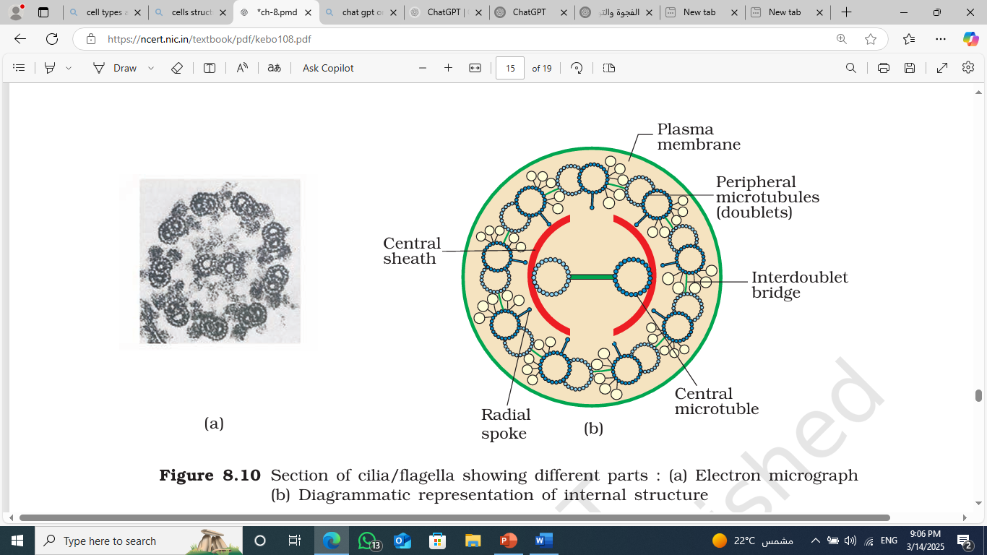

Slide 17
Centrosome and Centrioles :Centrosome is an organelle usually containing two cylindrical structures called centrioles. They are surrounded by amorphous pericentriolar materials. Both the centrioles in a centrosome lie perpendicular to each other in which each has an organization like the cartwheel. The centrioles form the basal body of cilia or flagella, and spindle fibers that give rise to spindle apparatus during cell division in animal cells.
Nucleus: Nucleus as a cell organelle was first described by Robert Brown as early as 1831. Later the material of the nucleus stained by the basic dyes was given the name chromatin by Flemming.
- The interphase nucleus (nucleus of a cell when it is not dividing) has highly extended and elaborate nucleoprotein fibers called chromatin, nuclear matrix and one or more spherical bodies called nucleoli (sing.: nucleolus). Electron microscopy has revealed that the nuclear envelope, which consists of two parallel membranes with a space between (10 to 50 nm) called the perinuclear space, forms a barrier between the materials present inside the nucleus and that of the cytoplasm. The outer membrane usually remains continuous with the endoplasmic reticulum and also bears ribosomes on it. At a number of places the nuclear envelope is interrupted by minute pores, which are formed by the fusion of its two membranes. These nuclear pores are the passages through which movement of RNA and protein molecules takes place in both directions between the nucleus and the cytoplasm. Normally, there is only one nucleus per cell, variations in the number of nuclei are also frequently observed. Can you recollect names of organisms that have more than one nucleus per cell? Some mature cells even lack nucleus, e.g., erythrocytes of many mammals and sieve tube cells of vascular plants. Would you consider these cells as ‘living’?

Slide 18
The nuclear matrix or the nucleoplasm contains nucleolus and chromatin. The nucleoli are spherical structures present in the nucleoplasm. The content of nucleolus is continuous with the rest of the nucleoplasm as it is not a membrane bound structure. It is a site for active ribosomal RNA synthesis. Larger and more numerous nucleoli are present in cells actively carrying out protein synthesis.
You may recall that the interphase nucleus has a loose and indistinct network of nucleoprotein fibers called chromatin. But during different stages of cell division, cells show structured chromosomes in place of the nucleus.
Chromatin contains DNA and some basic proteins called histones, some non-histone proteins and also RNA. A single human cell has approximately two meter long thread of DNA distributed among its forty six (twenty three pairs) chromosomes. You will study the details of DNA packaging in the form of a chromosome in class XII.
Every chromosome (visible only in dividing cells) essentially has a primary constriction or the centromere on the sides of which disc shaped structures called kinetochores are present. Centromere holds two chromatids of a chromosome.
Based on the position of the centromere, the chromosomes can be classified into four types The metacentric chromosome has middle centromere forming two equal arms of the chromosome. The sub-metacentric chromosome has centromere slightly away from the middle of the chromosome resulting into one shorter arm and one longer arm. In case of acrocentric chromosome the centromere is situated close to its end forming one extremely short and one very long arm, whereas the telocentric chromosome has a terminal centromere.

Slide 19
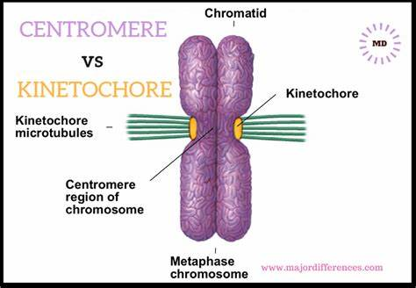
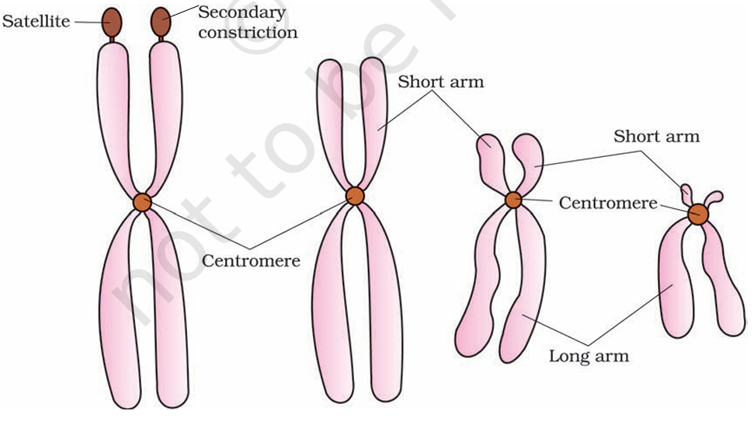

Slide 20
