Slide 1
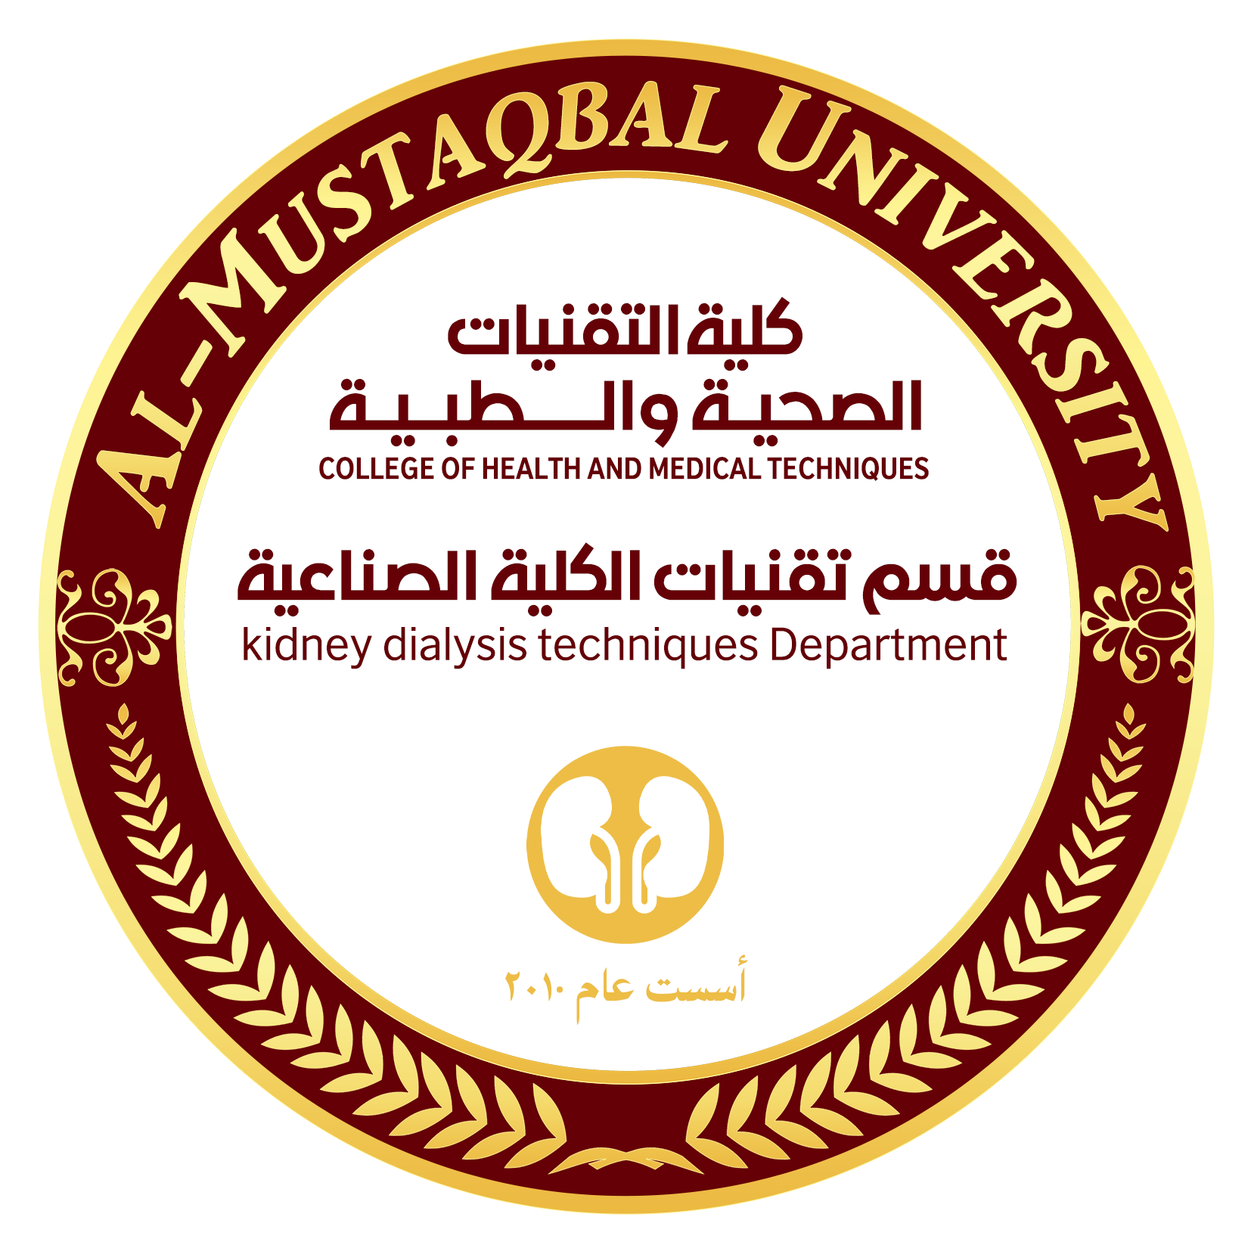

Kidney Dialysis Techniques Department
Prof. Dr. Younis A. Alkhafaji
Biology Lecture 4
Cell cycle
Cell division in prokaryotes
A- typically, a prokaryotic cell divides by binary fission, splitting into two nearly equal
halves
B- the main circular DNA molecule of the cell is replicated
C- new plasma membrane and cell wall materials are laid down between the two DNA
circles, eventually separating the daughter cells.
D- prokaryotic cells can have a generation time (general term for the period from the start
of one cell division to the start of the next cell division) as short as 20 minutes.

Slide 2
Cell division in eukaryotic cell :
Cell division is a very important process in all living organisms. The division cycle of most cells consists of four coordinated processes: cell growth, DNA replication, distribution of the duplicated chromosomes to daughter cells, and cell division.
Eukaryotic DNA molecules are organized in chromosomes.
*each chromosome is made of chromatin, a long DNA molecule with associated proteins.
*each chromosome contains hundreds to thousands of genes.
*each species has a characteristic number of chromosomes, In human23pairs where as in corn 20
chromosomes
*chromosomes carry the genetic information of a cell from one cell generation to the next.
*Chromosome consists of two chromatids or sister chromatids join together by centromere which
responsible for the movement of chromosomes at cell division.

Slide 3
Types of Cell Division
There are two distinct types of cell division out of which the first one is vegetative division, wherein each daughter cell duplicates the parent cell called mitosis. The second one is meiosis, which divides into four haploid daughter cells.
Mitosis: is a type of cell division in eukaryotic organisms during which a single parent cell divides to produce two genetically identical daughter cells. This process involves the precise duplication and segregation of the cellﹸs chromosomes to ensure that each daughter cell receives an identical set of genetic material. Mitosis is a key part of the cell cycle and occur in distinct phases: Prophase, metaphase, Anaphase and Telophase, followed by cytokinesis which separates the cytoplasm and cellular organellesالتمهيدي – الاستوائي –الانفصالي- والنهائي
Meiosis: In this type of cell division, sperm or egg cells are produced instead of identical daughter cells as in mitosis.
There are two primary phases in the cell cycle:
Interphase: This phase was thought to represent the resting stage set between subsequent cell divisions, but new research has shown that it is a very active phase.
M Phase (Mitosis phase): This is where the actual cell division occurs. There are two key steps in this phase, namely cytokinesis and karyokinesis. انقسام السايتوبلازم وانقسام النواة

Slide 4
The interphase further comprises three phases:
G0 Phase (Resting Phase): The cell neither divides nor prepares itself for the division.
G1 Phase (Gap 1): The cell is metabolically active and grows continuously during this phase.
S phase (Synthesis): The DNA replication or synthesis occurs during this stage.
G2 phase (Gap 2): Protein synthesis happens in this phase.
Quiescent Stage (G0): مرحلة الهدوء The cells that do not undergo further division exits the G1 phase and enters an inactive stage. This stage is known as the quiescent stage (G0) of the cell cycle.
Mitosis is nuclear division that produces two daughter nuclei, each with the same number and kinds of chromosomes as the parental nucleus.
There are four stages in the M Phase, namely:
Prophase :During prophase, the chromosomes supercoil and the fibers of the mitotic spindle begin to form between centrosomes located at the pole of the cells. The nuclear membrane also disintegrates at this time, freeing the chromosomes into the surrounding cytoplasm. During prometaphase, some of the fibers attach to the centromere of each pair of sister chromatids and they begin to move toward the center of the cell.
Metaphase: At metaphase the chromosomes align along the center plane of the cell.
Anaphase: During anaphase, the centromeres split and the sister chromatids begin to migrate toward the opposite poles of the cell
Telophase : During telophase, the chromosomes at either end of the cell begin to cluster together, which facilitates the formation of a new nuclear membrane. This also is when cytokinesis occurs, leading to two separate cells. One way to identify that telophase has begun is by looking for the formation of the cell plate, the new cell wall forming between the two cells.

Slide 5
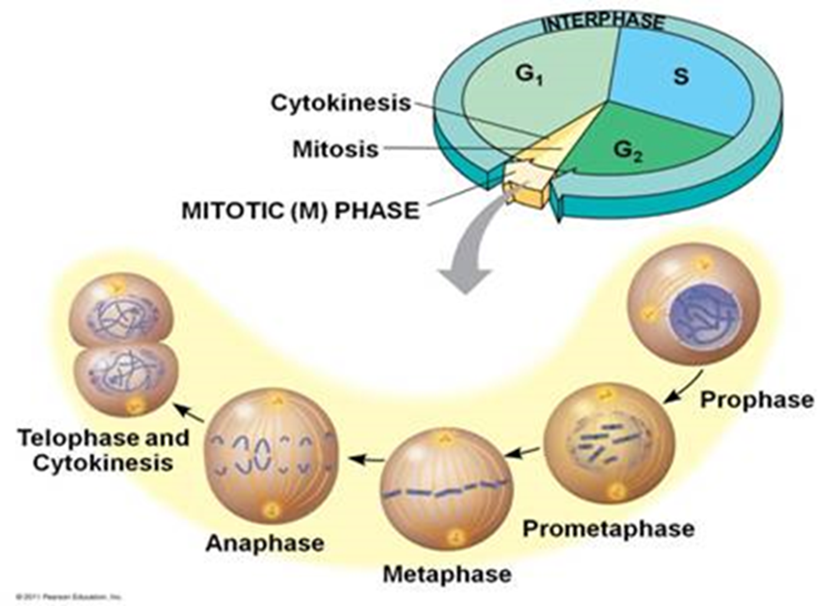

Slide 6
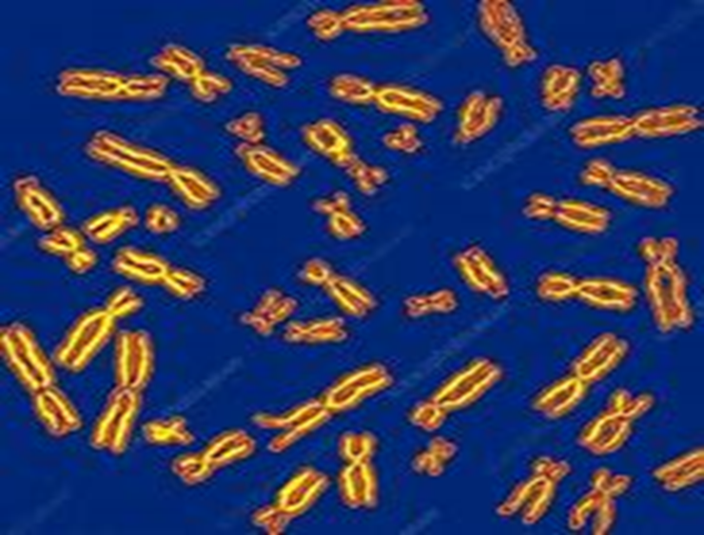
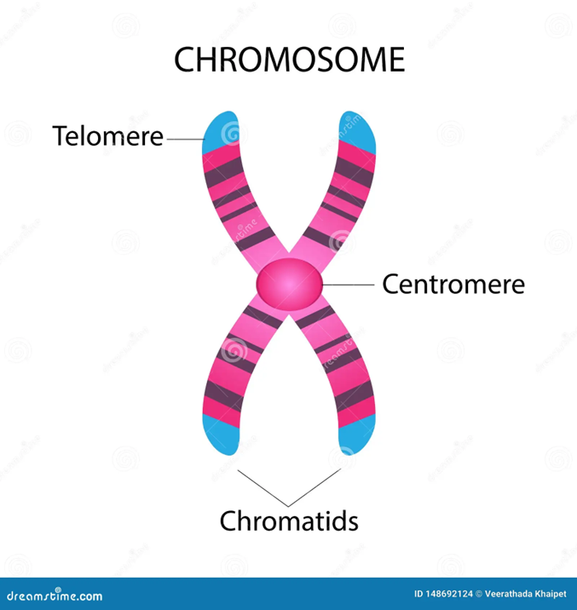

Slide 7
What is Meiosis?
Meiosis is the process in eukaryotic, sexually-reproducing animals that reduces the number of chromosomes in a cell before reproduction. Many organisms package these cells into gametes, such as egg and sperm. The gametes can then meet, during reproduction, and fuse to create a new zygote. Because the number of alleles was reduced during meiosis, the combination of two gametes will yield a zygote with the same number of alleles as the parents. In diploid organisms, this is two copies of each gene.
Function of Meiosis
Meiosis is necessary for many sexually-reproducing animals to ensure the same number of chromosomes in the offspring as in the parents. The act of fertilization includes two cells fusing together to become a new zygote. If the number of alleles of each gene is not reduced to 1 in the gametes that produce the zygote, there will be 4 copies of each gene in the offspring. In many animals, this would lead to many developmental defects.
meiosis must occur before reproduction. Meiosis occurs in two distinct divisions, with different phases in each.
Phases of Meiosis: Before meiosis, the DNA is replicated, as in mitosis. Meiosis then consists of two cell divisions, known as meiosis I and meiosis II. In the first division, which consists of different phases, the duplicated DNA is separated into daughter cells. In the next division, which immediately follows the first, the two alleles of each gene are separated into individual cells.

Slide 8
The following are descriptions of the two divisions, and the various phases, or stages of each meiosis. Remember, before meiosis starts the normally diploid DNA has been duplicated. This means there are 4 copies of each gene, present in 2 full sets of DNA, each set having 2 alleles. Interphase:
There are two stages or phases of meiosis: meiosis I and meiosis II. Before a dividing cell enters meiosis, it undergoes a period of growth called interphase. At the end of the meiotic process, four daughter cells are produced.
G1 phase: The period prior to the synthesis of DNA. In this phase, the cell increases in mass in preparation for cell division. Note that the G in G1 represents gap and the 1 represents first, so the G1 phase is the first gap phase.
S phase: The period during which DNA is synthesized. In most cells, there is a narrow window of time during which DNA is synthesized. Note that the S represents synthesis.
G2 phase: The period after DNA synthesis has occurred but prior to the start of prophase. The cell synthesizes proteins and continues to increase in size. Note that the G in G2 represents gap and the 2 represents second, so the G2 phase is the second gap phase. In the latter part of interphase, the cell still has nucleoli present.
The nucleus is bounded by a nuclear envelope and the cell's chromosomes have duplicated but are in the form of chromatin. In animal cells, two pairs of centrioles formed from the replication of one pair are located outside of the nucleus.

Slide 9
At the end of interphase, the cell enters the next phase of meiosis: Prophase I.
Prophase I :
In prophase I of meiosis, the following events occur:
Chromosomes condense and attach to the nuclear envelope.​
Synapsis occurs (a pair of homologous chromosomes lines up closely together) and a tetrad is formed. Each tetrad is composed of four chromatids.​
Genetic recombination via crossing over may occur
Chromosomes thicken and detach from the nuclear envelope.​
Similar to mitosis, the centrioles migrate away from one another and both the nuclear envelope and nucleoli break down.​
Likewise, the chromosomes begin their migration to the metaphase plate.
At the end of prophase I of meiosis, the cell enters into metaphase I.
Metaphase I:
In metaphase I of meiosis, the following events occur:
Tetrads align at the metaphase plate.​
Note that the centromeres of homologous chromosomes are oriented toward the opposite cell poles. At the end of metaphase I of meiosis, the cell enters into anaphase I.

Slide 10
Anaphase I:
In anaphase I of meiosis, the following events occur:
Chromosomes move to the opposite cell poles. Similar to mitosis, microtubules such as the kinetochore fibers interact to pull the chromosomes to the cell poles.
Unlike in mitosis, sister chromatids remain together after the homologous chromosomes move to opposite poles. At the end of anaphase I of meiosis, the cell enters into telophase I.
Telophase I
In telophase I of meiosis, the following events occur:
The spindle fibers continue to move the homologous chromosomes to the poles. Once movement is complete, each pole has a haploid number of chromosomes.
In most cases, cytokinesis(the division of the cytoplasm) occurs at the same time as telophase I.
At the end of telophase I and cytokinesis, two daughter cells are produced, each with one-half the number of chromosomes of the original parent cell.
Depending on the kind of cell, various processes occur in preparation for meiosis II. There is, however, a constant: The genetic material does not replicate again.
At the end of telophase I of meiosis, the cell enters into prophase II.

Slide 11
Prophase II:
In prophase II of meiosis, the following events occur:
The nuclear membrane and nuclei break up while the spindle network appears.​
Chromosomes do not replicate any further in this phase of meiosis.​
The chromosomes begin migrating to the metaphase II plate (at the cell's equator).
At the end of prophase II of meiosis, the cell enters into metaphase II.
Metaphase II: In metaphase II of meiosis, the following events occur:
The chromosomes line up at the metaphase II plate at the cell's center.​
The kinetochore fibers of the sister chromatids point toward opposite poles.
At the end of metaphase II of meiosis, the cell enters into anaphase II.
Anaphase II:
In anaphase II of meiosis, the following events occur:
Sister chromatids separate and begin moving to opposite ends (poles) of the cell. Spindle fibers not connected to chromatids lengthen and elongate the cell.​
Once the paired sister chromatids separate from one another, each is considered a full chromosome. They are referred to as daughter chromosomes.​

Slide 12
In preparation for the next stage of meiosis, the two cell poles also move further apart during the course of anaphase II. At the end of anaphase II, each pole contains a complete compilation of chromosomes.
Following anaphase II of meiosis, the cell enters into telophase II.
Telophase II:
In telophase II of meiosis, the following events occur:
Distinct nuclei form at the opposite poles.
Cytokinesis (division of the cytoplasm and the formation of two distinct cells) occurs.
At the end of meiosis II, four daughter cells are produced. Each cell has one-half the number of chromosomes as the original parent cell.
The final result of meiosis is the production of four daughter cells. These cells have one half the number of chromosomes as the original cell. Only sex cells are produced by meiosis. Other cell types are produced by mitosis. When sex cells unite during fertilization, these haploid cells become a diploid cell. Diploid cells have the full complement of homologous chromosomes.

Slide 13
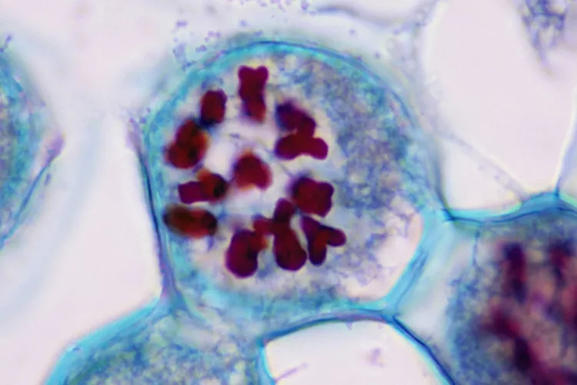
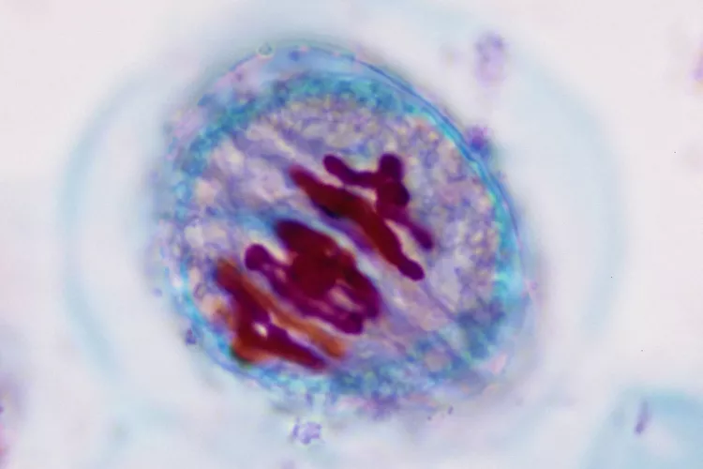
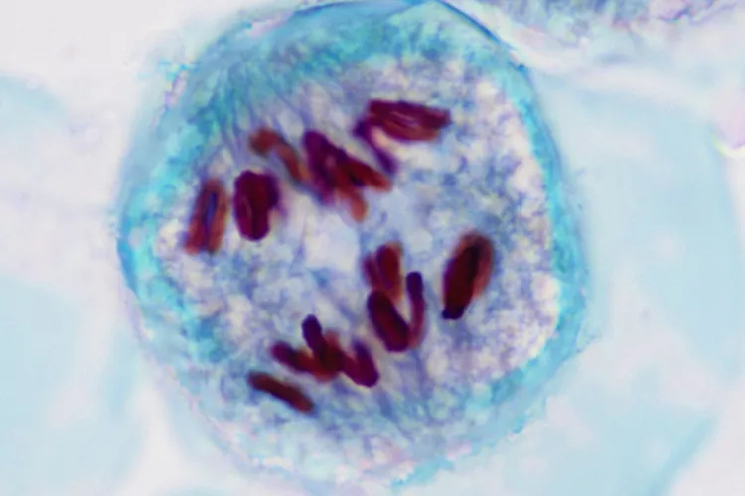
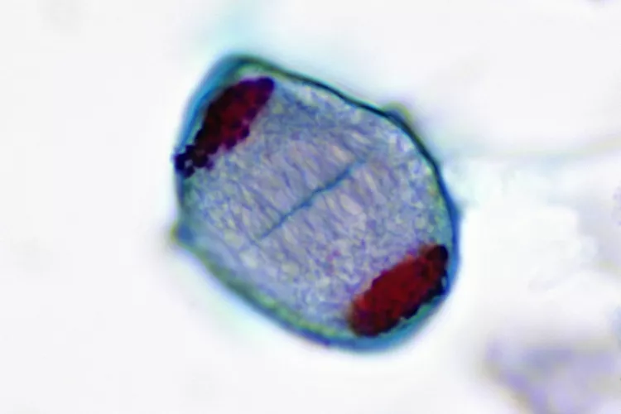
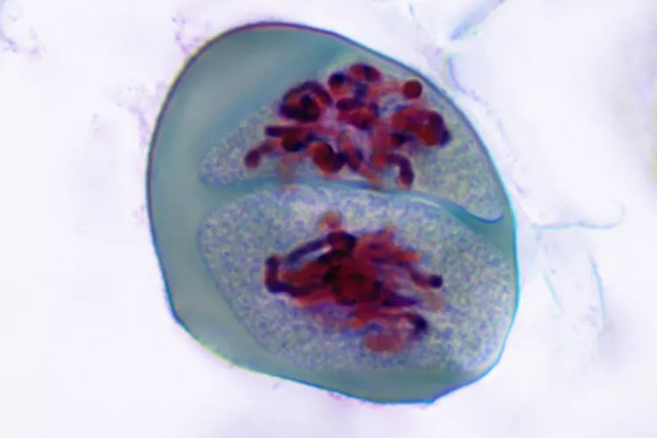
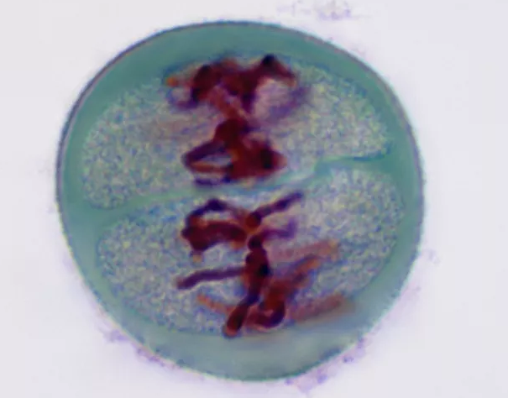
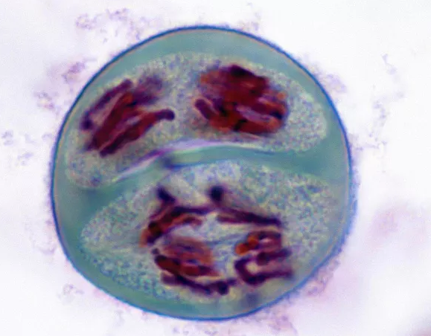
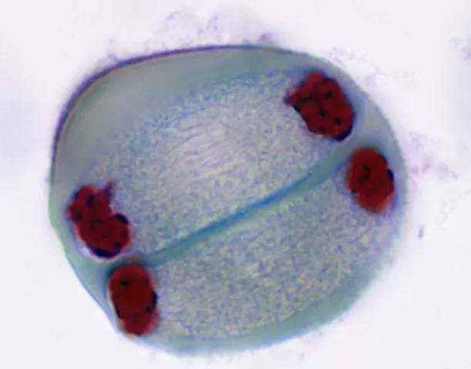
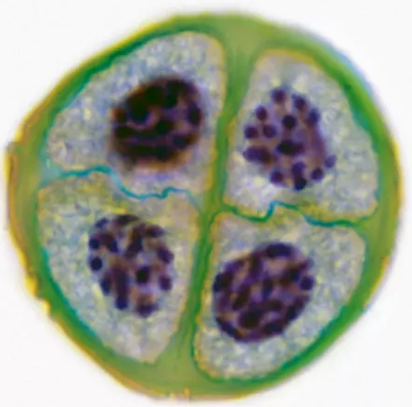
Prophase I
Metaphase I
Anaphase I
Telophase I
Prophase II
Metaphase II
Anaphase II
Telophase II
Stages of Meiosis: Daughter Cells

Slide 14
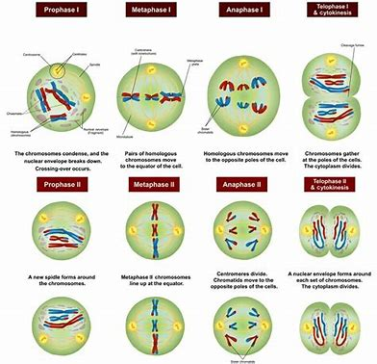

Slide 15
F L
T O I
A R S
N T
K E
S N

