Slide 1
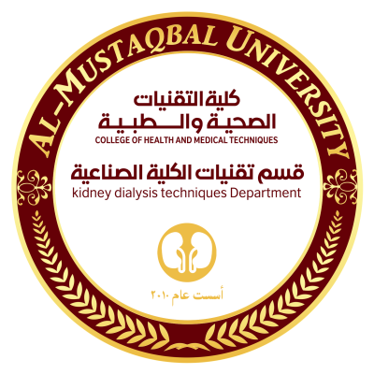

Kidney Dialysis Techniqu Department
Prof. Dr. Younis A. Alkhafaji
Introduction to Biological Classification ?
Do you understand the meaning of classification?
Classification basically is the arrangement of things in taxonomic groups in accordance with the observed similarities. It helps in understanding the group as a whole with simple ease. Now, here we’ll discuss with you the biological classification and how it has simplified things for us.
֍Biological classification is the scientific procedure that involves the arrangement of the organisms in a hierarchical series of groups and sub-groups on the basis of their similarities and dissimilarities.

Slide 2
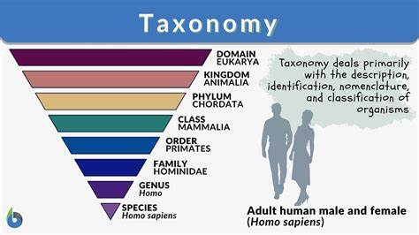
Lecture 2
Taxonomy of Living Organismes
The classification of living things includes 7 levels: kingdom, phylum, classes, order, families, genus, and species . The most basic classification of living things is kingdoms.
The correct order of the biological hierarchy from Kingdom to Species is
Five Kingdom Classification: Types, Features and Examples
The process of grouping organisms into different sets based on
similarities and differences is called classification. It makes studying
a wide range of organisms much easier and more systematic. The
five-kingdom classification was given by Robert. H. Whittaker in 1969.
֍ The five kingdoms in such a type of classification include Monera,
Protista, Fungi, Plantae, and Animalia.
in 2015 researchers suggested splitting Protista into
two new kingdoms, Protozoa and Chromista.
֍ Organisms are classified on the basis of their cell structure, body
Organization, nucleus, mode of nourishment, thallus organization,
evolutionary relationships, and reproduction.

Slide 3
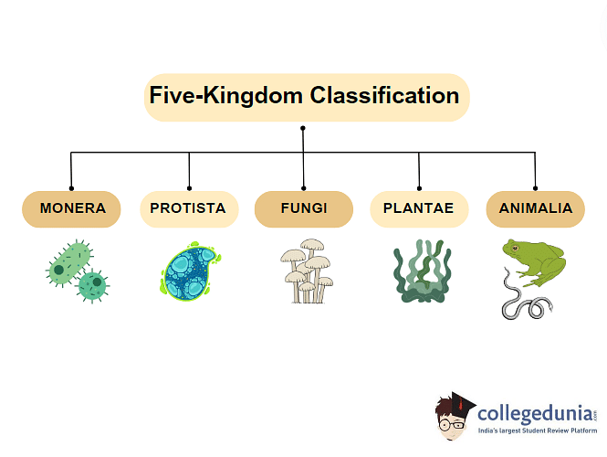

Slide 4
Classification | Human | Ostrich
Domain | Eukarya | Eukarya
Kingdom | Animalia | Animalia
Phylum | Chordata | Chordata
Class | Mammalia | Aves
Order | Primate | Struthioniform
Family | Hominidae | Struthionidae
Genus | Homo | Struthio
Species | Sapien | Camelus

Slide 5
The two-kingdom system of classification is the earliest classification and hence it takes into account only two kingdoms. However later, many new kingdoms have been added. The limitations of Linnaeus’ two-kingdom system of classification are as follows:
Certain species have both plants as well as animal-like characteristics. For example, some species of Euglena are autotrophic while others are heterotrophic. The positioning of such an organism is not specified in the two kingdoms system of classification.
Fungi lack chlorophyll and perform heterotrophic mode of nutrition. Yet, they are placed in the plant kingdom.
This system of classification did not distinguish between eukaryotic cells (organisms with a true nucleus) and prokaryotic cells (organisms that do not have true nuclei)
Lichens that show both plant-like and animal-like characteristics are placed in the plant kingdom.
In this system, unicellular organisms are put together with multicellular organisms.
The two-kingdom system does not acknowledge diversified life forms. Many organisms have not found space in any of the categories.

Slide 6
֍Kingdom-A taxonomic rank that is composed of smaller groups called phyla (or divisions).
֍ Phylum- The primary subdivision of a taxonomic kingdom, grouping together all classes of organisms that have the same body plan.
֍ Class -A group of entities with common characteristics, attributes and qualities.
֍ Order - A taxonomic rank used in classifying organisms, generally below the class, and comprised of families sharing a set of similar nature.
֍ Family - A taxonomic group of one or more genera, specially sharing a common attribute.
֍ A genus is a taxonomic category ranking used in biological classification that is below family and above species. Species exhibiting similar characteristics comprise a genus.
֍ A species is a group of organisms that share a genetic heritage, are able to interbreed, and to create offspring that are also fertile. Different species are separated from each other by reproductive barriers.

Slide 7
Advantages and Disadvantages of 5 Kingdom Classification
مزايا و سلبيات تصنيف الممالك الخمسه /يبسط دراسة الكائنات الحية / لا يأخذ في الاعتبار الاختلافات على المستوى الجزيئي / يجعل تحديد الهوية أسهل / يتجاهل العلاقات التطورية يساعد في الحفاظ على التنوع البيولوجي يتجاهل اختلافات طفيفة ولكنها مهمة يتيح السيطرة على الأمراض بشكل أفضل غير كاف لتصنيف الميكروبات يسهل التواصل العلمي يفشل في استيعاب الفيروسات
Advantages | Disadvantages
Simplifies study of organisms | Doesn’t consider molecular level differences
Makes identification easier | Ignores evolutionary relationships
Helps in biodiversity conservation | Overlooks minor yet significant differences
Enables better disease control | Inadequate for classifying
Facilitates scientific communication | Fails to accommodate viruses

Slide 8
The difference between Animal and Plant Kingdom are as follows:
Animal Kingdom | Plant Kingdom
Absence of cell wall | Presence of cell wall
Presence of locomotion | Absence of locomotion
Cannot photosynthesize | Can photosynthesize
Heterotrophic mode of nutrition | Mostly autotrophic mode of nutrition
Presence of well-defined nervous and excretory system | Absence of well-defined nervous and excretory system
Food is stored in form of glycogen | Stored food is starch
Lives for a certain number of years | Can live for years
Sexual reproduction is found | Asexual reproduction is found
Gives carbon dioxide, takes in oxygen | Releases oxygen, takes in carbon dioxide

Slide 9
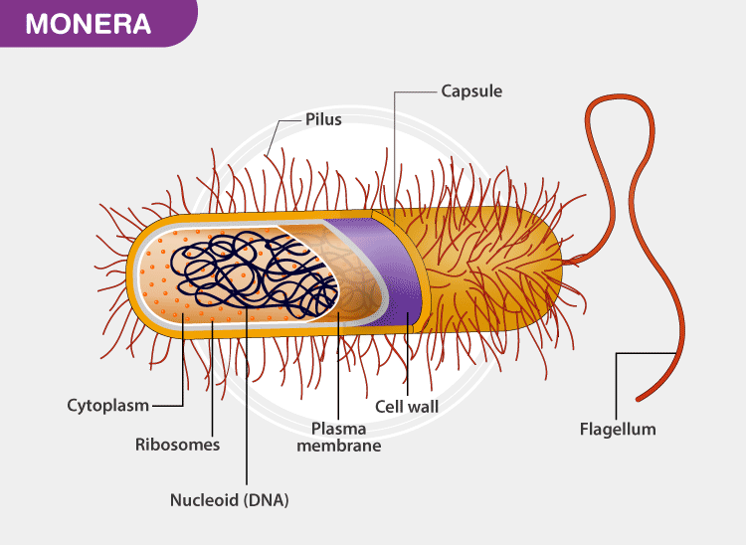
Kingdom Monera belongs to the prokaryote family. The organisms belonging to this kingdom do not contain a true nucleus. These are the oldest known microorganisms on earth. Their DNA is not enclosed within the nucleus.
►They are unicellular organisms found mostly in a moist environment. They are found in hot springs, snow, deep oceans, or as parasites in other organisms.
► The monerans do not possess any membrane-bound organelles.
Let us go through the kingdom monera notes to explore the characteristics and classification of monera.
Characteristics of Monera

Slide 10
The Monerans are unicellular organisms.
They contain 70S ribosomes.
The DNA is naked and is not bound by a nuclear membrane.
It lacks organelles like mitochondria, lysosomes, plastids, Golgi bodies, endoplasmic reticulum, centrosome, etc.
They reproduce asexually by binary fission or budding.
The cell wall is rigid and made up of peptidoglycan.
Flagellum serves as the locomotory organ.
These are environmental decomposers
They show different modes of nutrition such as autotrophic, parasitic, heterotrophic, or saprophytic.
Bacteria: Bacteria are microscopic organisms that can survive in diverse environments. They can be beneficial as well as harmful. They possess a simple structure without a nucleus and a few cell organelles. The bacteria are surrounded by two protective coverings- the outer cell wall and the inner cell membrane. Some bacteria are also covered by a capsule. Few bacteria like Mycoplasma do not have a cell wall. Short whip-like extensions known as pili surround the surface of the bacteria. The long whip-like structures are known as flagella. They exhibit autotrophic and heterotrophic modes of nutrition. Autotrophic bacteria derive nutrition from inorganic substances. They derive carbon and hydrogen from atmospheric carbon dioxide, H2, H2S, and NH3. The heterotrophic bacteria depend upon external organic materials for their food. These can be saprotrophs, parasites and symbionts.

Slide 11
Classification of Monera
Kingdom Monera is classified into three sub-kingdoms- Archaebacteria, Eubacteria, and Cyanobacteria.
Archaebacteria:
These are the most ancient bacteria found in the most extreme habitats such as salty area (halophiles), hot springs (thermoacidophiles) and marshy areas (methanogens).
The structure of the cell wall is different from that of the other bacteria which helps them survive in extreme conditions.
The mode of nutrition is autotrophic. The nucleotide sequences of its t-RNA and r-RNA is unique.
Eubacteria:
Eubacteria are also known as “true bacteria”.
The cell wall is rigid and made up of peptidoglycans.
It moves with the help of flagella.
A few bacteria contain short appendages on the cell surface, known as pili which help the bacteria during sexual reproduction. Pili also helps a pathogen to attach to the host.
They are divided into two categories; gram-positive and gram-negative, depending upon the nature of the cell wall and the stain they take.
Rhizobium and Clostridium are two eubacteria.

Slide 12
Cyanobacteria:
►These are also known as blue-green algae.
► These bacteria are photosynthetic in nature.
► They contain chlorophyll, carotenoids and phycobilins.
► They are found in the aquatic region.
► Some of these even fix atmospheric nitrogen. Nostoc, Anabaena, Spirulina are some cyanobacteria.
Monerans are very useful organisms.
▲They enrich the soil and serve as an important part of the nitrogen cycle.
▲ They are also helpful in the production of some food items and antibiotics. ▲ ▲ ▲ ▲ Methanogens play an important role in the treatment of sewage. Many organisms rely on archaebacteria as the source of food.

Slide 13
Practical Biology

Slide 14
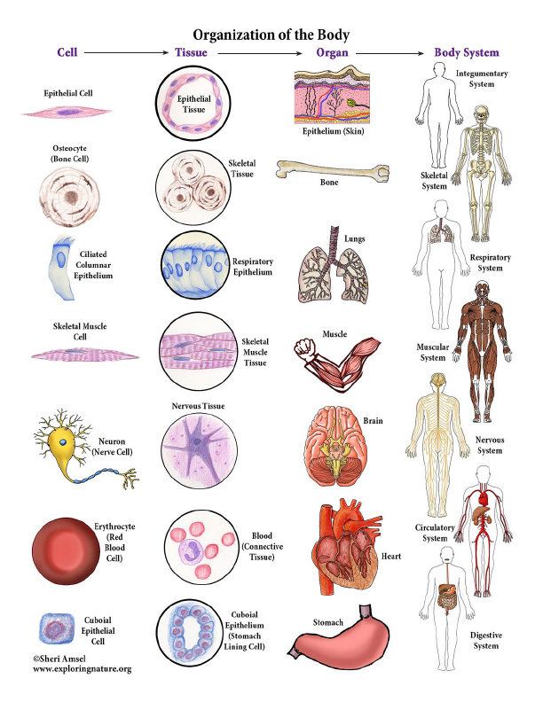

Slide 15
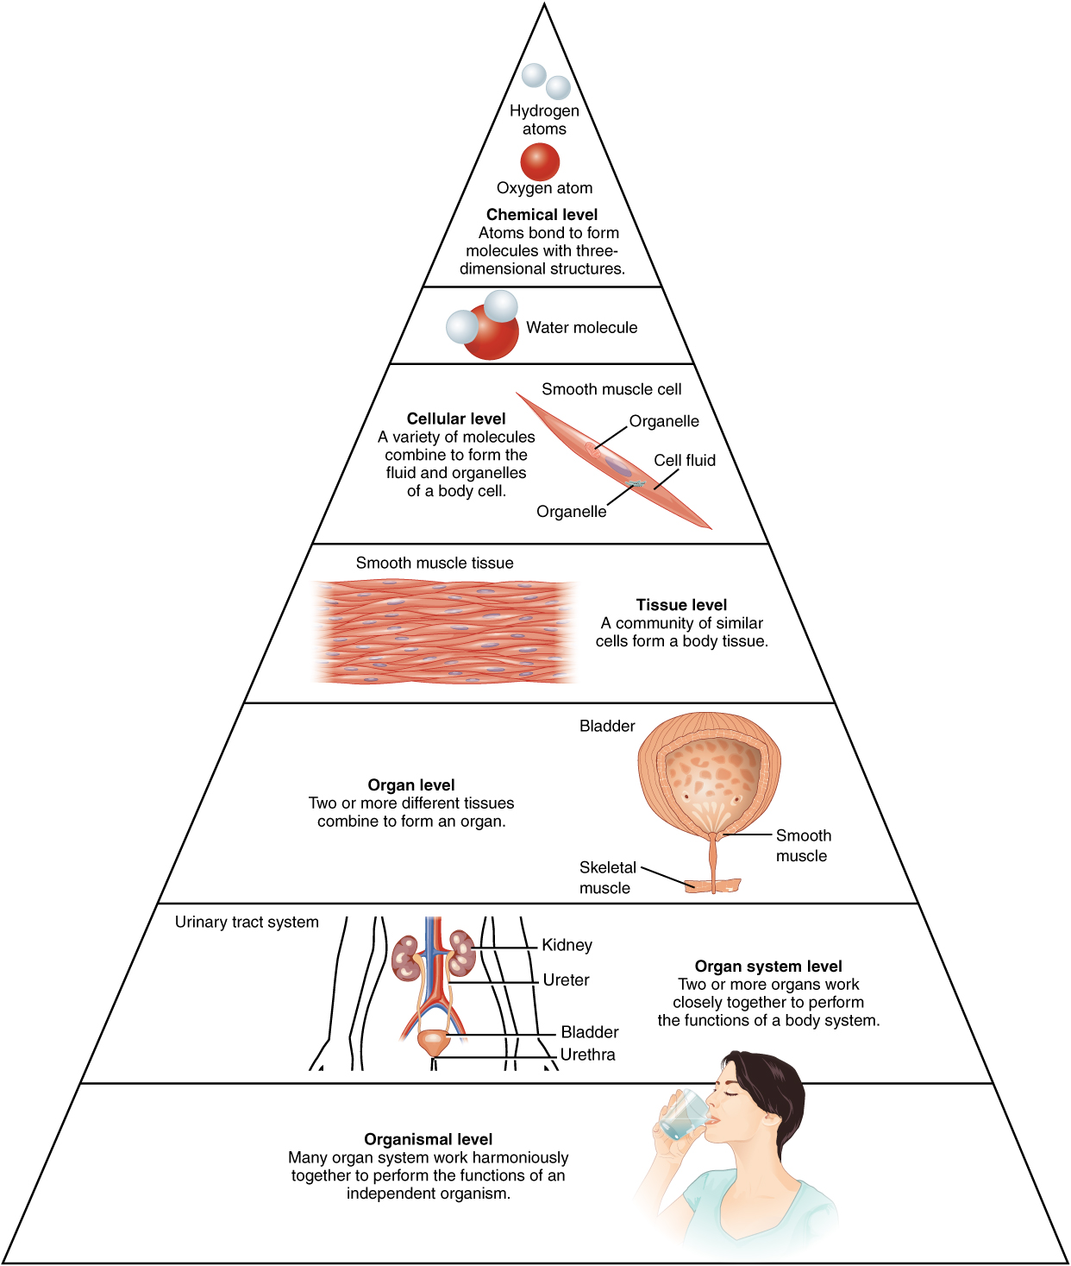

Slide 16
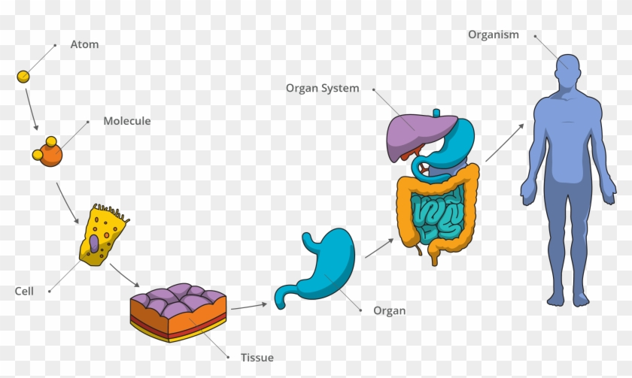

Slide 17
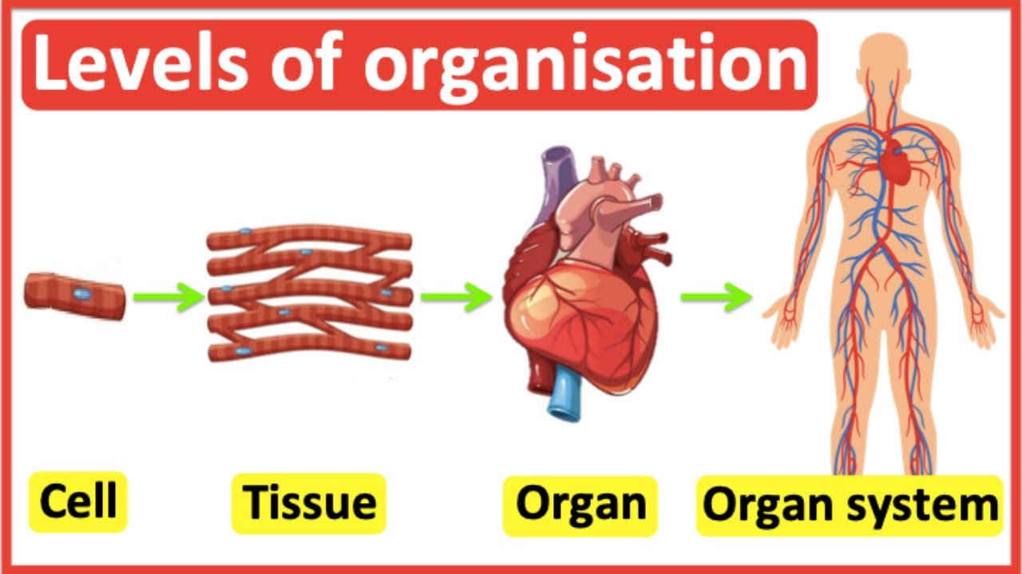

Slide 18
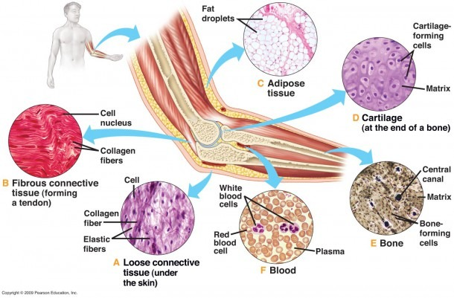

Slide 19
Life processes of the human body are maintained at several levels of structural organization. These include the chemical, cellular, tissue, organ, organ system, and the organism level. Higher levels of organization are built from lower levels.
All living and non-living things are made of one or more unique substances called elements, the smallest unit of which is the atom, (for example, the element oxygen (O) is made of O atoms, carbon (C) is made of C atoms and hydrogen (H) is made of H atoms.
Atoms combine to form molecules. Molecules can be small (for example, O₂, oxygen gas, which has 2 atoms of the element O; CO₂, carbon dioxide, which has 1 atom of C and 2 of O), medium (for example, C₆H₁₂O₆, glucose, which has 6 atoms of C, 12 of H, and 6 of O); or large (for example molecules called proteins are made of hundreds of atoms of C, H, and O with other elements such as nitrogen (N). Molecules are the building blocks to all structures in the human body.
All living structures are made of cells, which are made of many different molecules. Cells are the smallest independent living thing in the human body. The body is made of many different cell types, each with a particular function, (for example muscle cells contract to move something, and red blood cells carry oxygen). All human cells are made of a cell membrane (thin outer layer) that encloses a jelly-like cellular fluid containing tiny orga-like

Slide 20
As in other multicellular organisms, cells in the human body are organized into tissues. A tissue is a group of similar cells that work together to perform a specific function. There are four main tissue types in humans (muscular, epithelial, nervous and connective). An organ is an identifiable structure of the body composed of two or more tissues types (for example, the stomach contains muscular tissue made of muscle cells, which allows it to change its shape, epithelial tissue which lines both the inner and outer surface of the

Slide 21
As in other multicellular organisms, cells in the human body are organized into tissues. A tissue is a group of similar cells that work together to perform a specific function.
There are four main tissue types in humans (muscular, epithelial, nervous and connective).
An organ is an identifiable structure of the body composed of two or more tissues types (for example, the stomach contains muscular tissue made of muscle cells, which allows it to change its shape, epithelial tissue which lines both the inner and outer surface of the stomach, nervous tissue which sends and receives signals to and from the stomach and the central nervous system, and connective tissue which binds everything together).
Organs often perform a specific physiological function (for example, the stomach helps digest food).
An organ system is a group of organs that work together to perform a specific function (for example, the stomach, small and large intestines are all organs of the digestive system, that work together to digest foodstuff, move nutrients into the blood and get rid of waste).
The most complex level of organization, the human organism is composed of many organ systems that work together to perform the functions of an independent individual.

