Slide 1
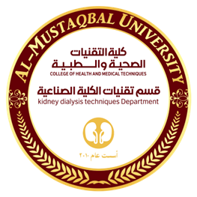

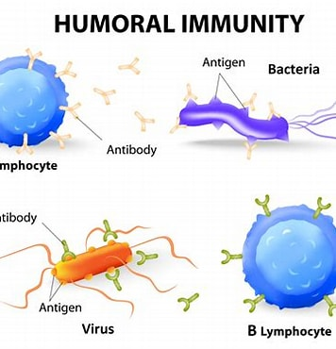
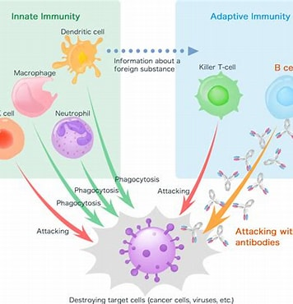
Kidney Dialysis Techniques Department
Prof. Dr. Younis A. Alkhafaji
Lecture: Humane Body Defense

Slide 2
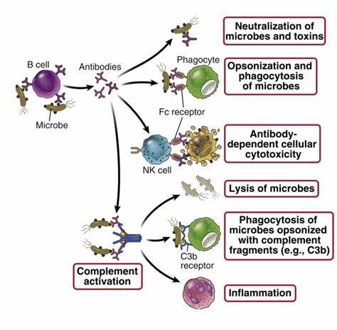
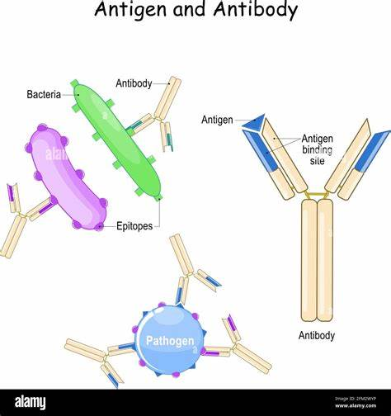

Slide 3
Lines of Defense
1st line
Physical, biochemical, & microbiome
Microbiome functions:
Produce enzymes for digestion
Synthesizes metabolites
Releases antibacterial substances
Competes w/pathogens for nutrients
Fosters adaptive immunity
Aids in communication between brain and GI tract
2nd line
Inflammation
Localized response & cleans up injury
Characteristics: Occurs in vascular tissues
Hemostasis
Vasodilation Increased vascular permeability and leakage
WBC adherence and migration
Activation is rapid
Response includes cellular and chemical components
Nonspecific- response is always the same

Slide 4
3rd line
Adaptive immunity
Functions of Antibodies: Protect against infection
Direct activation of the antibody alone
Affect infectious agents or toxins through: Neutralization-inactivate or blocking the binding to cells
Agglutination-clumping insoluble particles that are in suspension
Precipitation-making a soluble antigen into an insoluble precipitate
Indirect-requires activation of other components of the innate immune response
Inflammation
Phagocytosis
Complement

Slide 5
Physical Barriers
Skin
GI/GU linings
Respiratory tract
Body Secretions
Cell-derived chemical barriers
Lysosomes attack bacteria
Fatty acids and lactic acids create acidic environments
Antimicrobial peptides kill bacteria, fungi & viruses Examples Tears, saliva, earwax, sweat
Cardinal Signs of Infection
Rubor (redness, erythema)
Calor (heat)
Tumor (swelling)
Dolor (pain)
Functio laesa (loss of function)
**Initiation of Inflammatory Response
Cellular or tissue damage
Inflammatory mediators released which work together to destroy invaders, limit tissue injury and promote healing

Slide 6
Role of Complement System
Intensifies or complements the capacity of antibodies and phagocytes to clear pathogens and damaged cells
Activates inflammation
Composed of many proteins
Most potent defense to bacterial infection
Three major path ways:
Classic: activated by antibodies
Alternative: activated directly by substances found on the surface of microorganism
Lectin: activated by plasma proteins
Role of Clotting System Forms a fibrinous meshwork of fibrin strands and platelets at an injured or inflamed site
Prevents the spread of infection
Localizes microorganisms and foreign bodies
Forms a clot that stops bleeding
Provides a framework for repair and healing
Pathways
Tissue factor (extrinsic)-activated by tissue factor which is released by damaged endothelial cells- outside
Contact activation (intrinsic)-activated by damage to the vessel wall- inside

Slide 7
Role of Kinin System
Interacts with clotting system
Primary kinin is bradykinin- activates pain receptors Causes: dilation of blood vessels, pain, and smooth muscle contraction; increases vascular permeability
Role of Opsonins, Chemotactic Factor, Histamine, Membrane Attack Complex, Leukotrienes, Prostaglandins, Platelet Activating Factor.
Opsonins - C3b
Coat the surface of bacteria increasing their susceptibility to phagocytosis by inflammatory cells
Chemotactic factor- C5a
Diffuse from a site of inflammation and attract leukocytes to that site
Histamine- C3a + C5a = anaphylatoxins
Substance which induces vasodilation and increased capillary permeability
Membrane Attack complex- C6-C9
Leads to bacterial destruction and tissue injury by creating pores in the outer membranes of cells or bacteria. These pores facilitate the infusion of water into the cells culminating in cellular death.

Slide 8
Leukotrienes- slow reacting substances of anaphylaxis
Lipids that induce smooth muscle contraction (especially bronchoconstriction) and increased vascular permeability.
Prostaglandins
Cause increased vascular permeability, neutrophil chemotaxis, and pain. Pain results from direct effects on nerves.
Platelet activating factor
Causes endothelial cell retraction, which results in increased vascular permeability, leukocyte adhesion to endothelial cells, and platelet activation and can activate mast cells.
Acute and Chronic Inflammation
Acute
Self-limiting
Lasts 8-10 days
Local manifestations -Heat, swelling, redness, pain, loss of function
Systemic manifestations –Fever, Leukocytosis, Increased plasma protein synthesis
What can we do to treat inflammation?
Meds, ice, heat, rest, compression, elevation, NO opioids!!!

Slide 9
Chronic
**Unsuccessful acute inflammatory response - Characterized by pus formation and incomplete wound healing
**Microorganisms resistant to acute inflammation
**Toxins causing tissue damage
**Lasts weeks to months
**Clinical manifestations
**Dense infiltration of lymphocytes and macrophages
**Granuloma formation
**Epithelioid cell formation
**Giant cell formation

Slide 10
Stages of Wound Healing
Phase 1: Hemostasis (Coagulation)
Tissue damage causes bleeding into wound
Clot formation
Platelet degranulation
Increase capillary permeability
Promote growth factors
Phase 2: Inflammation
Begins within minutes of injury
Macrophages and mast cells release vasoactive cytokines
Neutrophils infiltrate
Lymphocytes initiate immune response

Slide 11
Phase 3: Proliferation and New Tissue Formation
Begins 3-4 days after injury and continues for about 2 weeks
Wound sealed and clot replaced with normal or scar tissue
Macrophages invade to clear debris, release growth factors, recruit fibroblasts
Angiogenesis—formation of new blood vessels
Lesion prepared for either regeneration or repair
Granulation-tissue grows into the wound from surrounding healthy connective tissue Epithelialization-epithelial cells grow into the wound from surrounding health tissue
Phase 4: Remodeling and Maturation
Begins several weeks after injury and can up to 2 years
Continuation of cellular differentiation
Scar tissue formation
Scar remodeling

Slide 12
Wounds Healing by Primary and Secondary Intention
Primary (surgery- closed wounds)
Secondary (wide open wounds)
Necessary for Proper Wound Healing
Granulation tissues (pink/red)
Nutrition
Oxygen
Adaptive Immunity
Develops slowly & the initial defenses against infection and promotes process against re-infection
Lymphocytes and antibodies develop in response to infection
Specific to infecting organism
Mediators are long-lived and systemic proving long-term protection
Has memory-provides long-term protection

Slide 13
Humoral Immunity
When a B cell responds to an antigen it becomes a plasma cell capable of producing antibodies.
3 phases:
B cell activation & differentiation
Antibodies (IgG) production
Primary and secondary immune responses
Role of Antigens and Lymphocytes in Immune Response
Antigens
Molecules on surface of microbes, infected cells, or abnormal tissues
Molecular targets of antibodies
Common antigens:
Infectious agents
Allergens
Chemical agents (including medications)
Abnormal molecules on the surface of cells (cancers and infected cells)

Slide 14
Lymphocytes
The body's immune response known as a white blood cell and the third line of defense in the body's immune system.
They are divided into two categories, T lymphocytes and B lymphocytes.
The T lymphocytes are more involved with the immune system and the B lymphocytes are responsible for making antibodies.
Role of Major Histocompatibility Complex (MHC), Mast Cells, Macrophages, Erythrocytes, Neutrophils, Eosinophils, Basophils, Natural Killer Cells, T-helper Cells, T-cytotoxic Cells, T-regulatory Lymphocytes, Memory Cells, Plasma Cells
Major Histocompatibility Complex (MHC)
Necessary for cell mediated immunity
Also referred to as human leukocyte antigens (HLA’s)
Glycoproteins on the surface of all human cells except RBCs.
Divided into two classes based on structure
MHC class I
Present endogenous (intracellular) antigens Any change in a cell that causes abnormality may result in a foreign antigen being presented by MHC cells
MHC class II
Present exogenous antigens
Only found on macrophages, dendritic cells and B lymphocytes

Slide 15
Mast Cells
Scattered throughout the body in connective tissues
Highly concentrated in the lungs, skin and GI/GU tract
Responsible for secreting histamine when the inflammatory response is activated when the body needs to rid itself of allergens
Macrophages
Type of phagocyte responsible for eating pathogens and cancer cells by breaking down foreign materials
Macrophages live in the blood vessels and will migrate over to the tissue once an injury has occurred
Erythrocytes
Red blood cells
Responsible for the transport of oxygen throughout the body
Neutrophils
Type of phagocyte that respond early on in the inflammatory response
Particularly attracted to bacteria and damaged tissue where they consume foreign materials
Main ingredient in pus when an infection is present in the body
Eosinophils
Type of phagocyte that are attracted to parasites by helping the patient fight the infection and eliciting the inflammation response

Slide 16
Basophils
Located in the blood waiting to be released into the tissues once the inflammation response has been activated
Causes a release of histamine from its granules in the presence of allergens.
Natural Killer Cells
Type of lymphocyte that are activated by T cells lacking particular antigens
Main responsibilities are to destroy cancer and viruses
T-helper Cells
Release cytokines which help B cells distinguish themselves from plasma cells and activate cytotoxic T cells along with macrophages
T-cytotoxic Cell
Main player in the body's adaptive immune system
Known as world travelers through the body because they can cross the blood brain barrier, blood vessel walls and non-lymphatic tissues
Activated by cytokines and attach themselves to cancer cells for destruction

Slide 17
T-regulatory Lymphocytes
Suppress the immune system
Memory Cells
Divided into T and B memory cells
B memory cells help the body to remember antigens and have a long life
T memory cells are also long living but tend to stick around in case there are any additional pathogens T cells also produce cytotoxic T cells
Plasma Cells
Type of B cell responsible for producing antibodies
Their life span is relatively short
T Cells and B Cells
T Cells Produced in the thymus
T cell receptors (TCRs) recognize antigen
Leave thymus, travel to and reside in secondary lymphoid tissue as mature immunocompetent cells
B Cells Produced in bone marrow
Each cell responds to only one specific antigen
B-cell receptors (BCRs) recognize antigen
Autoreactive B cells eliminated in bone marrow (those that respond to self-antigens)-referred to as central tolerance

Slide 18
Active and Acquired Immunity
Active Induced thru a slower more specific process & targets particular invaders & diseased tissue
Also involves memory which results in a more rapid response during future exposure to the same invader
Acquired Induced thru a slower more specific process & targets particular invaders & diseased tissue
Also involves memory which results in a more rapid response during future exposure to the same invader
Functions of Antibodies (Immunoglobulins)
IgG
Most abundant (80%-85%) of the antibodies in the blood
Most protective against infections
IgM
Largest antibody
First produced during initial or primary response to antigens
IgA
Found in blood & secretions

