Slide 1


Kidney Dialysis Techniqu Department
Prof. Dr. Younis A. Alkhafaji biology Lecture 2
Kingdom Protista:
Kingdom Protista is one of the five kingdoms that classify various living organisms. Kingdom Protista includes single-celled and multicellular eukaryotes like protozoans, algae, and various other microorganisms which are neither plants nor animals or fungi. Kingdom Protista possesses cells with a defined nucleus and membrane-bound organelles. Protists can be found in various habitats like aquatic, moist terrestrial, and even as symbionts or parasites within other organisms.
Ernst Haeckel, a naturalist of German descent, was the one who first introduced the idea of the kingdom Protista in the year 1866. Protista are primitive eukaryotic organisms and exhibit a wide range of diversity in size, shape, and life forms. They can be unicellular, multicellular, or colonial. Protista contains a defined nucleus and membrane-bound organelles, such as mitochondria, endoplasmic reticulum, Golgi apparatus, and sometimes chloroplasts in autotrophs.

Slide 2
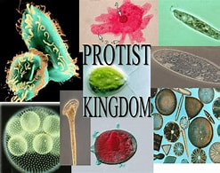
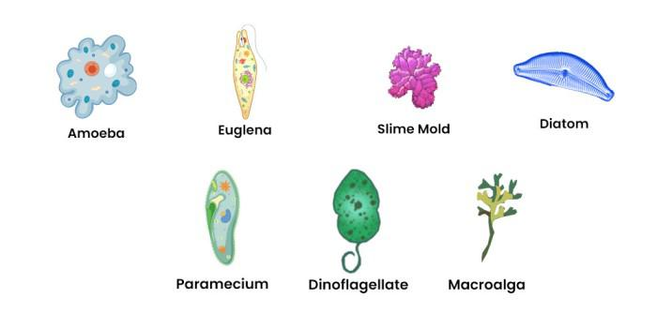
Some Kingdom Protista examples are:
Amoeba: Unicellular, motile protozoans that move by extending pseudopods and feed on microorganisms.
Paramecium: Ciliated, unicellular protozoans with a characteristic slipper-like shape.
Euglena: Unicellular organisms that can be both autotrophic (photosynthetic) and heterotrophic (predatory مفترسه) depending on environmental conditions.
Plasmodium: A protozoan parasite responsible for causing malaria in humans.

Slide 3
Characteristics of Kingdom Protista
Some Protista maybe unicellular, while others may include colonial or multicellular structures. The characteristics of Kingdom Protista is as follows:
►All protists are eukaryotic cells, with a well -defined nucleus and membrane-bound organelles.
► Protists varies in terms of size, shape, and life forms and can be found in various habitats, including aquatic environments (freshwater and marine), moist terrestrial environments, and within the bodies of other organisms as symbionts or parasites.
► Kingdom Protista mode of nutrition may be autotrophic, capable of photosynthesis to produce their own food (algae) or can be heterotrophic, obtaining nutrients by consuming other organisms or organic matter (protozoans).
► They can reproduce both sexually and asexually.
► Many protists are capable of movement, using structures like flagella, cilia, or pseudopods.
► Some protists, especially algae, have cell walls made of materials like cellulose, silica, or calcium carbonate.
► Protists can form symbiotic relationships with other organisms, including mutualistic and parasitic interactions and can play important ecological roles, serving as primary producers (autotrophic protists) and consumers/decomposers (heterotrophic protists) indifferent ecosystems.

Slide 4
Classification of Protista
The Kingdom Protista is composed of three different kinds of organisms: those that resemble plants, those that resemble fungi, and those that resemble animals. The classification of Protista is as follows:
Plant-like Protists
These plant-like protists that perform photosynthesis exhibit traits similar to those of plants. Dinoflagellates, chrysophytes, and euglenoids fall under this category.
֍ Dinoflagellates
The class Dinophyceae is comprised of around one thousand different species of photosynthetic protists and is classified under the division Pyrrophyta.
Dinoflagellates are single-celled, eukaryotic microorganisms characterized by two whip-like flagella used for movement.
Many dinoflagellates are autotrophic, containing chloroplasts and contributing to marine primary production.
►Some species are bioluminescent, producing light when disturbed.
They can form symbiotic relationships with corals الشعاب المرجانية, providing them with nutrients and color.
Some dinoflagellates cause harmful algal blooms تكاثر الطحالب الضارة known as “red tides,” المد الأحمر which can be toxic to marine life and even humans when consumed.

Slide 5
There is the potential for sexual as well as asexual reproduction.
Dinoflagellates Examples: Gonyaulax, Noctiluca, etc.
֍ Chrysophytes are sometimes referred to as the gems of the plant kingdom جواهر المملكة النباتية
▲These are free-floating, unicellular forms of fresh or salt water that may be found wherever.
▲ The majority of them are photosynthetic, and the silica and pectin that make up their cell walls are what give their cells their structure.
▲ Reproduction may occur either sexually or asexually, depending on the circumstances.
▲ The term “diatomaceous earth” التراب الدياتومي refers to the material that results from the aggregation of a significant number of diatoms’ cell wall deposits (which can be used as fuel after mining).
▲ The cell walls of diatoms are formed by two thin shells that cover one another and fit together like the lid and base of a soapbox.
▲ Example: Diatoms, Desmids, golden algae, الطحالب الذهبية etc

Slide 6
Euglenoids:
These are unicellular and have features with both plants and animals, although they behave more like animals.
It represent the transitional link between plants and animals.
They are green and get their sustenance from autotrophic sources (plant character).
These are unicellular flagellates (animal characters) that are similar to Euglena and are most often seen in still freshwater.
They have two different forms of flagella, one called Long Whiplash and the other called Short Tinsel.
Instead of having a cell wall, they have a pellicle, which is a protein-rich layer that allows their body to be flexible.
The meal is kept in granules that are made of protein and are known as pyrenoids.
They reproduce through asexual means.
In the dark, photosynthetic euglenoids change their feeding behaviour to that of heterotrophs; this kind of diet is referred to as mixotrophic.

Slide 7
Fungi-Like Protists (Slime Moulds) They have features of both animal and fungi, we collectively refer to them as fungus-animals. ⁕⁕⁕They exhibit amoeboid movement and can have multiple nuclei within a single cell.
Slime molds have a complex life cycle that includes both amoeboid and multicellular stages.
They are capable of reproduction via both sexual and asexual means.
They play a vital ecological role as decomposers, breaking down organic matter in forest floors and other habitats.
Slime molds are classified into two main groups: plasmodial slime molds (single, multinucleate mass of cytoplasm) and cellular slime molds (aggregations of individual cells).
Slime molds are distinct from true fungi due to their cellular structure and life cycle, despite their superficial resemblance.

Slide 8
Animal-Like Protists (Protozoans)
These protists, also known as protozoans, are organisms that engage in heterotrophic metabolism. They are divided into four categories, which are as follows:
Amoeboid Protozoans
They may be found in saltwater, as well as freshwater, and wet soil.
Similar to amoebas, they move with the assistance of a set of pseudopodia.
Other members of this group include Entamoeba histolytica and E. gingivalis, both of which, when swallowed after being exposed to polluted water, may result in a variety of digestive and mouth disorders or infections.
Flagellated Protozoans
They either live independently or are parasites.
They exhibit nuclear dimorphism, having both macro and micronuclei, as in the case of Paramecium and other similar organisms.

Slide 9
The vegetative nucleus, also known as the macronucleus, plays a role in the regulation of metabolic processes and growth.
Micronucleus, also known as the reproductive nucleus, is an important component for reproduction.
Sporozoans
They are obligate intracellular parasites, often causing diseases in their hosts, including humans.
They possess a unique organelle called the apical complex, which helps them penetrate host cells.
They live inside host cells, where they reproduce and cause damage, often leading to disease symptoms.
Sporozoans have complex life cycles involving both sexual and asexual stages. These cycles often require multiple hosts to complete.
Examples: Plasmodium, Monocystis, etc.

