Slide 1
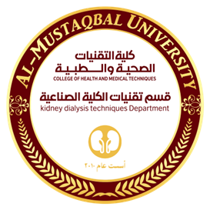

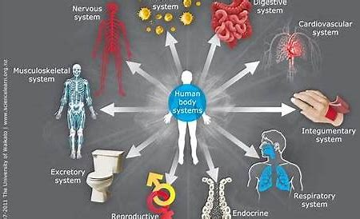
Kidney Dialysis Techniqu Department
Prof. Dr. Younis A. Alkhafaji
Practical biology 6 organ definition ,types and Function

Slide 2
Example: Human | Organism | A bunch of Organ Systems Working Together
Example: Nervous System | Organ System | A bunch of Organ Working Together
Example: Brain | Organ | A bunch of Tissues Working Together
Example: Nervous Tissue | Tissue | A bunch of Cell Working Together
Example: Nerve cell also called neuron | Cell | The smallest unit of Life

Slide 3
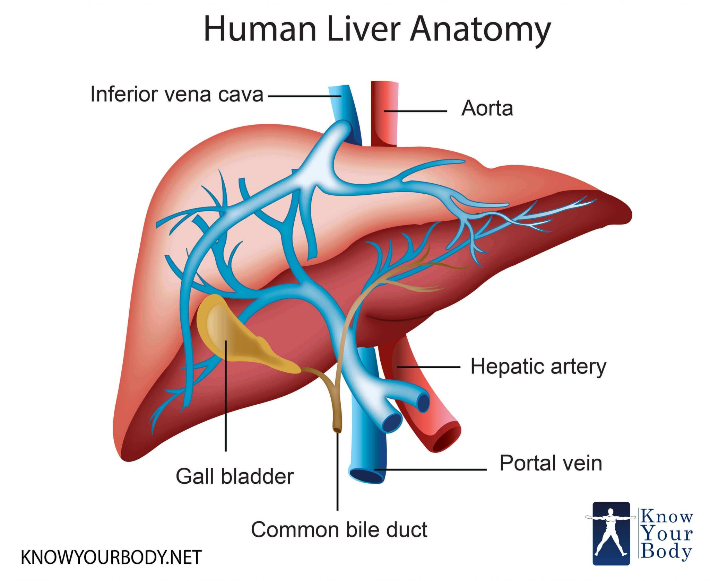
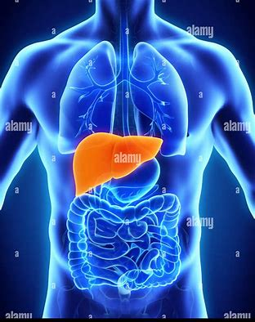
What is Liver: Liver is a Large Organ Located in the upper wright hand portion of the abdominal cavity beneath the diaphragm and on the tope of stomach, right Kidney and intestines.
The Liver main functions are removing waste products and foreign substances from blood- stream, regulating blood sugars level and creating essential nutrients.
The Liver average size is 7cm. for women and 10.5 cm. for men.
It is shaped- like a cone or wedge. على شكل مخروط أو إسفين

Slide 4
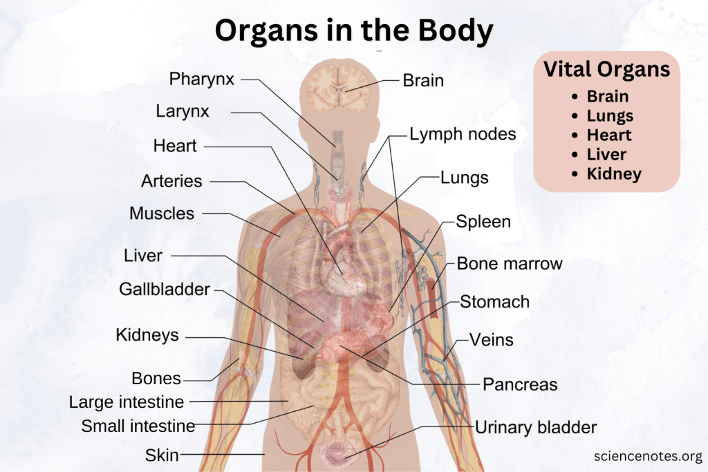
There are other Body Organs including for examples :-
Brain: Controls body functions and cognitive processes.
Heart: Pumps blood to deliver oxygen and nutrients.
Lungs: Facilitate breathing and oxygen exchange.
Liver: Detoxifies the body and produces bile.
Kidneys: Filter blood and produce urine.
An organ is a structure made of different tissues and has a
Specific shape and function in the body. The human body
has approximately 74 significant organs, either big or small,
that form organ systems together.
Organs in the body each perform specific functions vital for life
and overall well-being. They work in harmony within organ
systems to maintain the body’s homeostasis and facilitate
growth, reproduction, and survival.

Slide 5
The human body has 11 major organ systems:
Circulatory System: Includes the heart and blood vessels, transporting blood, oxygen, and nutrients.
Respiratory System: Composed of the lungs and airways, facilitating oxygen intake and carbon dioxide removal.
Digestive System: Includes the stomach, intestines, liver, and other organs that break down and absorb nutrients.
Nervous System: Composed of the brain, spinal cord, and nerves, controlling body functions and responses.
Muscular System: Encompasses all muscles, enabling movement and maintaining posture.
Skeletal System: Consists of bones and joints, providing structure and support.
Endocrine System: Includes glands that release hormones for regulation of processes like growth and metabolism.
Reproductive System: Involves organs like the ovaries and testes, facilitating reproduction.
Excretory System: Composed of the kidneys and bladder, removing waste from the body.

Slide 6
Immune System / Lymphatic System: Includes the lymph nodes and spleen, defending against pathogens.
Integumentary System: Includes the skin, hair, and nails, protecting the body and regulating temperature.
The exact number of organs in the human body varies depending on the definition of what constitutes an organ. Traditionally, there are about 78 organs, but some classifications count accessory organs and microstructures like glands, leading to numbers over 100.
تقليديا ، هناك حوالي 78 عضوا ، لكن بعض التصنيفات تحسب الأعضاء الملحقة والهياكل المجهرية مثل الغدد ، مما يؤدي إلى أعداد تزيد عن 100.
What Are the Vital Organs?
Vital organs are those necessary for survival. They include:
Brain: Controls body functions and cognitive processes.
Heart: Pumps blood to deliver oxygen and nutrients.
Lungs: Facilitate breathing and oxygen exchange.
Liver: Detoxifies the body and produces bile.
Kidneys: Filter blood and produce urine.

Slide 7
Which Organs Can a Person Survive Without?
While all organs contribute to health, some are not essential for survival:
Gallbladder: Removes bile, but its absence doesn’t prevent digestion.
Appendix: Once thought vestigial, its removal doesn’t impair health significantly.
One Kidney: A person can survive with one kidney.
One Lung: You can survive with just one.
Spleen: Its removal increases susceptibility to infections but isn’t life-threatening.
Reproductive Organs: Necessary for reproduction but not survival.
Eyes: Necessary for vision, but not essential for survival.
Paired Organs (one on each side)
  Kidneys
  Eyes
  Lungs
  Ears
  Reproductive organs (testicles, ovaries)

Slide 8
Centrally Located Organs:
Brain
Heart (slightly left)
Small intestine
Bladder
Organs on the Right Side:
Liver
Appendix
Gallbladder
Organs on the Left Side:
Spleen
Pancreas
Stomach
What Are Accessory Organs?
Accessory organs assist in bodily functions but are not part of the primary system they support. Examples include:
Gallbladder: Stores and releases bile.
Pancreas: Produces enzymes aiding digestion and hormones regulating blood sugar.
Salivary Glands: Aid in digestion by producing saliva.
Breasts: Aid the reproductive system by producing milk.

Slide 9
Largest and Smallest Organs in the Body.
Largest Organ: The skin is the largest organ, covering the entire body and serving as a protective barrier. Skin accounts for around 15% of body weight. The largest internal organ is the liver.
Smallest Organ: The pineal gland in the brain, about the size of a grain of rice, regulates sleep through melatonin production.
Here is a comprehensive list of the organs in the human body with their functions:
Central Nervous System:
Brain: Controls body functions and processes.
Spinal Cord: Transmits signals between the brain and body.
Circulatory System:
Heart: Pumps blood throughout the body.
Blood Vessels (arteries, veins, capillaries): Transport blood.
Respiratory System:
Lungs: Facilitate oxygen intake and carbon dioxide removal.

Slide 10
*Trachea: Connects the throat to the lungs.
*Bronchi: Passageways for air into the lungs.
*Digestive System:
*Stomach: Breaks down food for digestion.
*Small Intestine: Absorbs nutrients from food.
*Large Intestine: Absorbs water and forms feces.
*Liver: Detoxifies chemicals and metabolizes drugs.
*Pancreas: Produces digestive enzymes and hormones like insulin.
*Gallbladder: Stores bile for fat digestion.
*Excretory System:
*Kidneys: Filter blood to produce urine.
*Ureters: Transport urine from kidneys to bladder.
*Bladder: Stores urine.
*Urethra: Removes urine from the body.

Slide 11
Endocrine System:
Pituitary Gland: Regulates other glands and growth.
Pineal Gland: Produces melatonin for sleep regulation.
Thyroid Gland: Controls metabolism.
Parathyroid Glands: Regulate calcium levels.
Adrenal Glands: Produce hormones like adrenaline.
Pancreas (dual function): Regulates blood sugar.
Ovaries/Testes: Produce sex hormones.
Immune and Lymphatic Systems:
**Spleen: Filters blood and supports immunity.
**Lymph Nodes: Filter lymph and produce white blood cells.
**Thymus: Matures T-cells for the immune system.

Slide 12
Reproductive System:
Ovaries: Produce eggs and hormones.
Testes: Produce sperm and testosterone.
Uterus: Supports fetal development.
Prostate Gland: Produces seminal fluid.
Integumentary System:
Skin: Protects the body and regulates temperature.
Hair: Insulates and protects skin.
Nails: Protect the tips of fingers and toes.
Sensory Organs:
Eyes: Enable vision.
Ears: Facilitate hearing and balance.
Tongue: Detects taste and aids in speech.
Nose: Detects smell.

Slide 13
Skeletal System:
Bones (206 total): Provide structure and support.
Bone Marrow: Produces blood cells.
The list currently omits smaller or less prominent organs that are essential but often overlooked in traditional classifications. Here are examples of organs that could be added to reach a more comprehensive list:
Salivary Glands (Parotid, Sublingual, and Submandibular): Produce saliva for digestion and oral health.
Lymphatic Structures (such as Tonsils and Adenoids): Play roles in immunity and filtering pathogens.
Mesentery: A fold of tissue anchoring the intestines, now recognized as an organ.
Adipose Tissue: Fat stores, recently classified as an endocrine organ due to its hormonal activity.
Vas Deferens and Seminal Vesicles: Male reproductive organs aiding in sperm transport and seminal fluid production.
Bartholin’s and Skene’s Glands: Female reproductive glands involved in lubrication.
Inner Ear Structures (e.g., Cochlea and Vestibular System): Responsible for hearing and balance.

Slide 14
