Slide 1
Part 1: Protein Practical Tests
A. Qualitative Tests for Proteins
1. Biuret Test
Principle: Peptide bonds react with copper sulfate in alkaline medium to form a violet-colored complex.
Indication: Presence of proteins
Procedure: Add Biuret reagent to the sample and observe for violet color.
Clinical Use: Total protein estimation in serum

Slide 2
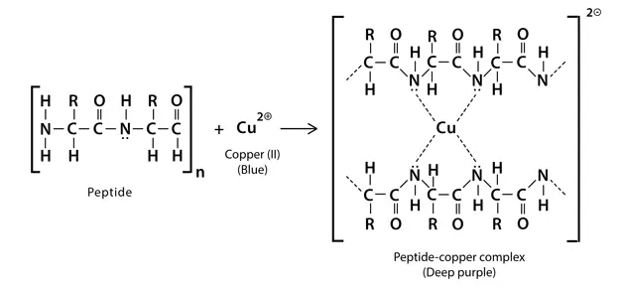

Slide 3
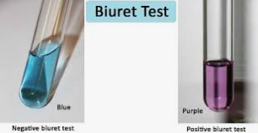

Slide 4
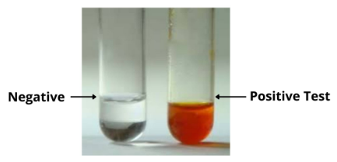
2. Xanthoproteic Test
Principle: Aromatic amino acids react with concentrated nitric acid to form yellow nitro derivatives.
Observation: Yellow color that deepens with alkali.
Use: Detection of tyrosine, tryptophan, and phenylalanine.

Slide 5
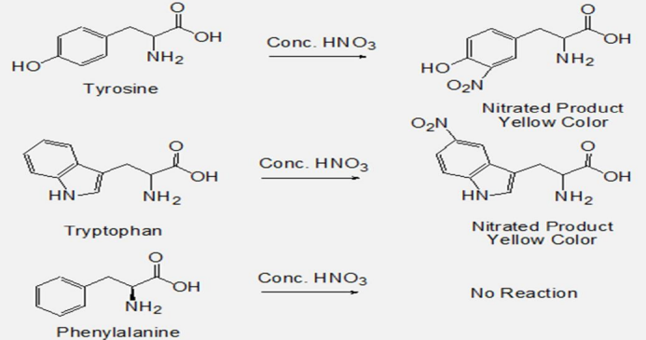

Slide 6
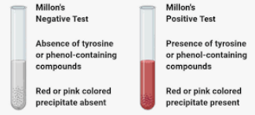
3. Millon’s Test
Principle: Tyrosine reacts with Millon’s reagent to give a red color.
Use: Specific for tyrosine-containing proteins.

Slide 7
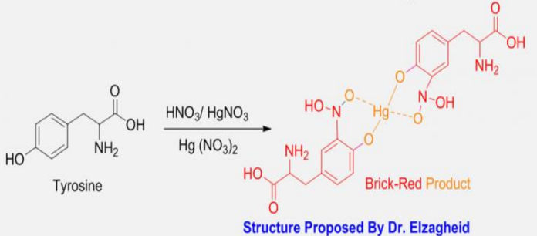

Slide 8
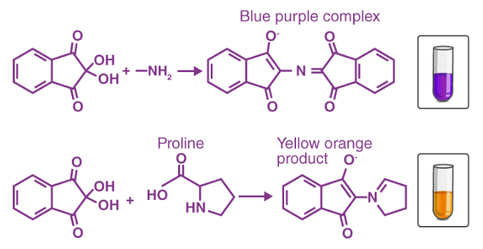
4. Ninhydrin Test
Principle: Amino acids react with ninhydrin to produce a blue or purple complex.
Use: Detection of free amino acids.

Slide 9
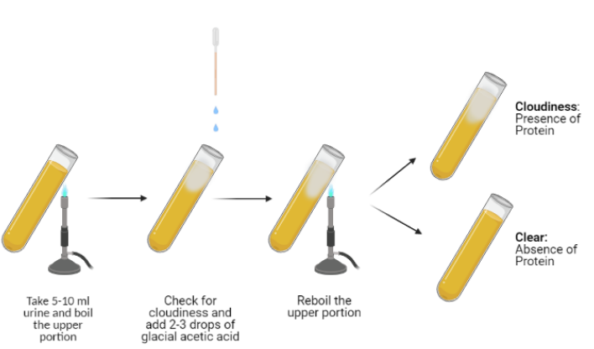
5. Heat Coagulation Test
Principle: Proteins denature and coagulate when heated.
Use: Detection of albumin in urine (proteinuria).

