Slide 1
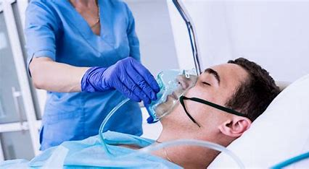
Oxygen Therapy
Prepared by:
Dr. Mahdi Hamza
Dr. Alaa Hamza
M.Sc.N: Ali Jassim

Slide 2
Oxygen Therapy
Oxygen therapy is the medical administration of supplemental oxygen to patients who have low oxygen levels in their blood (hypoxemia) or in the tissue (hypoxia).
Normal oxygen saturation (SpO2) levels typically range from 95% to 100%. This indicates the percentage of hemoglobin molecules in the blood that are carrying oxygen
Below 90% is considered low and may indicate hypoxemia, which can lead to hypoxia (insufficient oxygen supply to tissues).
Oxygen therapy can be administered through various devices, such as nasal cannulas, face masks, or mechanical ventilators, depending on the patient's condition and needs.

Slide 3
Indications of Oxygen Therapy
Hypoxemia: Low blood oxygen levels due to respiratory disorders, lung diseases (e.g., COPD, pneumonia), or heart failure.
Anemia or blood loss: Reduced red blood cells or hemoglobin affecting oxygen transport.
Post-surgical recovery: After surgeries involving the lungs or chest, to support oxygenation.
Respiratory failure: Inability to exchange gases effectively due to conditions like acute respiratory distress syndrome (ARDS)
Shock: To ensure adequate oxygenation in critical conditions.

Slide 4
Oxygen Delivery Systems
There are Two types:
Low-flow systems include nasal cannulas, face masks. These deliver varying oxygen concentrations due to the inhalation of room air.
2. High-flow systems deliver precise and consistent FiO2, regardless of the client’s breathing pattern. Example: Non-rebreather mask, Venture mask, T-piece .

Slide 5
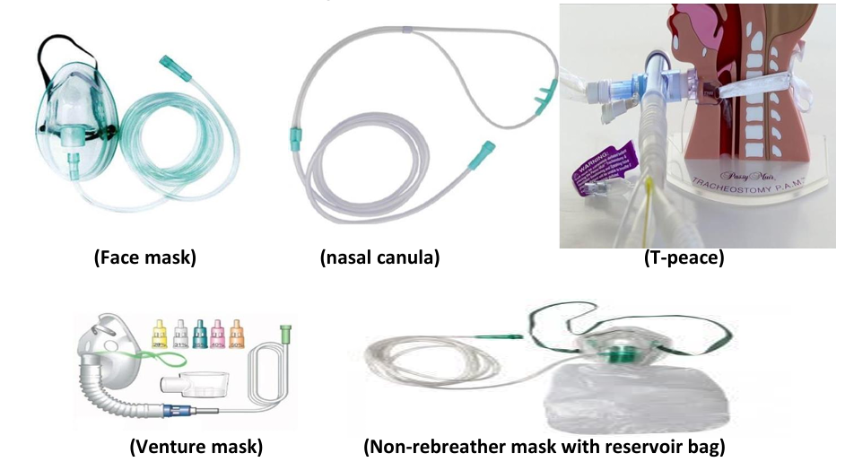
Oxygen Delivery Systems

Slide 6
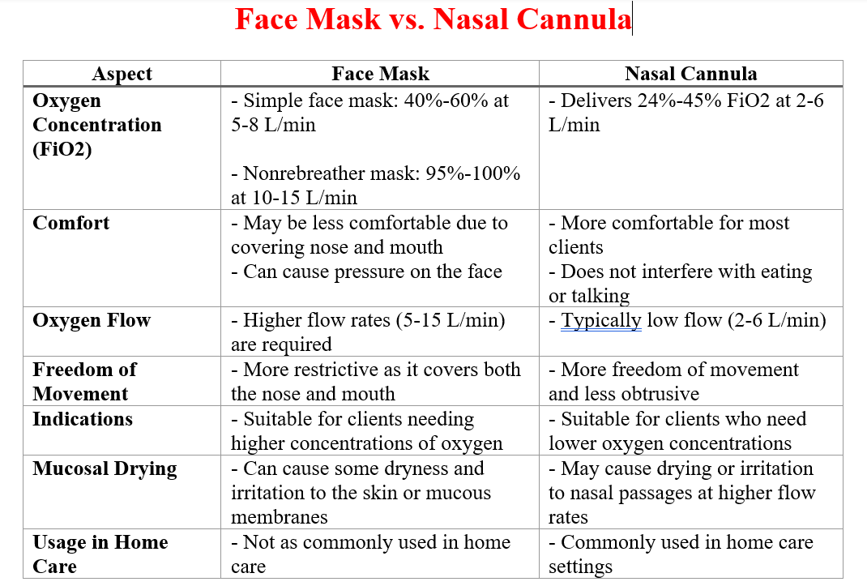

Slide 7
The most common complications of oxygen therapy
Oxygen toxicity: Prolonged exposure to high concentrations of oxygen can damage lung tissues and lead to symptoms like chest pain, coughing, and shortness of breath.
Dry or irritated mucous membranes: Dry oxygen can dehydrate the mucous membranes, causing discomfort and nasal or throat irritation.
Retinopathy

Slide 8
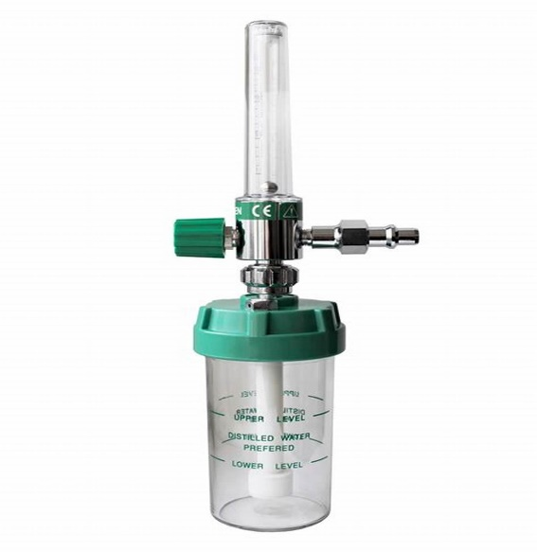
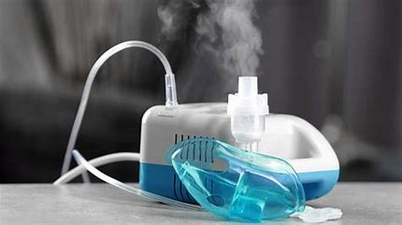
Essential Techniques for Effective Oxygen Administration
Humidification: to prevent airway dryness by using bubble humidifier
(Bubble Flowmeter with Humidifier)
Nebulization: a nebulizer is a drug delivery device
used to administer medication in the form
of a moist inhaled into the lungs.
Commonly used for the treatment of asthma, and
other respiratory diseases.
Cough & deep-breathing techniques: Preventing lung
problems after surgery

Slide 9
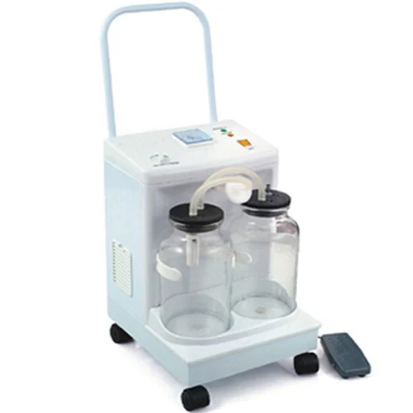
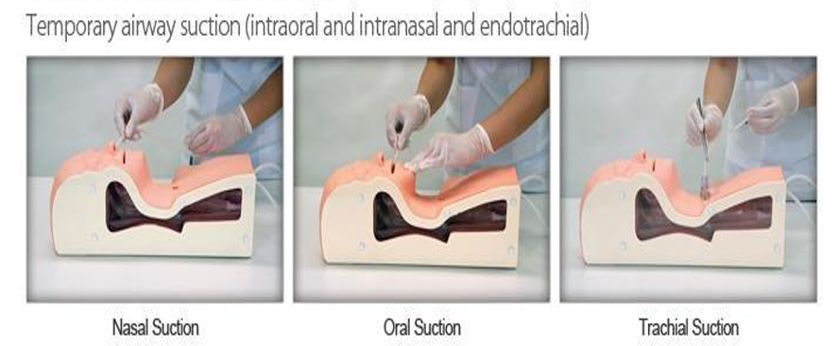
Essential Techniques for Effective Oxygen Administration
Chest physiotherapy (percussion, vibration): mobilization
and clearance of airway secretions
Suctioning techniques: procedure that removes oral
and respiratory secretions from the airway and keeps it clear.
Portable Suction machine

Slide 10


