Slide 1
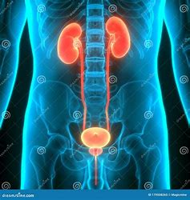
Urinary Catheterization
Prepared by:
Assist. Lecturer: Ali Jassim

Slide 2
Urinary catheterization
Urinary catheterization involves inserting a catheter into the urinary bladder and is typically performed only when absolutely necessary, due to the risk of introducing microorganisms and causing infection.
A catheter- associated urinary tract infection (CAUTI) is a “urinary tract infection that occurs while an indwelling catheter is in place or within 48 hours of its removal”
According to the Centers for Disease Control and Prevention, the risk of infection increases by 5% for each day that a catheter remains in place.
Catheters are commonly made of rubber or plastics although they may be made from latex or silicone.

Slide 3
Indications of Urinary catheterization
Urinary Retention:
Characterized by difficulty initiating urination (hesitancy), straining to void, decreased size and force of the urinary stream, interruption of flow, and the sensation of incomplete bladder emptying.
Urethral Obstruction:
Caused by anatomical conditions that impair urine flow, such as benign prostatic hyperplasia (BPH), prostate cancer, or urethral stricture.
Accurate Urine Output Monitoring:
Essential in critically ill or injured patients for precise fluid balance assessment.
Sterile Urine Collection:
Needed for diagnostic testing when contamination must be avoided.
Neurogenic Bladder Dysfunction:
Includes bladder control issues resulting from spinal cord injuries or severe incontinence unresponsive to other treatments.
Imaging Studies of the Lower Urinary Tract:
Catheterization may be required to facilitate contrast administration or ensure bladder drainage.
Postoperative Monitoring:
To track urine output following surgery, especially in procedures that may affect urinary function.

Slide 4
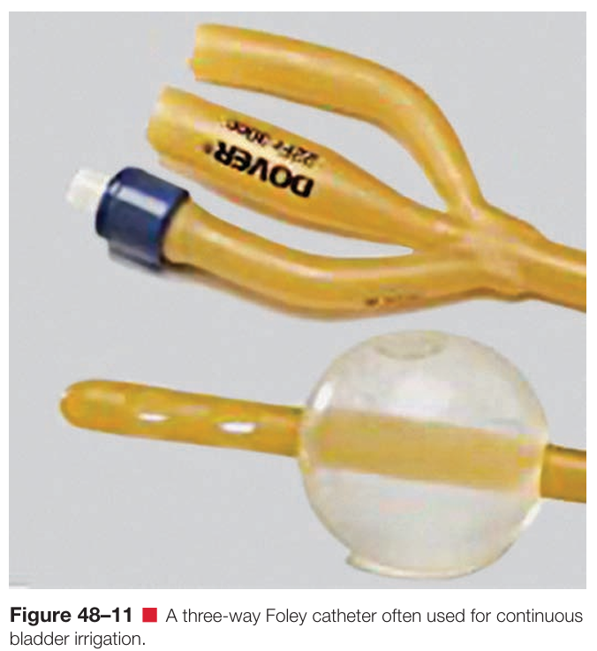
8. Continuous Bladder Irrigation : Clients who require continuous bladder irrigation may have a three-way Foley catheter (Figure 48–11 •). The three-way catheter has a third lumen through which sterile irrigating fluid can flow into the bladder. The fluid then exits the bladder through the drainage lumen, along with the urine.

Slide 5
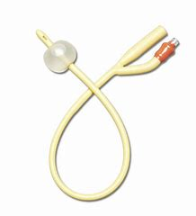
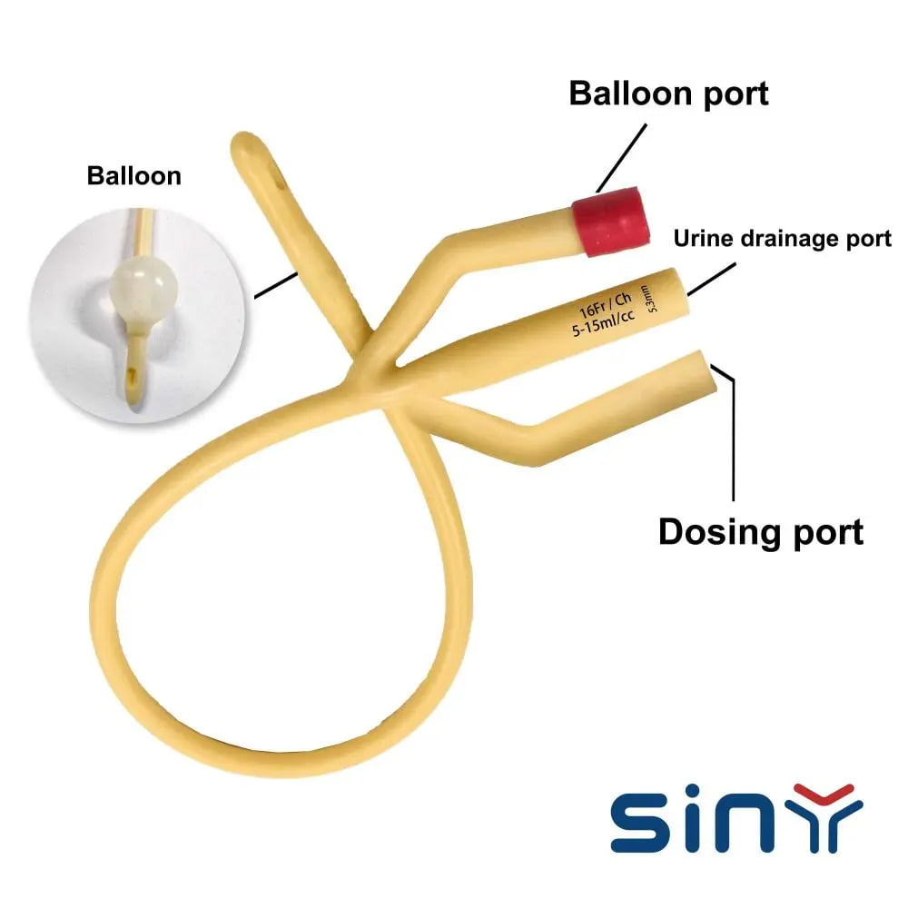
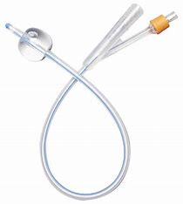
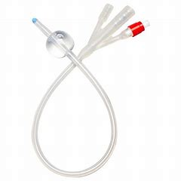
Types of Foley Catheter
Latex foley catheter
Tow way
Three way
1.A
1.B
2. Silicone foley catheter
Tow way
Three way
2.A
2.B

Slide 6
Foley Catheter Precautions
The balloon does not inflate after it is in place, Check the balloon inflation before inserting the catheter into the urethra. If the balloon still does not inflate after its placement into the bladder, then insert another Foley catheter.
Urine stops flowing into the bag, Check for correct positioning of the catheter and bag or for obstruction of urine flow within the catheter tube.
Urine flow is blocked, Change the bag or the Foley catheter or both. If the patient's urethra begins to bleed, monitor the bleeding.
The Foley catheter may introduce an infection into the bladder. The risk of infection in the urine increases
with the number of days, the catheter is in place.
If the balloon is opened before the Foley catheter is completely inserted into the bladder, bleeding, damage and even rupture of the urethra can occur. In some individuals, long-term permanent scarring and strictures of the urethra could occur.

Slide 7
Catheterization Equipment's
Urinary catheterization kits are sterile. They contain a Foley catheter, water-soluble lubricant jelly, a 10cc syringe with sterile water for the Foley balloon, a sterile drainage bag with sample port and tubing, sterile drapes, sterile gloves, iodine, sterile gauze, sterile specimen cup, and forceps.

Slide 8
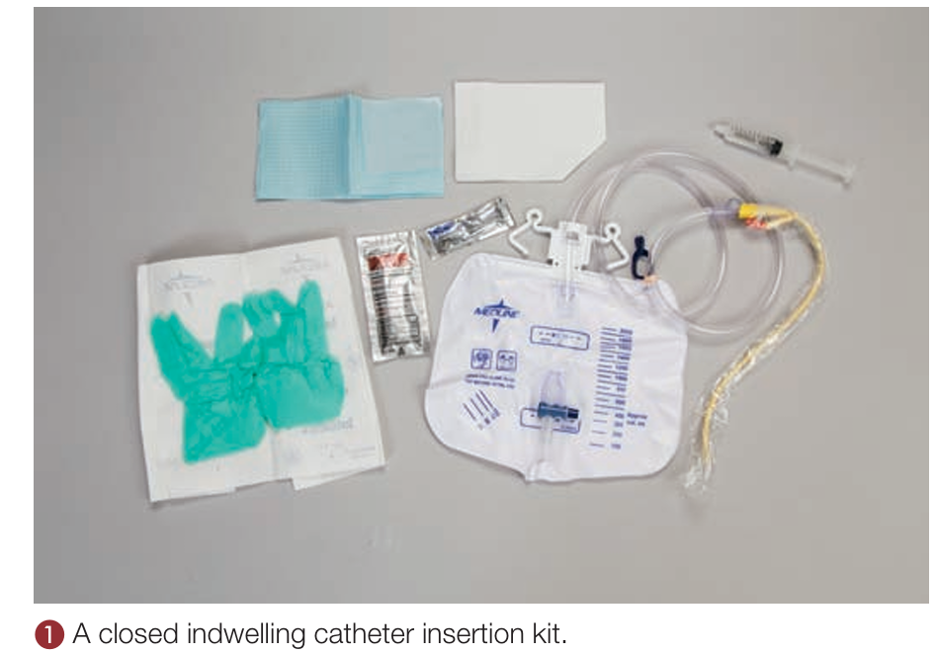

Slide 9
Prepare the Patient
Explain the reason for the procedure to the patient and/or family
Explain the steps of the procedure to the patient and/or family
Answer any questions the patient and/or family may have regarding the procedure
Check for allergies to latex and iodine
Wash your hands

Slide 10

Position of Female Patient
The female urethra is short compared to the male urethra. Insertion of the catheter is facilitated by having the patient on her back.
Adequate exposure of the urethra is obtained by flexing her knees, separating them and placing her feet flat on the bed about two feet about (Dorsal Recumbent Position).

Slide 11
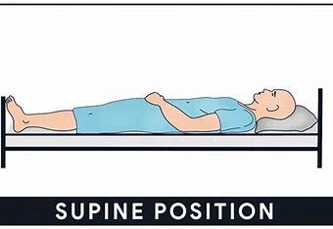
Position of Male Patient
The male urethra is long compared to the female urethra.
A catheter is placed while lying down with legs extended and flat on the bed in Supine Position.

Slide 12
Female Procedure
Tell patient when you are about to begin procedure
With non-dominant hand separate labia majora and labia minora as widely as possible.
Keep labia well separated throughout the procedure
With forceps pick up a saturated cotton ball-swipe one side of the urinary meatus with a single downward motion- discard cotton ball
Repeat on the other labia with another cotton ball-discard cotton ball
Repeat directly over the urethral meatus with another cotton ball-discard cotton ball
Pick up the lubricated catheter with dominant hand
Ask the patient to breathe deeply and slowly to further relax the sphincter.
Carefully insert the lubricated tip of the catheter into the urinary meatus.
Advance the catheter about 2-3 inches while continuing to hold the labia apart, until urine begins to flow.

Slide 13
Female Procedure
When urine stops flowing, release the labia, hold the catheter with your non-dominant hand, push the plunger on the attached saline filled syringe with your dominant hand and inflate the balloon to keep the catheter in place within the bladder.
Never inflate the balloon without first establishing urine flow, which assures you that the catheter has been correctly inserted into the bladder.
Position the collection bag level to prevent reflux of urine into the bladder, to facilitate gravity drainage of the bladder.
Tape the catheter to female patient's thigh to prevent possible tension on the urogenital trigone.

Slide 14
Male Procedure
Grasp the penis with your non-dominant hand
If he is uncircumcised, retract the foreskin.
With dominant hand, use a cotton ball held in forceps to clean the glans in a circular motion, starting at the urinary meatus and working outward-discard the cotton ball
Repeat the procedure two additional times.
With your dominant hand pick up the lubricated catheter
Gently straighten and stretch the penis to create a slight traction; lift the penis to an angle of 60O to 90O to straighten the urethral canal
Carefully insert the lubricated tip of the catheter into the urinary meatus.
Advance the catheter about 6-8 inches until urine begins to flow.

Slide 15
Male Procedure
When urine start flowing, release the penis , hold the catheter with your non-dominant hand, push the plunger on the attached saline filled syringe with your dominant hand and inflate the balloon to keep the catheter in place within the bladder.
Never inflate the balloon without first establishing urine flow, which assures you that the catheter has been correctly inserted into the bladder.
Position the collection bag level to prevent reflux of urine into the bladder, to facilitate gravity drainage of the bladder.
Tape the catheter to the thigh or lower abdomen.

Slide 16
Removing the Indwelling Catheter
Explain the procedure to the patient to ensure understanding and gain cooperation.
Perform hand hygiene and don clean gloves.
Provide privacy and position the patient comfortably, ensuring easy access to the catheter site.
Place a waterproof pad under the patient's buttocks or between the legs to protect the bedding.
Attach a syringe to the inflation port of the catheter and withdraw all the fluid from the balloon by gently pulling back the syringe plunger.
Once the balloon is deflated, slowly and steadily remove the catheter while observing the patient for any signs of discomfort.
Dispose of the catheter and drainage bag according to infection control policies.
Assist the patient with perineal hygiene, as needed.
Remove gloves and perform hand hygiene.
Document the procedure, including the time of removal, the patient's response, and the condition of the catheter.

Slide 17


