Slide 1
Intravenous (IV) Cannula
Prepared by:
Dr. Alaa Hamza
M.Sc.N: Ali Jassim

Slide 2
Intravenous (IV) Cannula
An intravenous (IV) cannula is a small, flexible tube inserted into a vein to deliver fluids, medications, or nutrients directly into the bloodstream. It is commonly used in hospitals and clinics for patients requiring intravenous treatment.
Types of IV Cannulas:
1- Short-term use cannulas: Typically used for a few days, often inserted into peripheral veins in arms or hands.
2- Long-term use cannulas: These may include central venous catheters (CVC) or peripherally inserted central catheters (PICC), used for extended periods.

Slide 3
Indications of Intravenous (IV) Cannula
Fluid Administration: Hydration or electrolytes for patients unable to drink or absorb fluids.
Medication Delivery: For quick and accurate delivery of drugs like antibiotics, chemotherapy, or pain management.
Blood Transfusions: For the safe and controlled infusion of blood products.
Diagnostic Procedures: In cases of contrast dye administration for imaging like CT scans.

Slide 4
Veins Commonly Used for IV Cannulation
Dorsal Hand Veins
Cephalic Vein (Forearm)
Basilic Vein (Forearm)
Median Cubital Vein (Elbow)
Accessory Cephalic Vein
Radial Vein (Forearm)
Ulnar Vein (Forearm)
Superficial Femoral Vein
Jugular Vein (Neck)
Antecubital Vein (Elbow)

Slide 5
Tips for I.V. Cannulation
Choose the most suitable vein based on patient condition and therapy duration.
Use a tourniquet to enhance vein visibility and palpability.
Maintain strict aseptic technique to prevent infections.
Insert the i.v. cannula at a shallow angle (10-30 degrees) for better success.
Stabilize the vein by stretching the skin before insertion.
Avoid joints to reduce the risk of catheter displacement.
Use the smallest gauge necessary to minimize trauma.
Secure the i.v.cannula properly with transparent dressings.
Monitor the site regularly for signs of infiltration or infection.

Slide 6
Complications of IV cannulation
Phlebitis: Inflammation of the vein, causing redness and pain.
Infiltration/Extravasation: Fluid leaks into tissue, causing swelling and damage, especially with harmful medications.
Hematoma: Blood outside the vein, leading to bruising and swelling.
Air Embolism: Air entering the bloodstream, causing shortness of breath and chest pain.
Infection: Redness, warmth, or pus at the insertion site, and possible fever.
Thrombophlebitis: A clot forming in the vein, causing pain and swelling.
Nerve Injury: Accidental damage to nearby nerves, causing tingling or pain.
Vein Rupture: A vein breaking, causing severe pain and swelling.
Catheter Breakage: A catheter piece breaking off inside the vein.
Venous Spasm: Temporary vein contraction, causing pain and blockage.

Slide 7
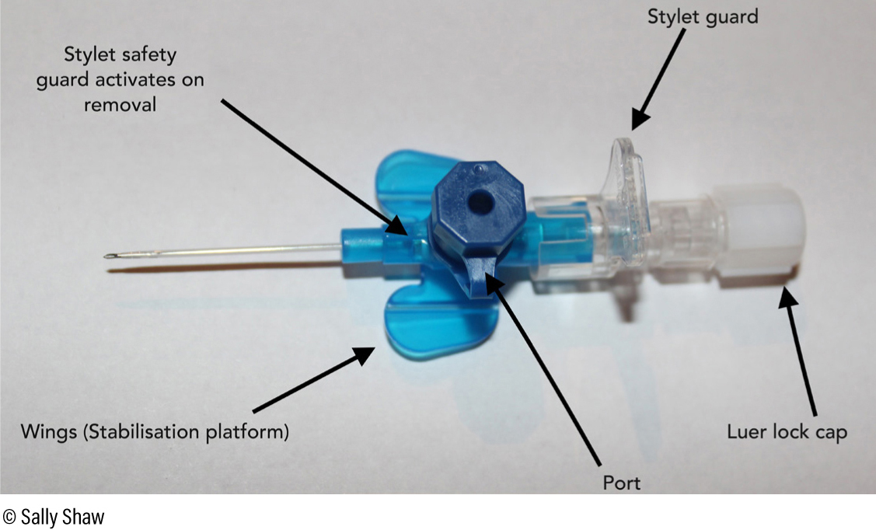

Slide 8
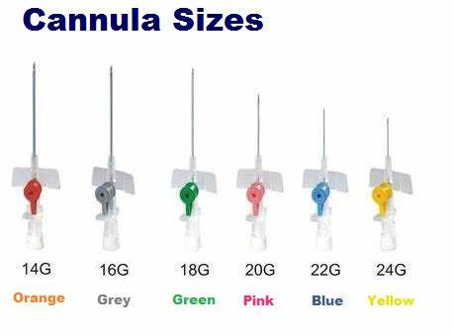

Slide 9


