Slide 1
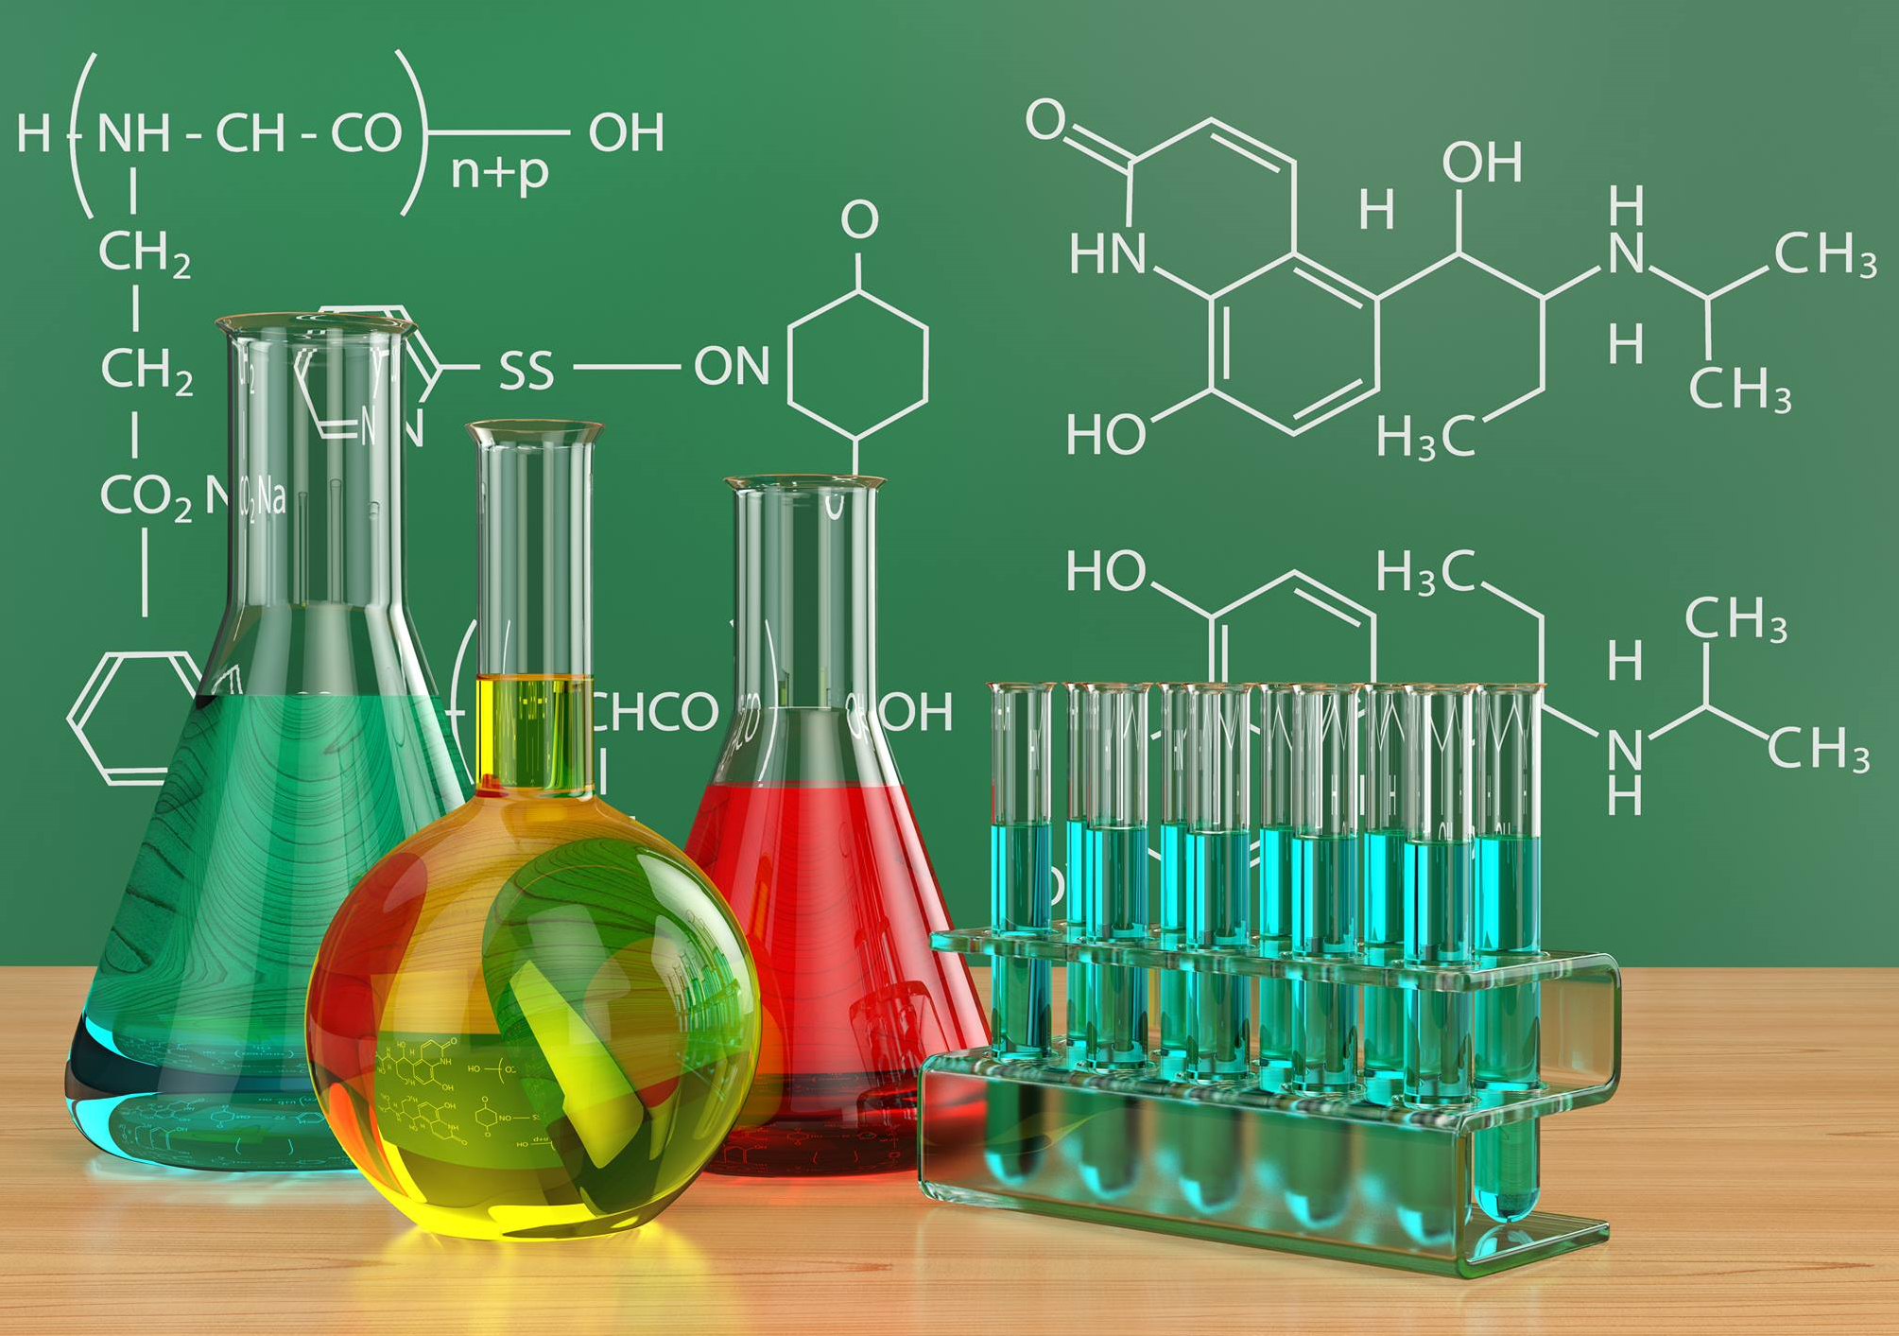


College of Medicine
Medical Chemistry
Practical lecture
Protein
Lecture No. 4
First stage
Prof. Dr. Talat T.K.
Dr. Widad Hamza Shekiar

Slide 2
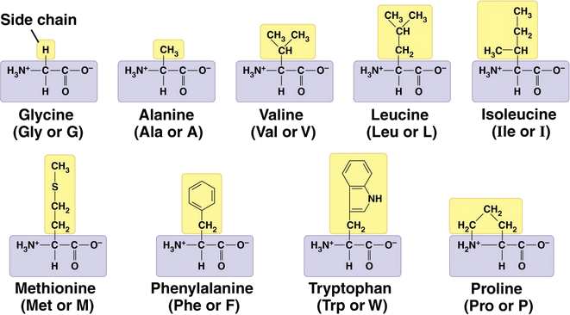
Classification of Amino Acids
Amino acids can be classified as
1-nonpolar (hydrophobic) with hydrocarbon side chains

Slide 3
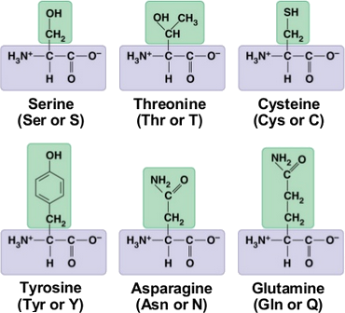
2-polar (hydrophilic) with polar or ionic side chains
A-Polar and no charged Amino Acids
An amino acid is polar when the R group is an alcohol, thiol, or amide.

Slide 4
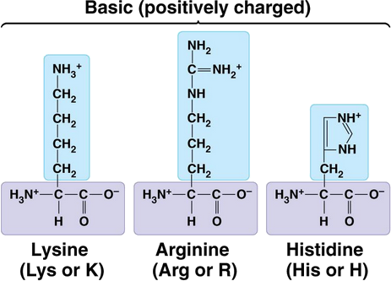
B-Polar and basic charged Amino Acids

Slide 5
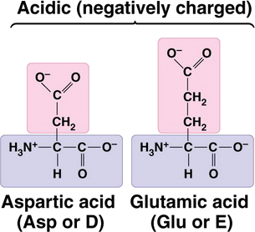
C-Polar and acidic charged Amino Acids

Slide 6
Part 1: Protein Practical Tests
A. Qualitative Tests for Proteins
1. Biuret Test
Principle: Peptide bonds react with copper sulfate in alkaline medium to form a violet-colored complex.
Indication: Presence of proteins
Procedure: Add Biuret reagent to the sample and observe for violet color.
Clinical Use: Total protein estimation in serum

Slide 7
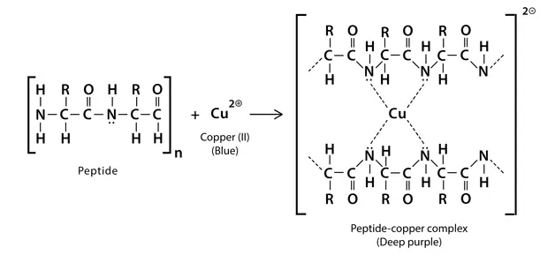

Slide 8
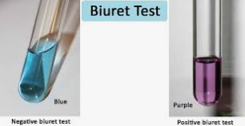

Slide 9
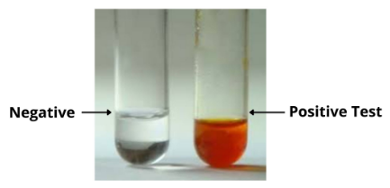
2. Xanthoproteic Test
Principle: Aromatic amino acids react with concentrated nitric acid to form yellow nitro derivatives.
Observation: Yellow color that deepens with alkali.
Use: Detection of tyrosine, tryptophan, and phenylalanine.

Slide 10
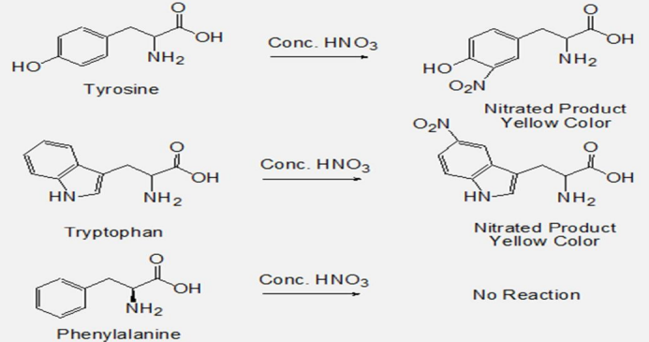

Slide 11
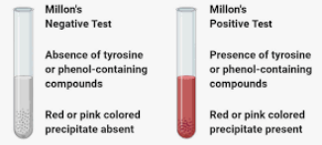
3. Millon’s Test
Principle: Tyrosine reacts with Millon’s reagent to give a red color.
Use: Specific for tyrosine-containing proteins.

Slide 12
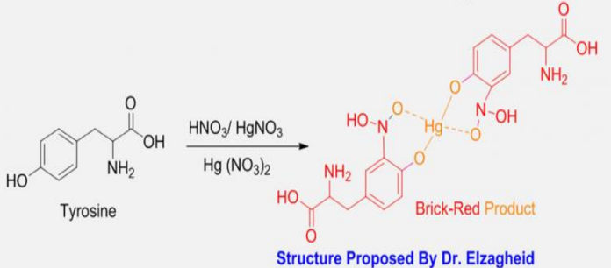

Slide 13
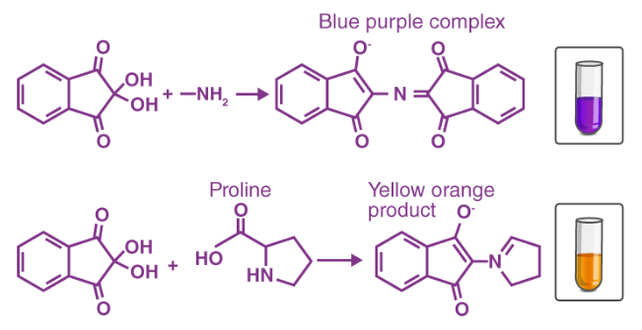
4. Ninhydrin Test
Principle: Amino acids react with ninhydrin to produce a blue or purple complex.
Use: Detection of free amino acids.

Slide 14
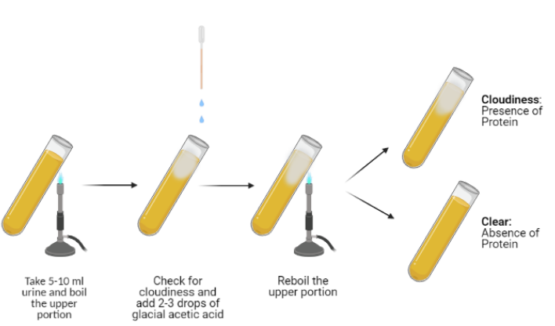
5. Heat Coagulation Test
Principle: Proteins denature and coagulate when heated.
Use: Detection of albumin in urine (proteinuria).

