Slide 1


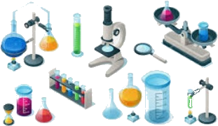
College of Medicine
Practical Medical Chemistry
Lecture No. 1
First stage
Glassware and instruments in Lab
Prof. Dr. Talat T.K.
Dr. Widad Hamza Shekiar

Slide 2
General Laboratory supplies
Laboratory
ware Most of laboratory ware used in medical chemistry laboratory is made of either glass or plastic.

Slide 3

Test tubes
•Available in different lengths and widths to serve a varying number of needs.
•Usually used for liquid samples, during chemical procedures and experiments
•Often, formed of Pyrex to allow heating of samples.
Test tubes
Types of tubes
Sample tubes
Centrifuge tubes

Slide 4
Test tube Racks
•Made from wood, iron or plastic.
•Available in different sizes

Slide 5
Beakers
•A simple container for liquids.
•Very commonly used in laboratories for boiling and preparing solution.
•Generally cylindrical in shape, with a flat bottom.
•Available in a wide range of sizes, from 1 mL up to several liters

Slide 6
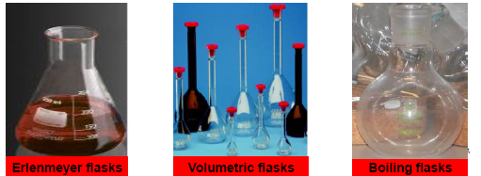
Flasks
•A flask has a wide "body" and narrow neck with an opening at the top
•They have different sizes
•They are used for:
-making, collecting and measuring solutions
-chemical reactions, mixing, heating, cooling or dissolving,
•Several types having different functions;
•The most common types are:

Slide 7
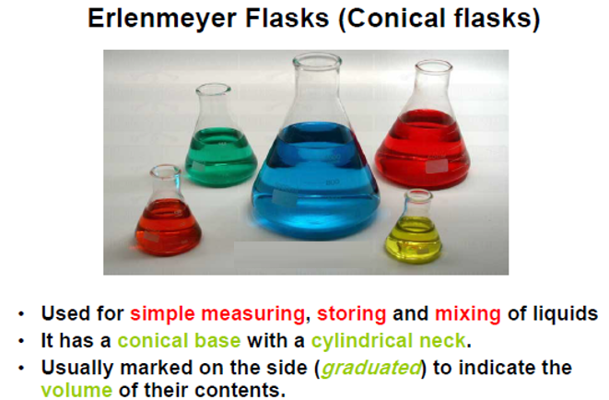

Slide 8
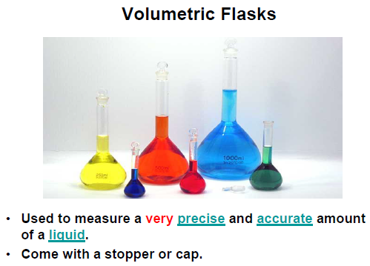

Slide 9
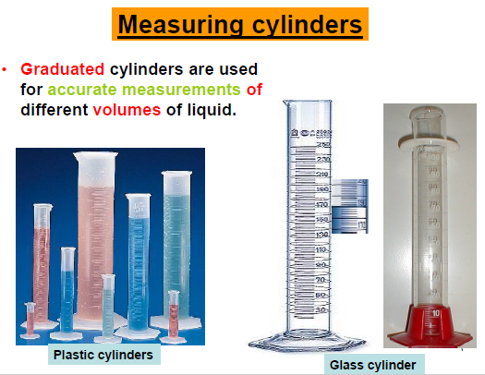

Slide 10
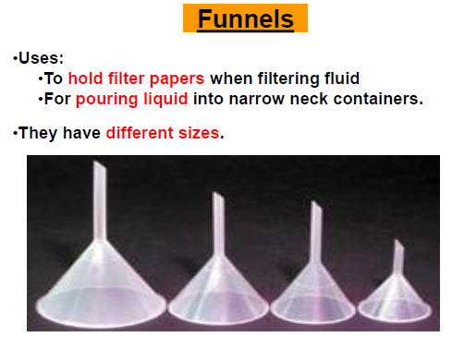

Slide 11
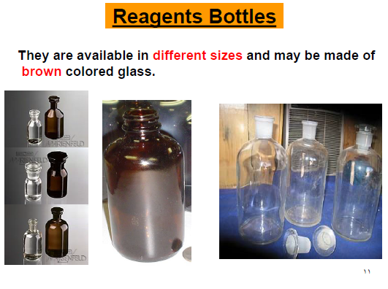

Slide 12
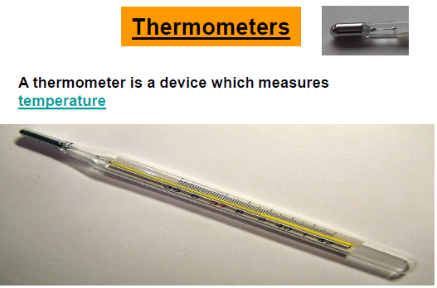

Slide 13
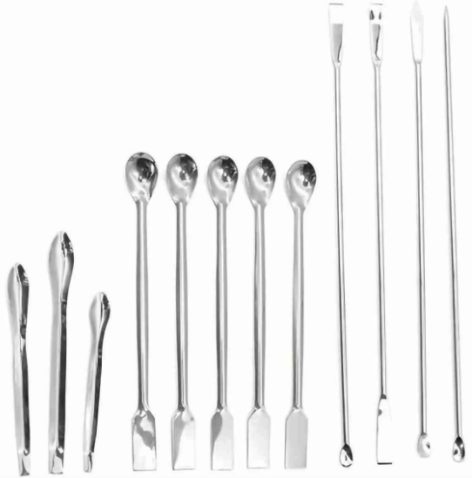
Spatulas
These Spatulas are a stainless steel utensil that used for scraping, transferring or applying powders and paste like chemicals or treatments. Featuring a spoons on the one end and a shovel on the other

Slide 14
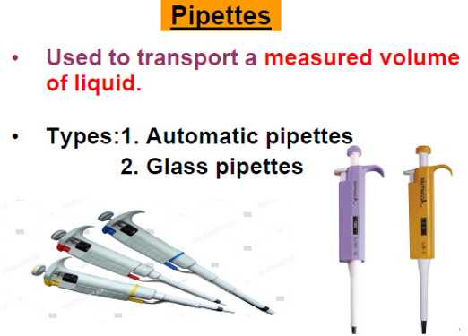

Slide 16
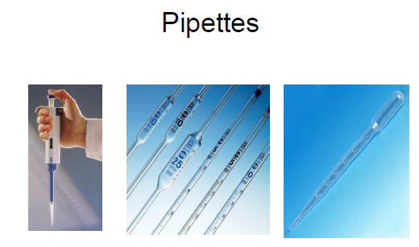

Slide 17
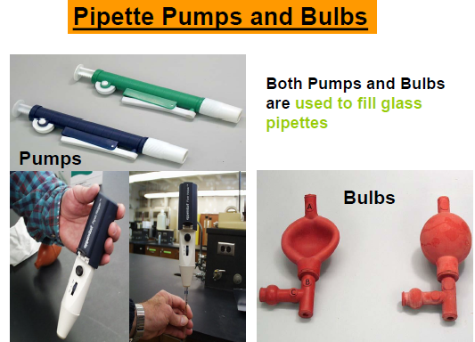

Slide 18
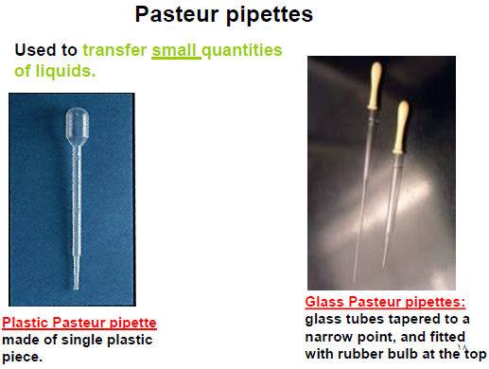

Slide 19
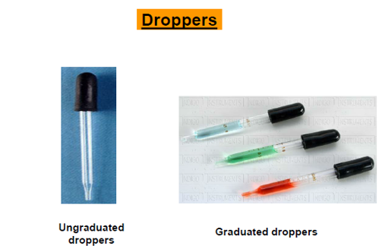

Slide 20
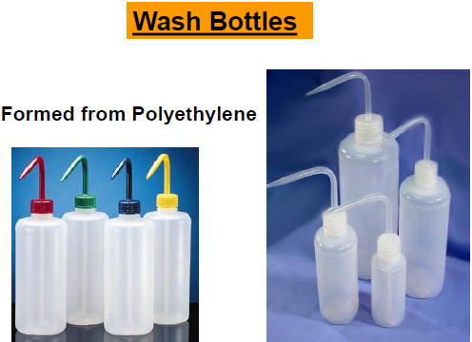

Slide 27
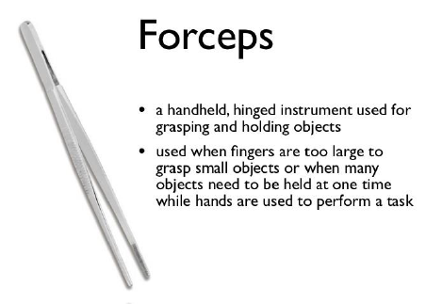

Slide 28
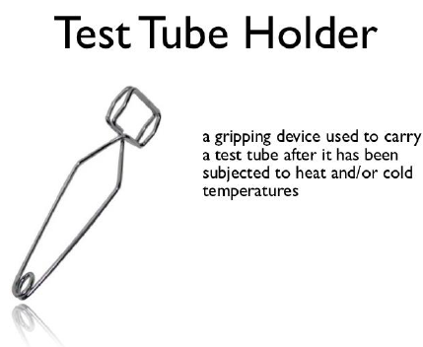

Slide 29
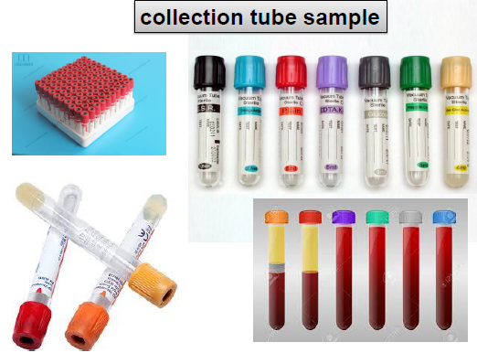

Slide 30
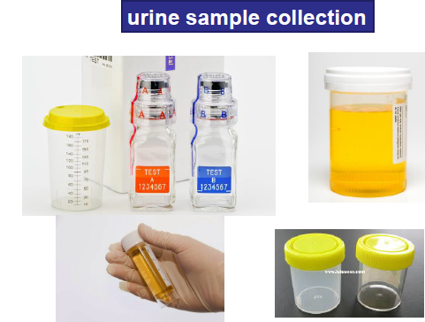

Slide 31
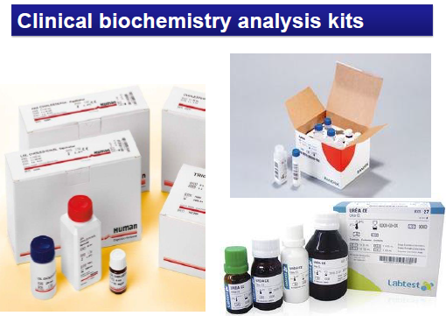

Slide 32
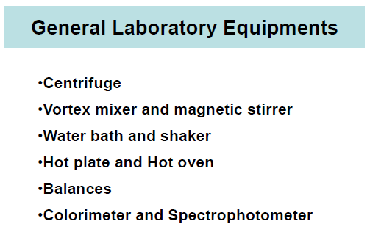

Slide 33
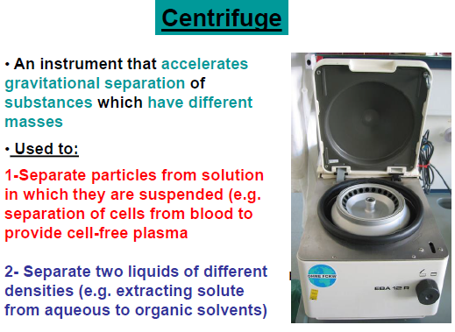

Slide 34
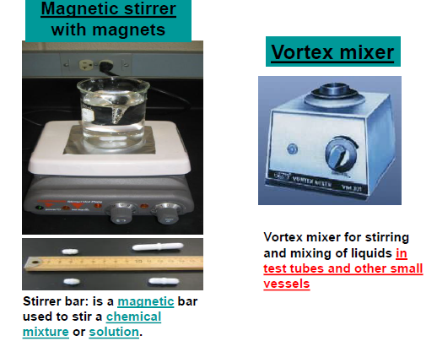

Slide 35
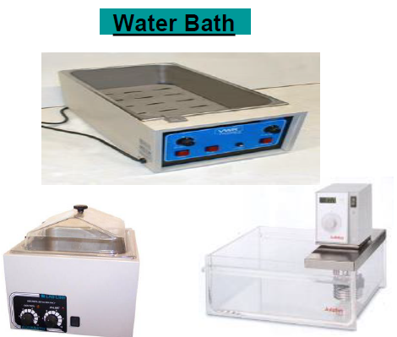

Slide 36
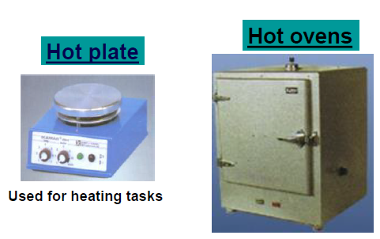

Slide 37
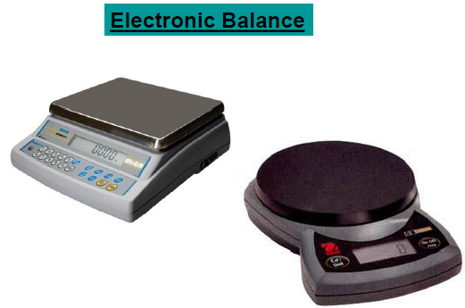

Slide 40
