Slide 1
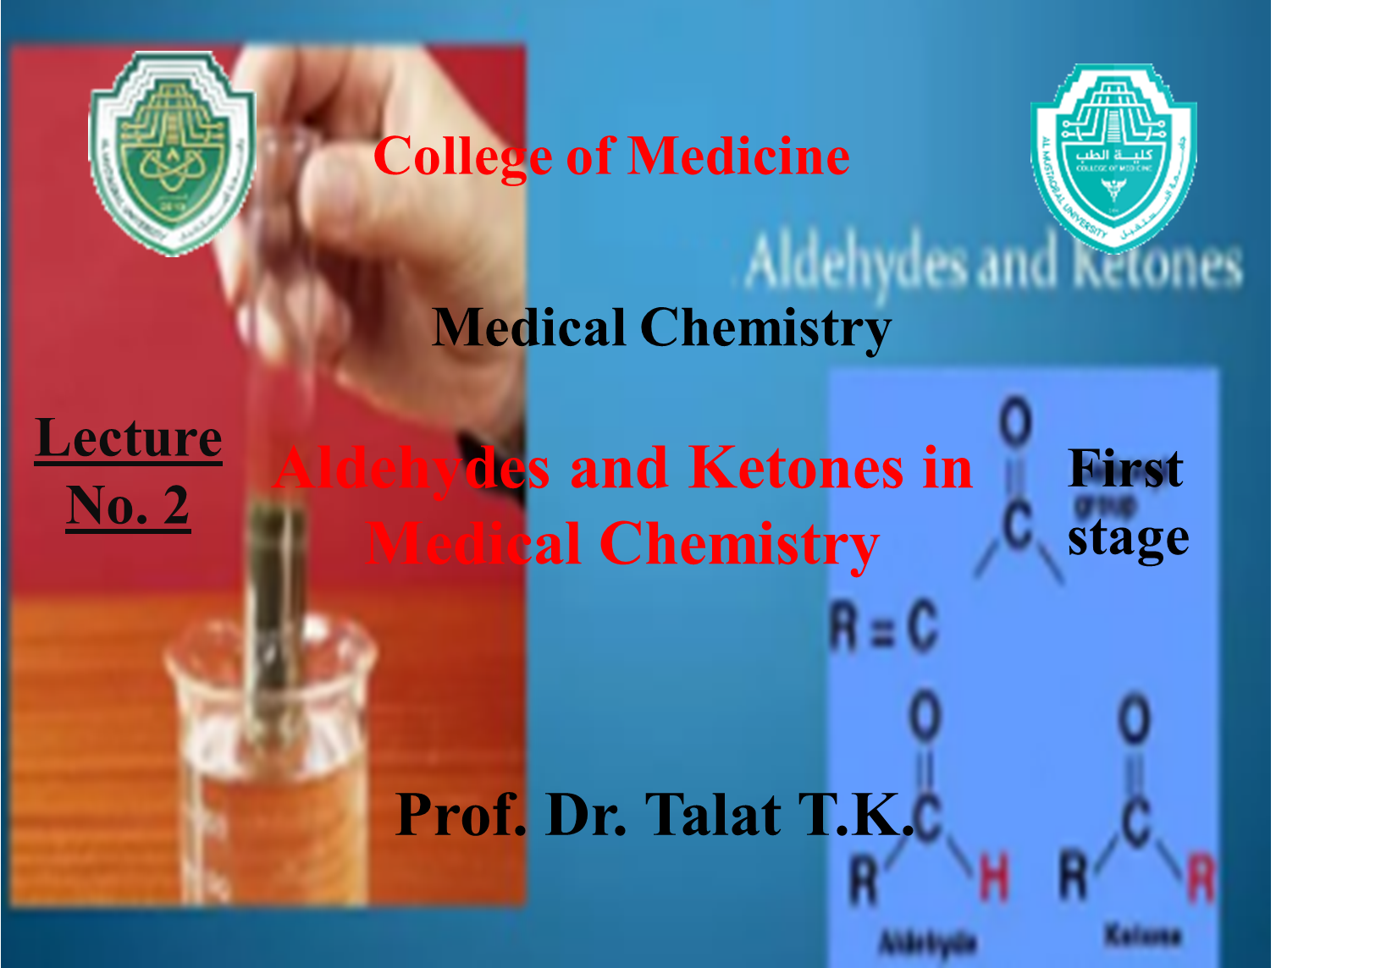

Slide 2
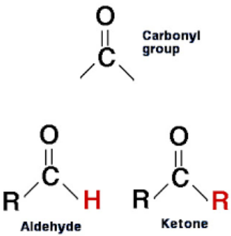
Aldehydes and Ketones in Medical Chemistry
Aldehydes and ketones are important organic compounds containing the carbonyl (-C=O) functional group. They play a crucial role in medical chemistry due to their involvement in biological metabolism, pharmaceutical applications, and drug synthesis.

Slide 3
1. Structure and Classification
Aldehydes (-CHO)
The carbonyl group is at the end of the carbon chain.
General formula: R-CHO
Naming: Replace -e of the parent alkane with -al (e.g., Methanal (Formaldehyde), Ethanal (Acetaldehyde)).
Example:
Formaldehyde (HCHO),
Acetaldehyde (CH₃CHO)

Slide 4
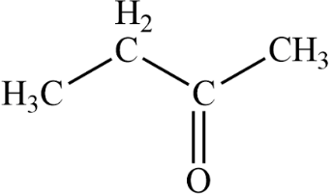
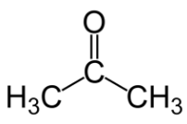
ketones (-CO-)
The carbonyl group is within the carbon chain (between two carbon atoms) or (not at the end).
General formula: R-CO-R’
Example:
Naming: Replace -e of the parent alkane with -one (e.g., Propanone (Acetone), Butanone).
Acetone (CH₃COCH₃),
Butanone (CH₃COCH₂CH₃

Slide 5
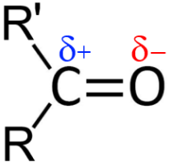
2. Physical and Chemical Properties
Physical Properties
Polarity: Both are polar due to the carbonyl group.
Solubility:Short-chain aldehydes and ketones dissolve in water, but solubility decreases with longer carbon chains. Aldehydes and ketones are water-soluble due to hydrogen bonding
Boiling Points: Higher than alkanes but lower than alcohols due to dipole-dipole interactions

Slide 6
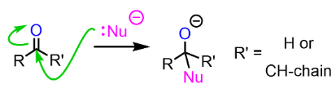
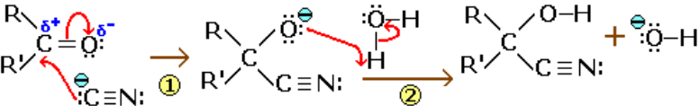
Chemical Properties
1. Nucleophilic Addition Reactions
Aldehydes and ketones undergo nucleophilic addition reactions, important in drug synthesis and biochemical reactions. (In chemistry, a nucleophile is a chemical species that forms bonds by donating an electron pair)
Examples:
Addition of hydrogen cyanide (HCN) → Cyanohydrin formation
attack due to the partial positive charge on the carbonyl carbon.

Slide 7
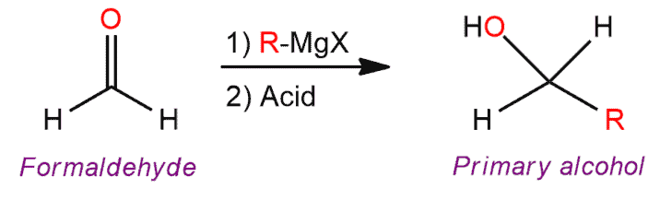
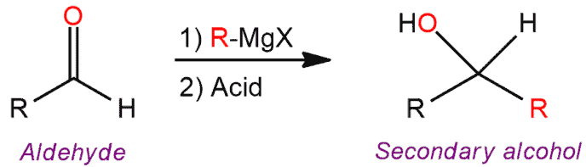
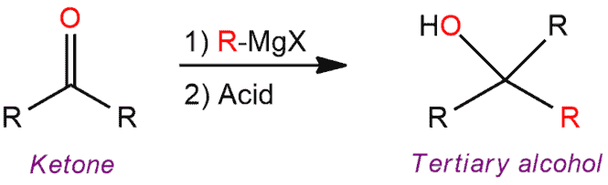
Addition of Grignard reagent (RMgX) → Alcohol formation

Slide 8
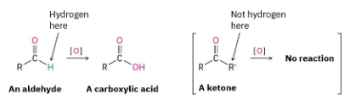
2. Oxidation
Aldehydes are easily oxidized to carboxylic acids (e.g., Benedict’s and Fehling’s test). Ketones are more resistant to oxidation.

Slide 9
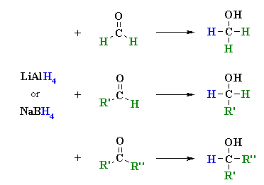
3. Reduction
Aldehydes and ketones can be reduced to alcohols using reducing agents such as: Lithium aluminum hydride (LiAlH₄) and Sodium borohydride (NaBH₄).

Slide 10
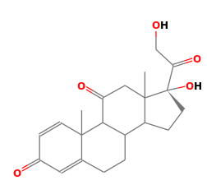
3. Role in Medicinal Chemistry
Aldehydes and ketones are found in various biologically active compounds, including:
1- Drugs and Pharmaceuticals
Formaldehyde: used as a disinfectant and preservative in hospitals and laboratories.
Acetone: Used as a solvent in pharmaceuticals.
Corticosteroids (e.g., Prednisone, Dexamethasone): Contain ketone functional groups. Prednisone: a synthetic drug similar to cortisone, used to relieve rheumatic and allergic conditions and to treat leukaemia.
Dexamethasone: a drug that is a more potent synthetic analogue of cortisol, used chiefly as an anti-inflammatory agent.
Prednisone
Dexamethasone

Slide 11
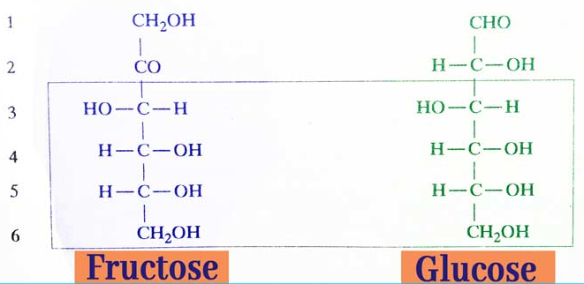
2. Natural Biomolecules
Glucose (an aldehyde sugar) and Fructose (a ketone sugar) play a key role in metabolism.

Slide 12
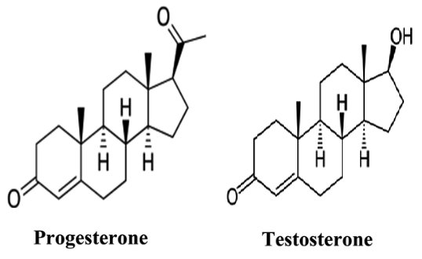
3-Steroids and Hormones (e.g., Testosterone and Progesterone) contain ketone groups.

Slide 13
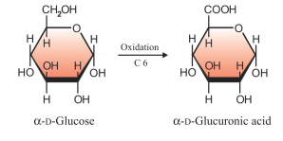
Biological and Medical Importance
Role in Metabolic Reactions
1. Glucose Metabolism:
Glucose, an important carbohydrate, contains an aldehyde group and is metabolized into glucuronic acid in the liver.

Slide 14
2. Pyruvate and Acetone:
Pyruvate (a ketone derivative) is a key intermediate in the Krebs cycle.
Acetone is one of the ketone bodies produced during fat metabolism.
3. Diabetes and Ketone Bodies:
In uncontrolled diabetes, excessive production of ketone bodies can lead to diabetic ketoacidosis (DKA).

Slide 15
Test of csarbonyl group
1. Fehling’s and Benedict’s Test
Aldehydes reduce Fehling’s and Benedict’s solution, producing a red precipitate.
Aldehydesa red precipitate.
2- 2,4-DNP Test (Dinitrophenylhydrazine Test)
Both aldehydes and ketones form a yellow/orange precipitate with 2,4-DNP reagent
aldehydes and ketones
a yellow/orange precipitate

