Slide 1
Al-Mustaqbal University
Biomedical Engineering Department
Class: 3th
Subject: Physiology II
Lecturer: M.SC. ZAINAB SATTAR JABBAR
1st term – Lect. 7: Immunity
Email: zainab.sattar.jabbar@uomus.edu.iq

Slide 2
Immunity
The human body has the ability to resist almost all types of organisms or toxins that tend to damage the tissues and organs. This capability is called immunity.
Much of immunity is acquired immunity that does not develop until after the body is first attacked by a bacterium, virus, or toxin, often requiring weeks or months to develop the immunity.
An additional portion of immunity results from general processes, rather than from processes directed at specific disease organisms. This is called innate immunity.

Slide 3
Innate Immunity
It includes the following:
1. Phagocytosis of bacteria and other invaders by white blood cells.
2. Destruction of swallowed organisms by the acid of the stomach and the digestive enzymes.
3. Resistance of the skin to invasion by organisms.
4. Presence in the blood of certain chemical compounds that attach to foreign organisms or toxins and destroy them. Some of these compounds are:
(1) Lysozyme attacks bacteria and causes them to dissolute.
(2) Basic polypeptides inactivate certain types of gram-positive bacteria.
(3) Complement complex a system of about 20 proteins that can be activated in various ways to destroy bacteria
(4) Natural killer lymphocytes that can recognize and destroy foreign cells, tumor cells, and even some infected cells.

Slide 4
Acquired (Adaptive) Immunity
It is extremely powerful specific immunity against individual invading agents such as lethal bacteria, viruses, toxins, and even foreign tissues from other animals. Acquired immunity is caused by a special immune system that forms antibodies and/or activated lymphocytes that attack and destroy the specific invading organism or toxin.
Two basic types of acquired immunity occur in the body. In one of these the body develops circulating antibodie that are capable of attacking the invading agent. This type of immunity is called humoral immunity or B-cell immunity. The second type of acquired immunity is achieved through the formation of large numbers of activated T lymphocytes that destroy the foreign agent. This type of immunity is called cell-mediated immunity or T-cell immunity.
Both types of acquired immunity are initiated by antigens which must have a high molecular weight,8000 or greater and recurring molecular groups, called epitopes, on the surface of the large molecule. Therefore, proteins and large polysaccharides are almost always antigenic.

Slide 5
Humoral Immunity
On entry of a foreign antigen, macrophages in the lymphoid tissue phagocytize the antigen and then present it to adjacent B lymphocytes. Those B lymphocytes become activated and differentiated into lymphoblasts:
Some of the further differentiate to form plasmablasts, which begin to divide giving in 4 days a total population of about 500 cells for each original plasmablast. The mature plasma cell then produces gamma globulin antibodies at an extremely rapid rate—about 2000 molecules per second for each plasma cell. The antibodies are secreted into the lymph and carried to the circulating blood. This process continues for several days or weeks until finally exhaustion and death of the plasma cells occur.
A few of the lymphoblasts form moderate numbers of new B lymphocytes similar to those of the original clone. They also circulate throughout the body to populate all the lymphoid tissue; they remain dormant until activated once again by a new quantity of the same antigen. These lymphocytes are called memory cells. Subsequent exposure to the same antigen will cause a much more rapid and much more potent antibody respons.
The formation of antibodies that occurs on first exposure to a specific antigen is called primary response which need more time to appear (about one week), with weak potency, and has short life. While that occurs after second exposure to the same antigen is called secondary response that characterized by rapid appearance, increased potency and duration.

Slide 6
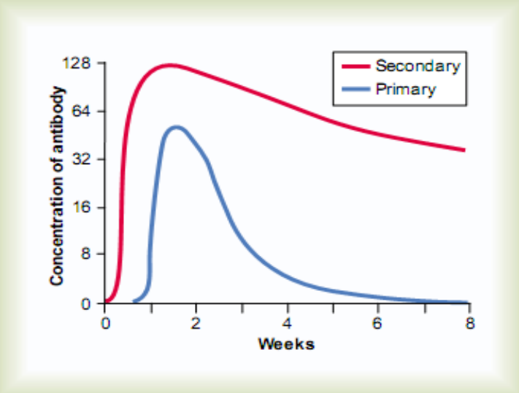
Humoral Immunity

Slide 7
Classes of Antibodies
There are five general classes of antibodies, respectively named IgM, IgG, IgA, IgD, and IgE.
The IgG is a bivalent antibody and constitutes about 75 per cent of the antibodies of the normal person.
The IgE constitutes only a small percentage of the antibodies but is especially involved in allergy.
The IgM antibodies have 10 binding sites that make them exceedingly effective in protecting the body against invaders during the primary response.

Slide 8
Mechanisms of Action of Antibodies
Antibodies act mainly in two ways to protect the body against invading agents:
1) Direct Action of Antibodies on Invading Agents:
The antibodies can inactivate the invading agent in one of several ways, as follows:
1. Agglutination, in which multiple large particles with antigens on their surfaces, such as bacteria or red cells, are bound together into a clump.
2. Precipitation, in which the molecular complex of soluble antigen (such as tetanus toxin) and antibody becomes so large that it is rendered insoluble and precipitates.
3. Neutralization, in which the antibodies cover the toxic sites of the antigenic agent.
4. Lysis, in which some potent antibodies are occasionally capable of directly attacking membranes of cellular agents and thereby cause rupture of the agent.
2) Activation of the complement system:
Complement is a collective term that describes a system of about 20 proteins, many of which are enzyme precursors. The principal actors in this system are 11 proteins designated C1 - C9, B, and D. All these are present normally among the plasma proteins in the blood as well as among the proteins that leak out of the capillaries into the tissue spaces. The enzyme precursors are normally inactive, but they can be activated mainly by the so-called classic pathway.

Slide 9
Mechanisms of Action of Antibodies
The classic pathway is initiated by an antigen-antibody reaction setting into motion a “cascade” of sequential reactions. Multiple end products are formed and several of these cause important effects that help to prevent damage to the body’s tissues caused by the invading organism or toxin. Among the more important effects are the following:
1. Opsonization and phagocytosis: One of the products of the complement cascade, C3b protein, strongly activates phagocytosis by both neutrophils and macrophages, causing these cells to engulf the bacteria to which the antigen antibody complexes are attached. This process is called opsonization.
2. Lysis: One of the most important of all the products of the complement cascade is the lytic complex, which is a combination of multiple complement factors and designated C5b6789. This has a direct effect of rupturing the cell membranes of bacteria or other invading organisms.
3. Agglutination: The complement products also change the surfaces of the invading organisms, causing them to adhere to one another, thus promoting agglutination.
4. Neutralization of viruses: The complement enzymes and other complement products can attack the structures of some viruses and thereby render them non virulent.
5. Chemotaxis: Fragment C5a initiates chemotaxis of neutrophils and macrophages, thus causing large numbers of these phagocytes to migrate into the tissue area adjacent to the antigenic agent.
6. Activation of mast cells and basophils: Fragments C3a, C4a, and C5a activate mast cells and basophils, causing them to release histamine, heparin, and several other substances into the local fluids. These substances in turn cause increased local blood flow, increased leakage of fluid and plasma protein into the tissue, and other local tissue reactions that help inactivate or immobilize the antigenic agent.

Slide 10
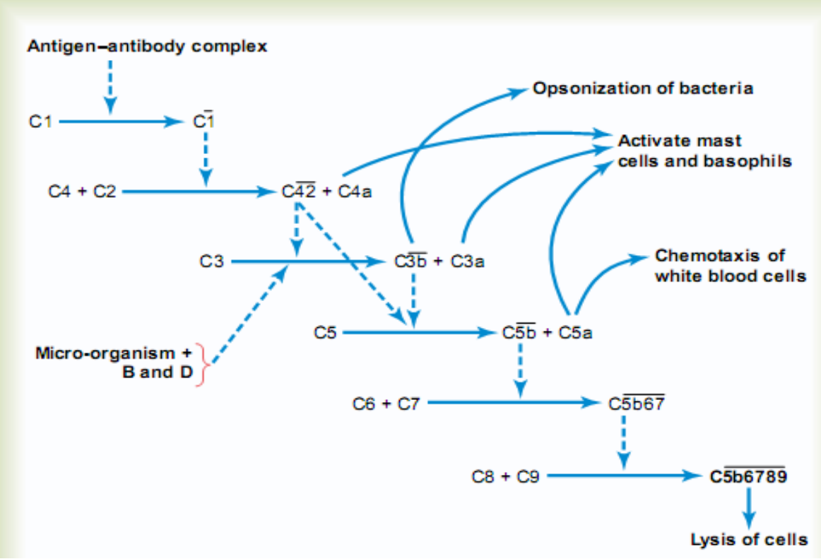
Mechanisms of Action of Antibodies

Slide 11
Cell-mediated Immunity
T-cell responses are extremely antigen specific, like the antibody responses of B cells, and are at least as important as antibodies in defending against infection.
Although B lymphocytes recognize intact antigens, T lymphocytes respond to antigens only when they are bound to specific molecules called MHC proteins on the surface of antigen-presenting cells in the lymphoid tissues.
The three major types of antigen-presenting cells are macrophages, B lymphocytes, and dendritic cells.
There are two types of MHC proteins:
1) MHC I proteins, which present antigens to cytotoxic T cells.
2) MHC II proteins, which present antigens to T helper cells

Slide 12
Cell-mediated Immunity
It has become clear that there are multiple types of T cells. They are classified into three major groups: helper T cells, cytotoxic T cells, and suppressor T cells.
I. Helper T Cells: The helper T cells are the most numerous of the T cells, usually constituting more than three quarters of all of them. They serve as the major regulator of virtually all immune functions by forming a series of protein mediators, called lymphokines, that act on other cells of the immune system as well as on bone marrow cells. Some of the specific regulatory functions are the following:
1. Stimulation of growth and proliferation of cytotoxic T cells and suppressor T cells.
2. Stimulation of B-cell growth and differentiation to form plasma cells and antibodies.
3. Activation of the macrophage system.
4. Feedback stimulatory effect on the helper cells themselves.
II. Cytotoxic T Cells: The cytotoxic T cell is a direct-attack cell that is capable of killing micro-organisms and, at times, even some of the body’s own cells. For this reason, these cells are called killer cells.
The cytotoxic T cell secretes hole-forming proteins, called perforins that punch round holes in the membrane of the attacked cell. Some of the cytotoxic T cells are especially lethal to tissue cells that have been invaded by viruses.
The cytotoxic cells also play an important role in destroying cancer cells, heart transplant cells, or other types of cells that are foreign to the person’s own body.

Slide 13
Cell-mediated Immunity
III. Suppressor T Cells: Much less is known about the suppressor T cells, but they are capable of suppressing the functions of both cytotoxic and helper T cells. For this reason, the suppressor cells are classified, along with the helper T cells, as regulatory T cells.
The suppressor T-cell system plays an important role in limiting the ability of the immune system to attack a person’s own body tissues, which is called immune tolerance.
Therefore, failure of the tolerance mechanism causes autoimmune diseases such as:
(1) Rheumatic fever in which the body becomes immunized against tissues in the joints and heart, especially the heart valves, after exposure to a specific type of streptococcal toxin that has an epitope in its molecular structure similar to the structure of some of the body’s own self-antigens.
(2) Glomerulo-nephritis in which the person becomes immunized against the basement membranes of glomeruli.
(3) Myasthenia gravis in which immunity develops against the acetylcholine receptor proteins of the neuromuscular junction, causing paralysis.
(4) Lupus erythematosus in which the person becomes immunized against many different body tissues at the same time that causes extensive damage and often rapid death.

Slide 14


