Slide 1




L:5
Parasitology
prof. Dr. Nada Khazal

Slide 2
Phylum: Aschelminthes or Nemathelminthes
Class: Nematoda (roundworms, threadworms).
1.Ascaris lumbricoides (Giant roundworms)
2.Enterobes (pinworm)
3. Trichuris trichiura (Whip worm)
4.Anchylostoma (Hook worm)
5.Necator americanus Associated with Nocturnal Pruritus.
The nematodes are elongated, non segmented worms that are tapered at both ends All are dioecious (bisexual). Unlike other helminthes, nematodes have a complete digestive system, including a mouth, an intestine that spans most of the body length, and an anus. The body is protected by a tough, non cellular cuticle. Nematodes have separate, distinctive sexes. The worm can invade any part of the body; liver, kidneys, intestines, subcutaneous tissue, or eyes. Humans are the sole host
The mode of transmission of All types of Nematodes except Anchylostoma by ingestion of contaminated soil, food & water while Anchylostoma by skin penetration
The infective stages and diagnostic stages of All types of Nematodes are eggs except Anchylostoma The infective stages is larvae

Slide 3
1.Ascaris lumbricoides (Giant roundworms)
A more serious disease of worldwide occurrence is Loeffler’s syndrome or ascariasis, caused by Ascaris lumbricoides. The disease transmitted by ingesting the soil containing egg. Larva grow in the intestine, causes intestine obstruction, may pass to the blood and through the lung. Humans are the sole host.
Adults
Adult A. lumbricoides – ymaerc a emussa yllausu mrow white color with a tint of pink. Fine striations are visible on the cuticle. Ascaris adult worms are the largest known intestinal nematodes. The average adult male is small only seldom reaching 30 cm in length. The male is characteristically slender and possesses a prominent incurved tail. The adult female measures 22 to 35 cm in length and resembles a pencil lead in thickness .

Slide 4
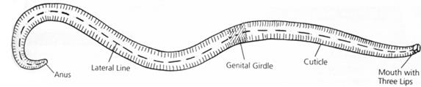
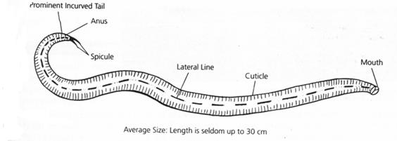
Table A. lumbricoides adults : Typical characteristics
Characteristic | Adult female | Adult male
length | 22 to 35 cm | Up to 30 cm
Color | Creamy – white pink tint | Creamy – white pink tint
Other features | Pencil – lead thickness | Prominent incurved tail
figure

Slide 5
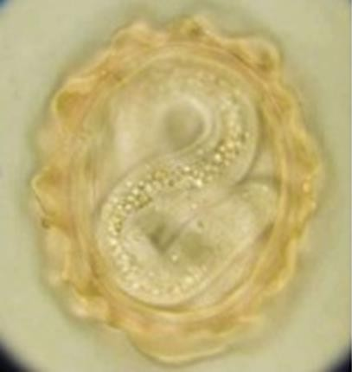
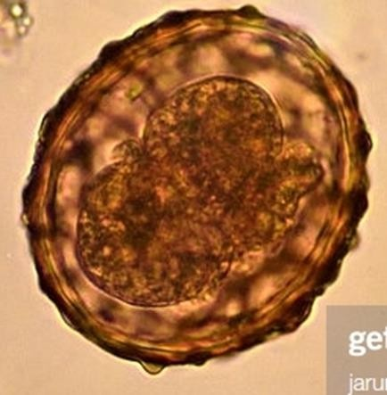

Table ( 2 ) : A. lumbricoides fertilized egg: Typical characteristics
Size | 40 to 75 μm by 30 to 50 μm
Shape | Rounder than nonfertilized version
Embryo | Undeveloped unicellular embryo
Shell | Thick , chitin
Other features | My be corticated or decorticated
Table (3 ) : A. lumbricoides nonfertilized egg: Typical characteristics
Size | 85 to 95 μm by 38 to 45 μm size variations possible
Shape | Varies
Embryo | Unembryonated ; amorphous mass of protoplasm
Shell | Thin
Other features | Usually corticated

Slide 6
Life cycle
The life cycle of A. lumbricoides is relatively complex compared with the parasites presented thus far. Infection begins following the ingestion of infected eggs that contain viable larvae. Once inside the small intestine, the larvae emerge from the eggs. The larvae then complete a liver lung migration by first entering the blood via penetration through the intestinal wall. the first “stop” on this journey is the liver . From there, the larvae continue the trip via the blood stream to the second “stop” the lung . Once inside the lung, the larvae burrow their way through the capillaries into the alveoli . Migration into the bronchioles then follows. From here , the larvae are transferred through coughing into the pharynx, where they are then swallowed and returned to the intestine. Maturation of the larvae occurs, resulting in adult worms, which take up residence in the small intestine. The adults multiply and a number of the resulting undeveloped eggs (up to 250,000 per day) are passed in the feces .
Small intestine is the normal habitat of Ascaris lumbricoides

Slide 7
Life cycle of A. lumbricoides
ingestion of infective stages (egg) in small intestine convert to larva penetration the intestinal wall in to blood liver (the first “stop” on this journey) in to blood lung (the second“stop”on this journey) into the alveoli into the bronchioles the larvae are transferred through coughing into the pharynx then swallowed returned to the intestine adult worms
eggs in the feces .
The adults of Ascaris multiply and a number of the resulting undeveloped eggs are
passed in the feces per day up to 250000 Egg
Main feature that distinguishes fertilized egg from unfertilized eggs of Ascaris lumbricoides is the Size This second stage larvae is known as Rhabtitiform larvae

Slide 8
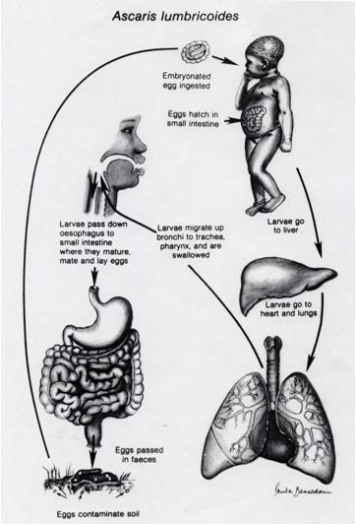
Prevention and Control
control of Nematodes= Avoid taken contaminated food and water
control of Ascaris lumbricoides =
Avoid taken contaminated
food and water
Treatment of Nematodes= Mebendazole
Treatment of Ascaris = albendazole and mebendazole

Slide 9
Clincal symptoms
Ascariasis / Roundworm Infection:
Patients who develop symtomatic ascariasis may be infected with as few as a single worm. worm may produce tissue damage as it migrates through the host. A secondary bacterial infection may also occur following worm perforation out of the intestine. Patients infected with many worms may exhibit abdominal pain, vomiting, fever, and distention. mature worms may entangle themselves into a mass that may ultimately obstruct the intestine, appendix, liver, or bile duct & intestinal complications may result in death. In addition, discomfort from adult worms exiting the body through the anus, mouth, or nose may occur. Heavily infected children who do not practice good eating habits may develop protein malnutrition
Diagnosis
Macroscopic examination by see the adults passed in stool or throat the mouth or nose.
Detection larva stage in sputum & Demonstration of eggs in feces.
egg in stool, (ovum have heavy protective tuberculated shall) is the common specimen source required to detect Treated with mebendazole.

Slide 10
Pathogenicity: The pathogenicity can be caused by either the migrating larvae or the adult worms.
A- Migration of larvae
The pathogenic effects of larval migration are due to allergic reaction and not the presence of larvae as such. Therefore, the initial exposure to larvae is usually asymptomatic, except when the larval load is very heavy But when reinfection occurs subsequently there may be intense cellular reaction to the migrating larvae
A: In the lungs
Larve destroy capillaries in the lungs, causing hemorrhage Heavy infections can lead to pools of blood which block air sace Migration of white blood cells lead to more congestion, this condition known as Ascaris pneumonitis (Loefflers pneumonia). Lung tissue destroyed and bacteria infections occur may be fatal.
B- Adult worm
Overcrowding leads to wandering.If worms migrate to stomach, acid irritates them leading to nausea, abdominal pain, and allergic reaction. Penetration the intestine can lead to peritonitis which is often fatal. If worms migrate to lung, they can cause extensive damage and possible death.

Slide 11
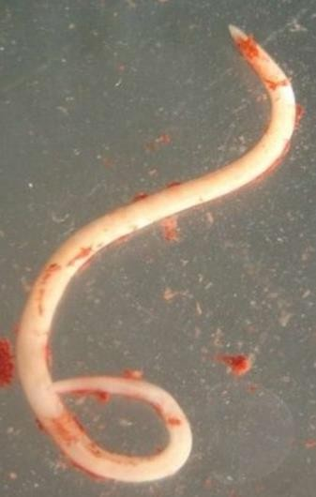
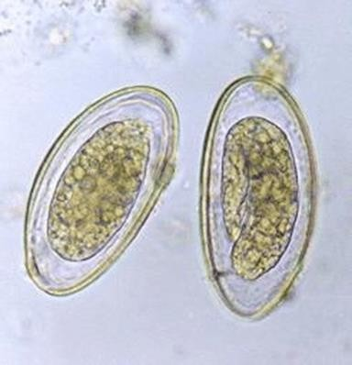
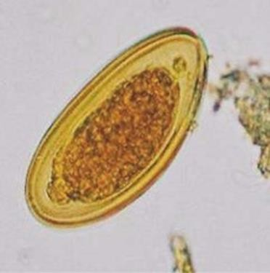
Enterobiasis (pinworm)
The most common nematode infection is Enterobies (pinworm disease or oxyuris or Seat worm ) is caused by Enterbius vermicularis, which causes anal itching it white worms visible in stool or perianal region but otherwise does little damage.
Male and female of worms mate in the ileum of the small intestine. Diagnostic stage: adults female and egg in stool (plano-covex D- Shaped unembryonated ovum, flattening on side, thin shell
Deposited on perianal skin).Ova found in dirt under the nails and in household dust.) Under cool moist conditions, the egg
remains viable for about 2 weeks.
Transmission by ingesting the egg (Contaminated fingers)

Slide 12
Clinical features of Enterobiasis:
About 3rd infection are asymptomatic
External autoinfection from anus to mouth: when female lay eggs on the perianal area with fingers leads to the deposition of eggs under nails.
Internal autoinfection from anus to colon: when eggs laid on the perianal skin immediately hatch into infective stage of larva then migration through the anus and develops into worms in the colon.
-occurs mostly in children and most common in female than in males. when female crawls out of the anus to lay eggs, this leads to scratching and Itching around the anal and perianal region of the skin anus.
The worm crawling into the vulva and vagina causes irritation and a mucous discharge. It may migrate up to the uterus, and fallopian tubes leading sleeping disturbances.
Treatment = mebendazole

Slide 13
Life Cycle
E. vermicularis is monoxenous, passing its entire life cycle in the human host. It has no intermediate host.
The male is seldom seen as it does not migrate. It usually dies after mating and is passed in the feces.
The gravid female migrates down the colon to the rectum at night and crawls about on the perineal skin to lay its sticky eggs. The worm may retreat into the anal canal and
come out again to lay more eggs.
A single worm lays from 5000 to 17,000 eggs, when the eggs are all laid, the worm dies or gets crushed by the host during scratching, the eggs, however, are only
infrequently found in feces.
When eggs containing infective larvae are swallowed, they hatch out in the intestine. They moult in the ileum and enter the caecum, where they mature into adults.
It takes from 2 weeks to 2 months from the time the eggs are ingested, to the development of the gravid female, ready to lay eggs.

Slide 14
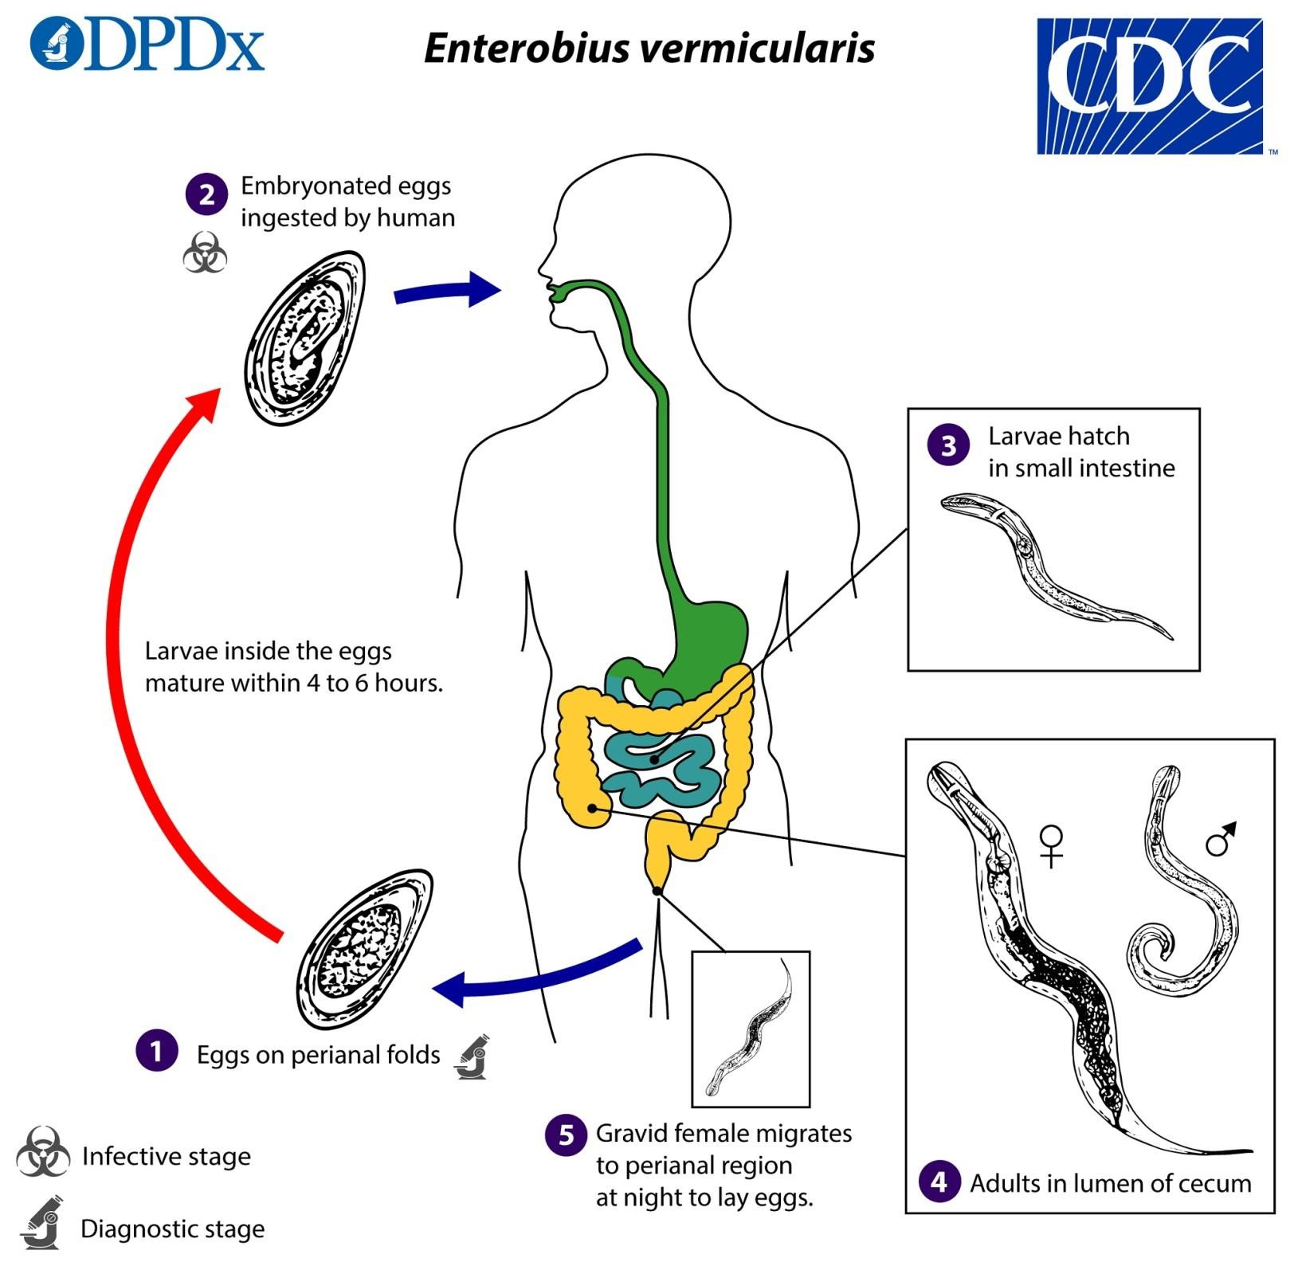

Slide 15
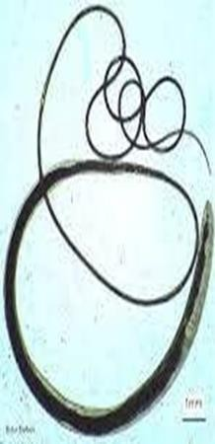
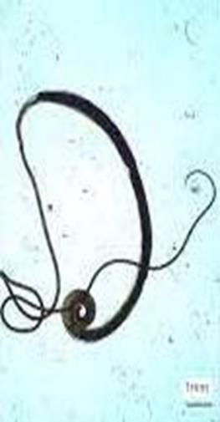
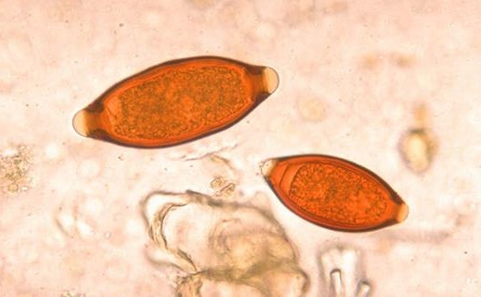



Trichuris trichiura (Whip worm)
Morphology The worm is flesh coloured.The name Trichuris means a hair- like tail (Greek trichos—hair, oura—tail).
The infection is usually asymptomatic; worms are found on the rectal mucosa causes abdominal pain, dysentery diarrhea, and rectal prolapsed can occur. The disease transmitted by ingesting the egg.
Diagnosis egg in stool, (Egg is barrel shaped with bipolar or double plug or 2 cell stage, Undeveloped cell, embryonated, American foot ball shape)
Adult habitat: cecum, appendix, colon and rectum.

Slide 16
Life cycle
The entire life cycle can be passed in one host, from the ingested infective egg to the development of the adults and the release of their eggs in faeces.
the egg has to undergo development in the soil and then infect another person. Humans are the
only natural host for T. trichiura, but morphologically similar worms are found to infect pigs
and some monkeys.
The adult worms are found attached to the wall of the caecum and appendix.
The fertilized female lays about 5000 eggs per day. The egg passed in feces contains an unsegmented ovum. At this stage it is not infective for humans. The egg undergoes development in soil, optimally under warm, moist, shady conditions, when the infective rhabditiform larva develops within the egg in 3 to 4 weeks.
Infection occurs when the mature embryonated eggs containing the infective larvae are swallowed in food or water. The eggs hatch in the small intestine.
In about 2 to 3 months they become mature adults and embedded on the caecal wall, with the
thread-like anterior portion and thick posterior end . Eggs start appearing in faeces usually about 3 months after infection

Slide 17
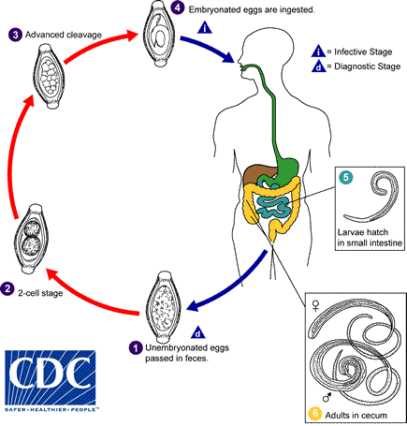

Slide 18
Pathogenesis and Clinical Features
The name of disease is trichuriasis or trichocephaliasis, it is asymptomatic except when the worm load is heavy. Disease may result either due to mechanical effects or allergic reaction.
The blood loss is about 0.005 ml per worm per day. Over a period of time this may lead to anaemia and malnutrition.
Mechanical blockage of the appendiceal lumen by masses of whipworms may cause acute appendicitis.
Mucus diarrhea, chronic dysentery and abdominal pain are frequently seen in such cases. Some patients, particularly young children may
develop rectal prolapse.
Treated with mebendazole
.

Slide 19
Anchylostoma (Hook worm) & Necator American
This disease is caused by Anchylostoma duodenale. The worm attaches to the intestinal mucosa, causing anorexia, ulcer-like symptoms, and chronic intestinal blood loss, leading to Iron deficiency anemia due to parasite sucks and ingests blood. This disease is transmitted through directed skin penetration by Filariform larvae found in soil.
Diagnosis egg in stool (thin shall, 4-8 cell stage). Reservoir host: dogs
Morphology
They are stout cylindrical worms, pale pink or greyish white, but may appear reddish brown due to ingested blood.
Habitat
The adult worms live in the small intestines of infected persons, mostly in the
jejunum, less often in the—duodenum and infrequently in the ileum.
Transmission
When a person walks barefooted on soil containing the filariform larvae they penetrate the skin & enter the subcutaneous tissue. The common sites of entry are the skin between the toes . Rarely infection may take place by the oral route, the filariform larvae being carried on contaminated vegetables or fruits

Slide 20
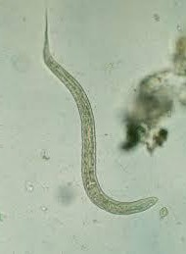
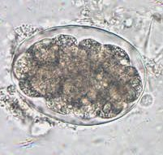
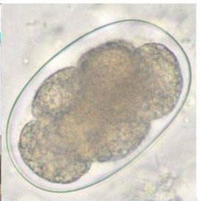
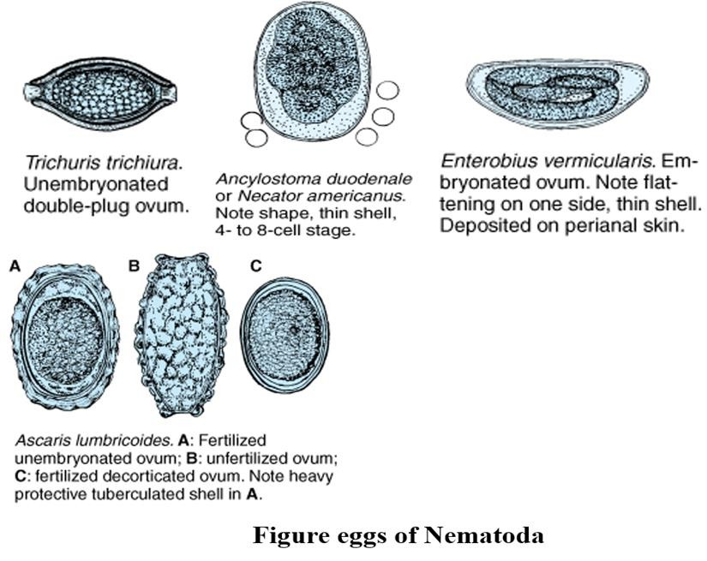
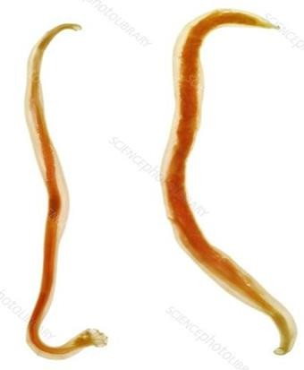
Eggs
The eggs are oval. When released by the adult worm in the intestine, the egg contains an unsegmented ovum
Eggs
Filariform larvae
adult worm

Slide 21
Life Cycle
Humans are the only natural host. Eggs freshly passed in feces are not infective for humans. When deposited in the soil, the embryo develops inside the eggs. In about 2 days, a rhabditiform larva, hatches out of the egg. It feeds on bacteria and other organic matter in the soil, grows in size and moults twice, on the 3rd and 5th days after hatching to become the third-stage infective filariform larva, with a sharp pointed tail. The filariform larvae are non-feeding. They can live in the soil, grass or other vegetation for about 5 weeks, waiting for their hosts. When a person walks barefooted on soil containing the filariform larvae they penetrate the skin and enter the subcutaneous tissue.
In the subcutaneous tissue the larvae enter the venues and are carried in circulation to the right heart and to the lungs. In the lungs. they break out of the capillaries to reach the alveoli, from where they migrate up the respiratory tract to the epiglottis. They crawl over the epiglottis to the pharynx and are swallowed.
During migration or on reaching the jejunum, they moult and develop a temporary buccal capsule by which
they get attached to the gut mucosa. They feed and grow in size, undergo a fourth and final moulting, develop the buccal capsule and grow into adults. It takes usually about 6 weeks to 6 months from the time of infection for the adult worms to become sexually mature and start laying eggs.
Rarely infection may take place by the oral route, the filariform larvae being carried on contaminated
vegetables or fruits. The larvae may penetrate the buccal mucosa to reach the venous circulation and complete their migration via the lungs and causes Anemia .

Slide 22
hookworm infection
If you have a hookworm infection that lasts a long time. Anemia is characterized by a low red blood cell count, which can contribute to heart failure in severe cases. It is more at risk of having severe anemia.
Other complications that can develop from these infections include nutritional deficiencies and a condition known as ascites. This condition is caused by serious protein loss and results in fluid build up in the abdomen. Children who have frequent hookworm infections can experience slow growth and mental development from losing iron and protein.
Laboratory diagnosis
Demonstration of the eggs in faeces by direct microscopy or by concentration methods is the diagnostic test. In stool samples examined 24 hours or more after collection, the eggs may have hatched and rhabditiform larvae may be present.

Slide 23
Life cycle of Anchylostoma duodenale
Eggs rhabditiform larva filariform larvae adult worms
==================================================
filariform larvae (infective stages ) penetration the skin
blood heart lung into the alveoli
into the bronchioles the larvae are transferred
through coughing into the pharynx then swallowed returned to the intestine adult worms
eggs in the feces is ( diagnostic stage ) .

Slide 24
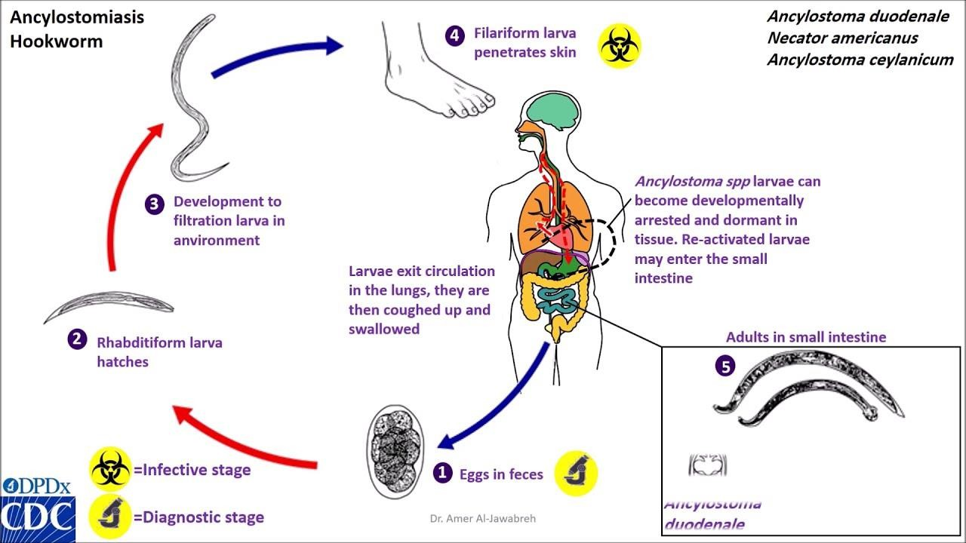

Slide 25
Other worm causes infections
Onchocerca volvulus is a parasitic worm that causes river blindness
Wuchereria bancrofti is a human parasitic worm that causes elephantiasis, and the disease is transmitted by mosquitoes
The Chinese liver worm (Clonorchis sinensis) infects the human's bile duct
liver fluke causes jaundice (Fasciola hepatica and Clonorchis sinensis)
4 . Babesia like Plasmodium causes Anemia
5. Paragonimus westermaniis Japanese lung fluke

