Slide 1






Slide 2
Class: Sporozoa obligatory intracellular protozoa
Plasmodium = intermediated host= human & definitive host = mosquito of Anopheles
Toxoplasma = intermediated host= human and definitive host = cat
A:Malaria or black water fever (Plasmodium species)
Plasmodium falciparum causes malignant tertian malaria incubation period 7-10
P. malariae: causes Quartan malaria, incubation period 18-40
P. vivax: causes benign tertian malaria, incubation period 10-17 days
P. ovale: causes benign tertian malaria, incubation period 10-17 days
Malaria is an acute infectious disease of the blood, P. falciparum accounts for
some 50 % of all malaria cases, and P. vivax for 18 %of malarial cases.
Sporozoans reproduce asexually in human cells by a process called schizogony, in which multiple nuclear divisions are followed by envelopment of the nuclei by cell walls producing merozoites (ring stage). These, in turn, become trophozoites. Sexual reproduction occurs in the Anopheles, where new spores (sporozoites) are formed process called sporogony.

Slide 3

Table ( 1) : Plasmodium vivax :Typical characteristics ( based on Giemsa stain ).
Appearance of infected RBCs | Enlarged , distorted
Ring form (merozoites) | Delicate cytoplasmic ring measuring 1/3 RBC diameter Single chromatin dot, Ring surrounds a vacuole
Developing trophozoite | Irregular ameboid appearance Ring remnants common Brown pigment
Immature schizout | Multiple chromatin bodies Brown pigment
Mature schizont | 12 to 24 merozoites occupying majority of the RBCs Merozoites surrounded by cytoplasmic material Brown pigment may be present
Microgametocyte | Large pink to purple chromatin mass surrounded by colorless to pale halo
Macrogametocyte | Round to oval cytoplasm , Eccentric chromatin mass Delicate light – brown pigment present throughout cell

Slide 4
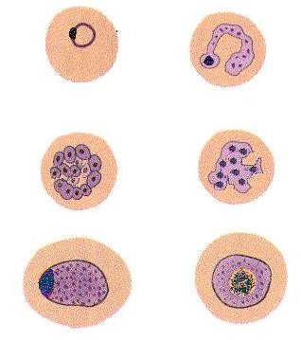
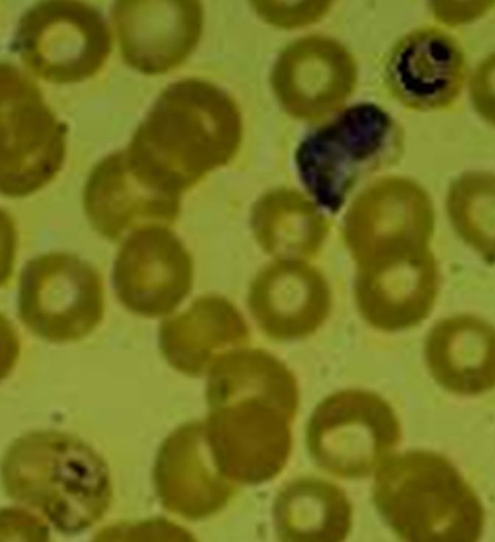
Ring form Early trophozoite,
merozoites
Developing trophozoite
Mature schizonte
Immature schizonte
Microgametocyte ♂
Macrogametocyte♀

Slide 5
Mode of infection of plasmodial parasite
Insect bite of a female Anopheles mosquito
Blood transfusion from infected donors.
Organ transplantation.
Congenitally and trasplacentally.
Needle stick injury: In case of drugs addiction.
Important properties
There are two cycles in the life cycle:
Schizogony (asexually in human; intermediated host),
sporogony (Sexual reproduction in the Anopheles; definitive host)
Sporozoites (infective stage)
pathogenic stage: all liver and RBCS stages.
  Diagnostic stage: All intracellular RBCS STAGES (ring,macrogamete and
microgamete).
Habitat: 1-intra-Liver cells 2- Intra-RBCS

Slide 6
Life cycle
Members of the mosquito genus Anopheles are responsible for the transmissions of malaria to humans via a blood meal. These vector transfers malarial sporozoites form its salivary gland into the human wound. Following entrance into the body, the sporozoites are carried through the preipheral blood to the parenchymal cells of the liver. It is here where schizogony occurs. This exoerythrocytic cycle of growth and reproduction lasts from 8 to 25 days, depending on the specific Plasmodium species involved. The infected liver cells eventually rupture and introduce merozoites into the circulating blood. All clinical manifestation in malaria due to the host reaction with parasite products from (Erythrocytes schizogony( trophozoite forms of plasmodium present inside
the liver cells
These migrating merozoites target age and – size – specific RBCs to invade, and upon doing so initiate the erythrocytic cycle of growth .it is in this asexual phase that the plasmodia feed on hemoglobin and pass through the numerous stages of growth, including the six morphologic forms previously described. Upon formation of the merozoites, one of three paths may take place. Some of the RBCs infected with merozoites rupture, releasing these forms to target and infect new RBCs, and this part of the cycle repeats itself. Numerous erythrocytic cycles may occur.

Slide 7
However, other infected RBCs containing merozoites develop into microgametocytes and macrogametocytes. Still others are destroyed by the immune system of otherwise healthy individual.
Transmission of malaria back into the vector occur when the mosquito ingests mature male (micro) and female (macro) gametocytes during a blood meal, thus initiating the sexual cycle of growth. a male and female gametocyte unite in the mosquito’s stomach and form a zygote.the zygote becomes elongated and active and is called Ookinete. matures into an oocyst . upon complete maturation , the oocyst ruptures and releases numerous sporozoites , which migrate into salivary gland of the mosquito and are ready to infect another unsuspecting human .

Slide 8
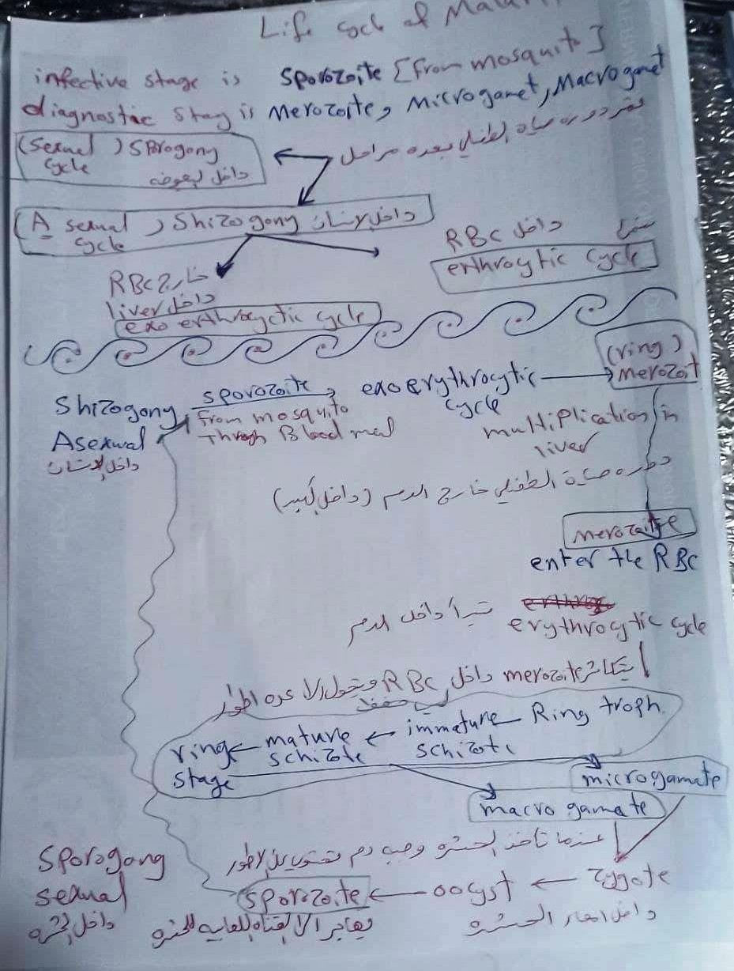

Slide 9
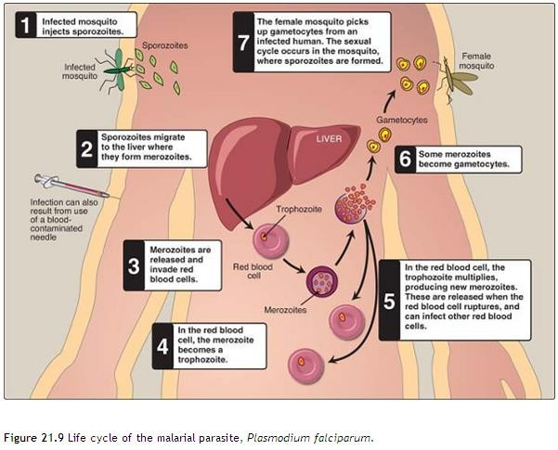

Slide 10
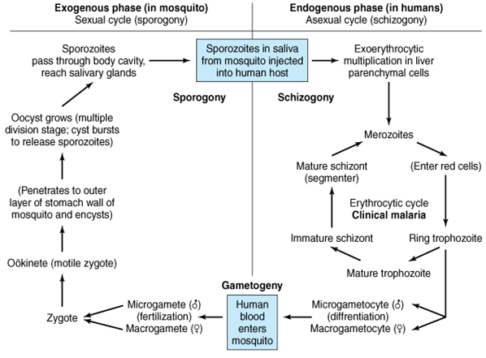

Slide 11
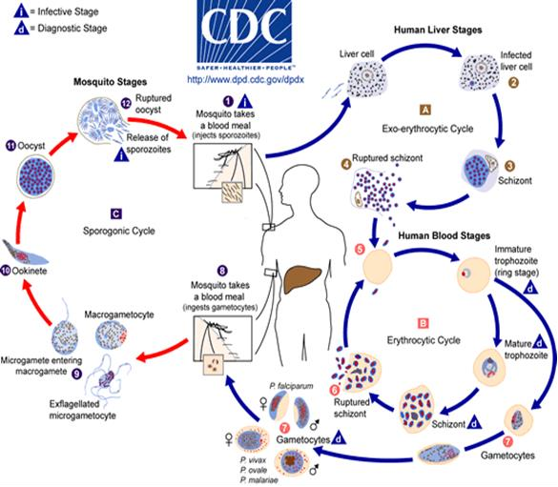

Slide 12
Pathology and clinical significance:
Plasmodium sporozoites are injected into the bloodstream, where they rapidly migrate to the liver. There they form cyst-like structures containing thousands of merozoites. Upon release, the merozoites invade red blood cells, using hemoglobin as a nutrient. Eventually, the infected red cells rupture, releasing merozoites that can invade RBC. If large numbers of red cells rupture at roughly the same time, a Febrile paroxysm of fever can result from the massive release of toxic substances.
P.falciparum is considered to be the one causing a greater number of
mortality rates throughout the world, it is the most dangerous plasmodial
species. It can cause a rapidly fulminating disease,
characterized by persistent high fever and orthostatic hypotension. Infection can lead to capillary obstruction and death if treatment is not prompt.
-Destruction of red blood cells by release of merozoites & the action of the
spleen to first sequester the infected red cells & then to lyse them.
- The enlarged spleen is due to congestion with erythrocytes, coupled with hyperplasia of lymphocytes & macrophages.

Slide 13
- P. malariae, P. vivax, and P. ovale cause milder forms of the disease, because they invade either young or old red cells, but not both. This is in contrast to P. falciparum, which invades cells of all ages of RBC. malarial is a common and serious disease, causing 300 million cases per year, with a death rate of about one percent.
-Malaria caused by P. falciparum is more severe than that caused by other plasmodia:
It is characterized by infection of more red cells than the other species & by occlusion of the capillaries with aggregates of parasitized red cells. This is lead to hemorrhage and necrosis particularly in the brain (cerebral malaria).
P. falciparum causes a high level of parasitemia, because it can infect red
cells of all ages.
Extensive hemolysis and kidney damage occur, with resulting hemoglobinuria. The dark color of the patient’s urine has given rise to the term (black water fever).
The hemoglobinuria can lead to acute renal failure.

Slide 14
Clinical symptoms of Malaria. The symptoms of Patients begin after the incubation period from the first exposure. These symptoms usually seen in cases of the flu, including nausea, vomiting, headache, muscle pains, Abdominal pain, Splenomegaly & hepatomegaly, Myalgias & Arthralgias.
As infected RBCs begin to rupture, the resulting merozoites, hemoglobin, and toxic cellular was products initiate the first in a series of paroxysms. These paroxysms typically occur every 48 hours. The main symptoms is Anemia and High-grade fever (reach 41 C), and chills are the most common in people who are infected with malaria. The timing of the fever cycle is 72 h. for P. malariae & 48 h. for the other plasmodia Types
After infection liver and RBC, typical picture of malaria is 1- Febrile paroxysm. Has three stages
Cold stage: it lasts for 15–60 minutes, the patient has intense cold and
uncontrolled shivering
Hot stage: it lasts for 2-6 hrs. the temperature is 41°C or higher
Sweating: when the patient goes in profuse sweat. The temperature drops rapidly & the patient usually falls into deep sleep, to wake up refreshed

Slide 15
Lab. Diagnosis of Plasmodium
Detection of parasite in intracellular of RBC
-Microscopic examination of blood, by thick and thin Giemsa-stained smears. Thick smear to screen for the presence of organisms during febrile paroxysm
- PCR-based test for Plasmodium nucleic acids
-Serologic procedures (ELISA test) for a protein specific for P. falciparum.
Prevention and Control of Plasmodium = the vector control, and avoidance anopheles mosquitoes by using insecticide
Avoidance of exposure to mosquitoes at there peak feeding time (usually dusk to dawn). Insect repellents, insecticide, impregnated bed or Widespread use of bed nets & suitable clothing.
Treatment of Plasmodium
Drug treatment depends on the stage of infection. Primaquine is effective against the exoerythrocytic forms in the liver and bloodstream and also against the gametocytic form, but inactive against parasites in red blood cells. Therefore, for the erythrocytic form, primaquine is administered in conjunction with a blood schizontocide such as chloroquine.
-chloroquine-resistant strains of P. falciparum either Mefloquine or combination of quinine & doxycycline is used.

Slide 16
B: Toxoplasmosis (Toxoplasma gondii)
Toxoplasma gondii is obligatory intracellular, T. gondii is found inside the reticuloendothelial cells.
Mode of infection
Humans can become infected by the accidental ingestion of food, water contain mature oocysts present in cat feces, by eating raw or undercooked meat containing tissue cyst, or fingers contaminated with cat feces.
congenitally from an infected mother (Intrauterine infection from mother to fetus)
from Blood transfusion or transplantation from infected donors.
-Intermediate host: human (Accidental host ), cattle , lamb and pork, rodents.
-Final host or definitive hosts : cats (sexual cycle
-Infective stage: fecal oocyst from cats , or tissue cyst from cattle or Tachyzoite → from pregnant women

Slide 17
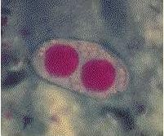
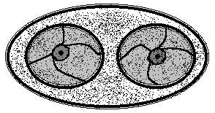
Table ( 2 ): Toxoplasma gondii oocyst : Typical characteristics
Size range | 25 to 35 μm long , 10 to 15 μm wide
Appearance | Transparent
Shape | Oval
Other features | Young oocyst contains two sporoblasts. Mature oocyst contains two sporocysts, each containing four sporozoites.

Slide 18

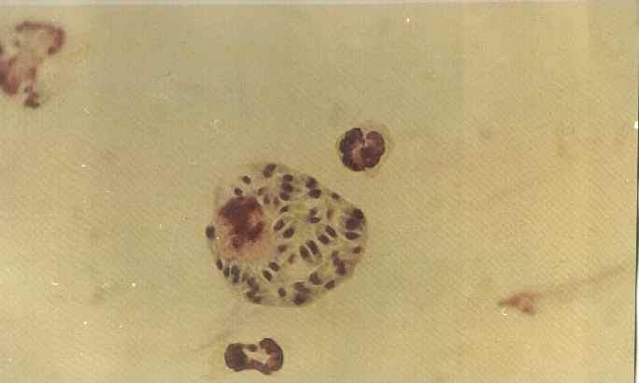
There are two kinds of Toxoplasma trophozoites (tachyzoites & bradyzoites) Table ( 3 ): Toxoplasma gondii tachyzoite : Typical characteristics
General comment | Actively multiplying morphologic form (multiply rapidly)
Size | 3 to 7 μm by 2 to 4 μm
Shape | Crescent shaped , often more rounded one end
Number of nucleui | One
Other features | Contains a variety of organelles that are not readily visible (intracellular trophozoite) proliferating tachyzoites within a host cell are known as pseudocyst
Sporozoites

Slide 19
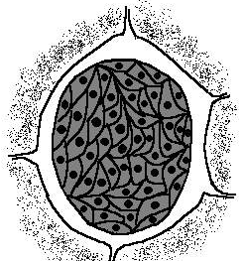
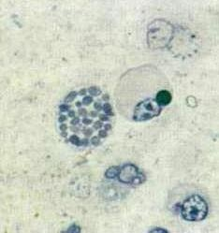
Table ( 4 ): Toxoplasma gondii Bradyzoite : Typical characteristics
General comment | Slow - growing morphologic form (multiply slowly)
Size | Smaller than tachyzoites
Physical appearance | Similar to that of the tachyzoites
Number of nucleui | One
Other features | Hundreds to thousands of bradyzoites enclose themselves to form a cyst that may measure 12 to 100 μm in diameter Young tissue cysts contain only 2 bradyzoites, while the older ones may contain hundreds of bradyzoites.

Slide 20
Pathogenicity and Clinical symptoms of Toxoplasmosis
Infections of normal human hosts are common and usually asymptomatic.
After infection of the intestinal epithelium, the cysts spread to other organs, especially the brain, lungs, liver, muscle, and eyes.
Tachyzoites directly destroy the cells, particularly parenchymal and reticuloendothelial cells, whereas bradyzoites released from ruptured tissue cysts cause local inflammation with blockage of blood vessels and necrosis. Most common recognized finding is cervical lymphadenopathy, usually painless and fever, Single or multiple enlarged nodes may persist at one site or there may be involvement of many scattered nodes.
the fulminating fatal infections serious consequences are limited to:
Pregnant women (congenital infections)
Immunodeficient or in debilitated or in immunocompromised individuals. they can causes very severe Infections in these patient such as encephalopathy,
meningoencephalitis, or cerebral mass lesions.
Underlying conditions associated with toxoplasmosis in the compromised host include various types of malignancies (such as Hodgkin’s disease, non- Hodgkin’s lymphomas , leukemia, or tumors), collagen vascular disease, organ transplantation, and AIDS. T. gondii is the most common cause of secondary CNS infection in patients with AIDS and intracerebral mass lesions in patients

Slide 21
Congenital infection:
Mean the mothers are infected during pregnancy that transported to the fetus. In the fetus, the infection clears from visceral tissues and may localize in the central nervous system. Infections in the first trimester and early second trimester may lead to spontaneous abortion
Congenital infection stillbirths leads to
1-Hydrocephalus & Microcephaly
3-Convulsion (Seizure)
2-Chorioretinitis
4. blindness, and hearing loss
5-calcium in the brain (Cerebral calcification) 6.psychomotor disturbances
lymphadenopathy, that involved are the deep cervical lymph nodes
with fever, malaise, headache, muscle pain, fatigue and sore throat.
Rarely occure pneumonitis, myocarditis and meningoencephalitis, central nervous system disorders which may be fatal in some cases and disabilities later in life.
Lumps (cysts) of the organism are carried from cat feces to humans or by human ingestion of inadequately cooked meat containing the lumps.

Slide 22
Life cycle
-the oocyst is formed by sexual reproduction (gametogony) occurs in cat which are the definitive host.
-tachyzoites and tissue cysts represent stages of asexual multiplication (schizogony) occurs in humans, mice, rats, sheep, cattle, pigs, and certain birds, which are the intermediate hosts
Upon ingestion of Toxoplasma cysts present in the brain or muscle tissue of contaminated mice or rats, the enclosed bradyzoites are released in the cat and quickly transform into tachyzoites. Both sexual and asexual reproduction occurs in the gut of the cat. The sexual cycle results in the production of immature oocysts, which are ultimately shed in the stool. The oocysts complete their maturation in the outside environment, a process that typically takes from 1 to 5 days. Rodents, particularly mice and rats, serve as the intermediate hosts, ingesting the infected mature Toxoplasma oocysts while foraging for food. The sporozoites emerge from the mature oocyst and rapidly convert into actively growing tachyzoites in the intestinal epithelium of the rodent.

Slide 23
enteric cycle
occurs in domestic cat. It includes both schizogony and gametogony within the
mucosal epithelial cells of the small intestine. Cat acquires infection by ingestion of any of the three infectious stages (tachyzoites and bradyzoites from tissue cysts in the flesh of other animals (rodents), and sporozoites from oocysts in cat feces, these invade mucosal cells of cat’s small intestine in which they undergo several cycles of asexual generation before the sexual cycle begins with the formation male and female gametocytes which gives rise to male and female gametes respectively. After sexual fertilization of male and female gametes, oocysts develop, exit from host cell into the gut lumen, and pass out in the feces, this oocyst contains a sporoblast which becomes infectious only after development in soil for 3–4 days by the sporoblast divides then become sporocyst by acquiring a cyst wall. The mature oocyst containing eight sporozoites is the infective form of the parasite. It can remain infective in the moist soil for about one year. When ingested, it can either repeat its cycle in a cat or if ingested by rodent or other mammal, including humans or certain birds.

Slide 24
Exoenteric cycle
occurs in humans, mice, rats, sheep, cattle, pigs, and certain birds, which are the intermediate hosts. Man acquires infection by:
ingestion of food and drinks contaminated with cat’s feces containing sporulated oocysts.
by ingestion of undercooked meat containing tissue cysts. In the duodenum the oocysts release sporozoites, and tissue cysts release bradyzoites.
These pass through the gut wall, circulate in the body, and invade various cells,
especially macrophages, where they form tachyzoites, multiply, break out and spread the infection to other organs. they enter into the neural and muscular tissues, such as the brain, eye, and skeletal and cardiac muscles where they multiply slowly (as bradyzoites) to form tissue cysts, initiating chronic stage of the disease. Tissue cysts may also develop in other organs such as lungs, liver and kidneys. Tissue cysts, when ingested by both definitive and intermediate hosts, are infective. Human infection may also be acquired by: organ transplantation or blood transfusion, transplacental transmission, and
accidental inoculation of tachyzoites. Maternal infection rate during the
reproductive years is estimated to be between 3- 5%

Slide 25
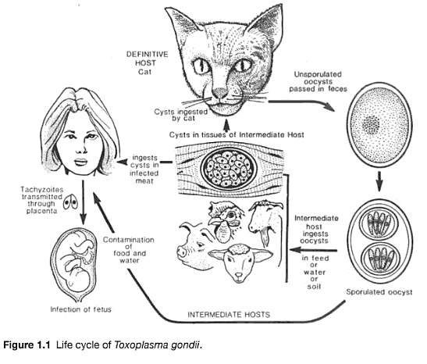

Slide 26
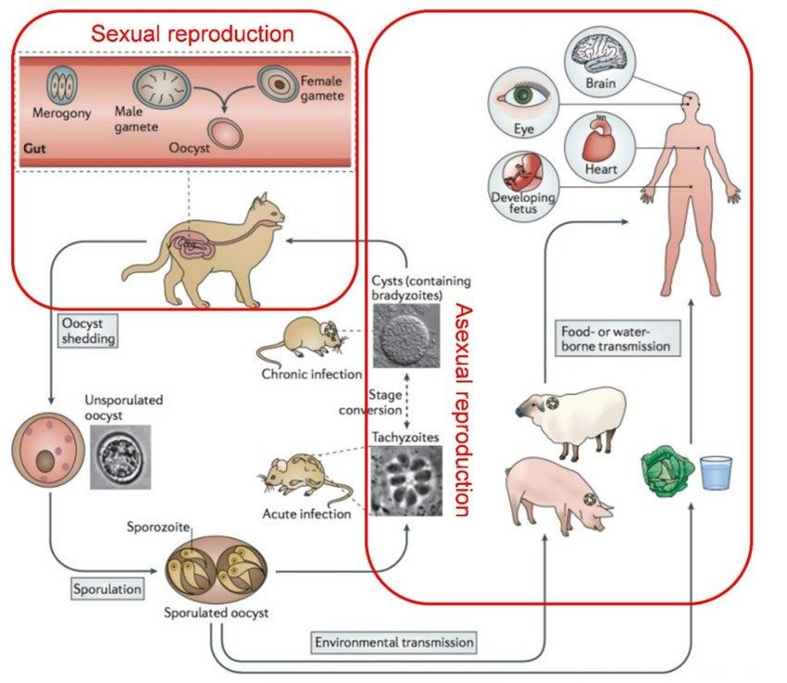

Slide 27
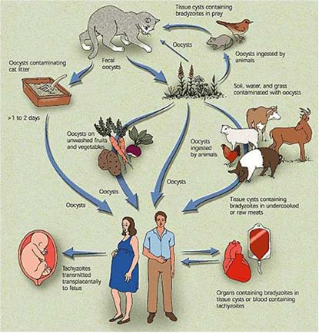

Slide 28
Diagnosis and treatment:
The initial diagnostic approach
involves detection of
be
parasites in tissue specimens, but this may
often
inconclusive. With the recent availability of commercial diagnostic kits, serologic tests to identify toxoplasma are now routinely used. These include tests for Toxoplasma- specific IgG and IgM.
T. gondii can also be isolated by inoculation of tissue culture.
Toxoplasma antigendetectionin blood or CSF may be demonstrated by ELISA.
Polymerase chain reaction (PCR). Toxoplasma DNA can be detected
in the blood and CSF by PCR
Treatment of Toxoplasma gondii = pyrimethamine, combination with sulfadiazine
For pregnant woman spiramycin is a successful alternative drug for toxoplasmosis

Slide 29
Control and Prevention
control of Toxoplasma gondii
Avoidance of human contact, particularly of pregnant women with cat feces and uncooked meat.
Pregnant women are advised to avoid cat litter. Management to control and handle uncooked and undercooked meat carefully. • Wearing gloves when handling soil. • Wash hands with soap and water after outdoor activities. • when preparing raw meat, wash any cutting boards, sinks, knives that touched the raw meat thoroughly with soap and hot water to avoid contaminating other foods.

