Slide 1




L:4 Parasitology
Helminths or Worm (Metazoa)
prof. Dr. Nada Khazal

Slide 2
Helminthes
Phylum:
Cestodaes: Platyhelminthes (flatworms) (Tape Worm)
Trematodes ( Flukes)
Nematodes (Roundworms)
Cestodaes (Tape Worm)
  Taenia saginata=Beef Tape Warm
  Taenia solium=Pork TW
  Hymenolepis nana =Dwarf TW
  Diphyllobotherium latum =Broad fish TW
  Echinococcus granulosis=Dog TW
    A) Echinococcus vogeli :polycystic disease
B) Echinococcus multilocularis :alveolar echinococcosis, or multilocular hydatid cyst.

Slide 3
General properties of Helminthes
Helminthes: are multicellular and contain internal organ system.
All cestode helminths are Monoecious or hermaphrodites are not Separated sexes (Both male and female reproductive organs at the same mature segment)
All cestoda have stages: ovum, larva (juvenile) and adult.
They lack a digestive system and absorb soluble nutrient directly through their
cuticle, causing mechanical blockage of the intestine.
cestodes segmented that primarily intestinal parasite. Adult worm consist of :
  head or scolex, with hooks and sucker that function to attach the worm to the intestinal wall.
  neck is very short after scolex, & the region of segment proliferation and
production of segments
  body segment or strobila (proglottids). Three types of segments:
    Immature segments: the beginning of segmentsafter the neck.
    Mature segment: has both male and female reproductive organs.
    Gravid segment: has uterus contain fertile eggs, these pass out of the body in the stool. Mature egg has internal embryo is called oncospheres (hexacanth embryos) which contain three pairs of hooks (Six hooks).
cestodes utilize more than one host.
The infection occur in human during ingestion the larva in mediated host in
most parasites OR may be occur ingestion the egg.
The diseases transmitted from animals to human, are called Zoonosis diseases

Slide 4
1.Taenia saginata=Beef Tape Warm
Adult worm develop in the small intestine, in human measure about 5 m
and the body consist of the following:
scolex which is rounded in shape & have 4 sucker, neck, immature segment which the genital organ are not develop, mature contain full set of sexual male & female organ , gravid segment contain uterus with lateral arms about (15-30 arm ) & fertile eggs. Eggs of this worm are spherical in shape & consist of 3 hexacanth embryo and has three paris of hooklet.
T. saginata causes Taeniasis; this disease caused by the larval form of T.saginata. This disease is transmitted by larvae in undercooked or raw beef (mediated host is beef ), most infected individual are asymptomatic.
-Infective stage is larva (cysticercus bovis)
-Diagnostic stage is eggs or proglottides (gravid segment) in stool
-Pathogenic stage is Adult Worm

Slide 5
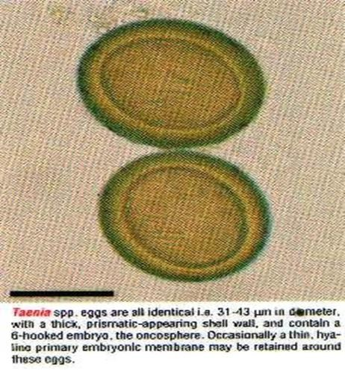
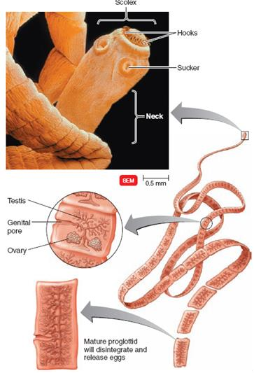
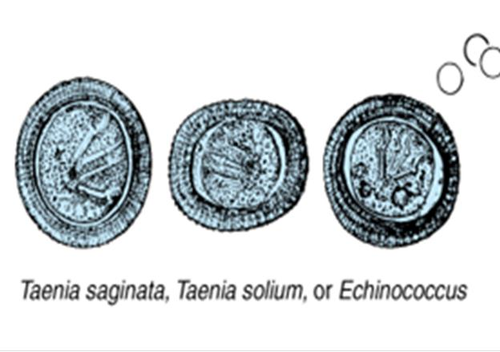

Slide 6
Life cycle
Infection with Taenia saginata occurs following ingestion of raw / undercooked cow meat contaminated with a cysticercus larva. Scolex attachment to the intestinal mucosa occurs in the small intestine where maturation into an adult worm occurs. The resulting adult multiplies , producing numerous eggs, some of which may be passed into the feces. These eggs are then consumed by the proper animal species (beef), where the onchosphere hatches. The onchosphere then migrates via the blood to the animal tissue and converts into the infective cysticercus larva stage. A new cycle is initiated upon human ingestion of the infected animal meat.
Clinical symptoms of Taeniasis
Nondescript symptoms, such as diarrhea, abdominal pain, change in appetite, and slight weight loss, may be experienced by Taenia- infected patients. in addition , symptoms including dizziness, vomiting, and nausea may also develop in such patients. Laboratory tests often reveal the presence of a moderate Eosinophilia. The prognosis is usually good .

Slide 7
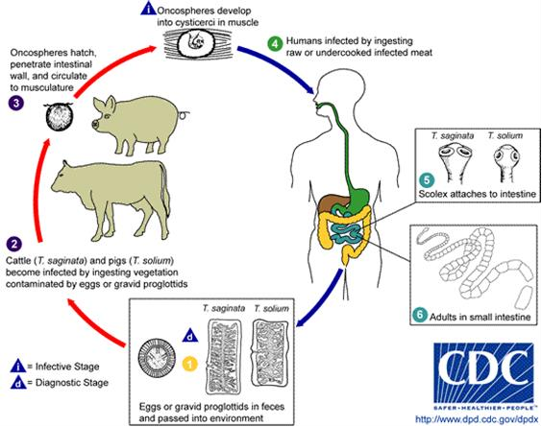

Slide 8
2.Taenia solium=Pork TW
Adult worm develop in the middle of small intestine, in human measure about 3 m and the body consist of the following: scolex which is rounded in shape & have 4 sucker ,also has rostellum and contain double circle and small hooks. The neck, immature, mature segment, & eggs are same in T. saginata , while gravid segment contain uterus with lateral arms about (7-15arm ) & fertile eggs. T. solium causes :
A: Taeniasis; this disease caused by the larval form of T. solium. this disease is transmitted by larvae in undercooked or raw pork (mediated host). This worm causes diarrhea, most infected individual are asymptomatic. Infective stage is cysticercus cellulosae in the muscle of different organs of pigs and human.
Taeniasis dignosed by detection of proglottides or egg in stool.
B:cysticercosis this disease follows by ingestion of T. solium eggs from human feces & produces infection in the brain and eyes.
Intermediate host: human (accidently) and pigs.
Final host is: human only.
  Human may be as intermediate and final host
Habitat: adult worm in the small intestine of human.

Slide 9
Life cycle
Infection with taenia solium occurs following ingestion of raw / undercooked pork meat contaminated with a cysticercus larva. Scolex attachment to the intestinal mucosa occurs in the small intestine where maturation into an adult worm occurs. The resulting adult multiplies , producing numerous eggs, some of which may be passed into the feces. These eggs are then consumed by the proper animal species (pig), where the onchosphere hatches. The onchosphere then migrates via the blood to the animal tissue and converts into the infective cysticercus larva stage . a new cycle is initiated upon human ingestion of the infected animal meat.
-Infective stage is larva(cysticercus cellulosae ) & egg
-Diagnostic stage is eggs or segment) in stool
-Pathogenic stage is Adult Worm
proglottides (gravid

Slide 10
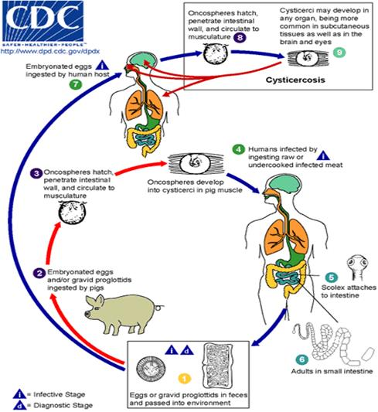

Slide 11
-Taeniasis / pork Tape worm infection
Clinical symptoms
Nondescript symptoms, such as diarrhea, abdominal pain, change in appetite, and slight weight loss , may be experienced by Taenia- infected patients . in addition, symptoms including dizziness, vomiting, and nausea.
-cysticercosis
Taenia solium is produced neurocysticercosis after ingestion of the egg.
It is more dangerous because of human is the intermediate host
In human larvae can cause serous symptoms if they localize in the brain, resulting in
Neurocysticercosis
The severity of cysticercosis depends on location, size and number of larvae in tissues, as well as the host immune response.
Cysticercosis in the brain causes headache, vomiting, and seizures.
Cysticercosis in the eyes can appear as uveitis or retinitis, or the larvae can be visualized floating in the vitreous.
Subcutaneous nodules containing cysticerci commonly occur.
Cysts also are commonly found in skeletal muscle.
Laboratory tests often reveal the presence of a moderate Eosinophilia .

Slide 12
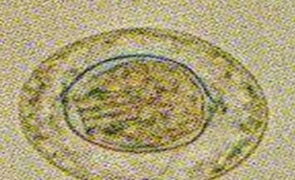
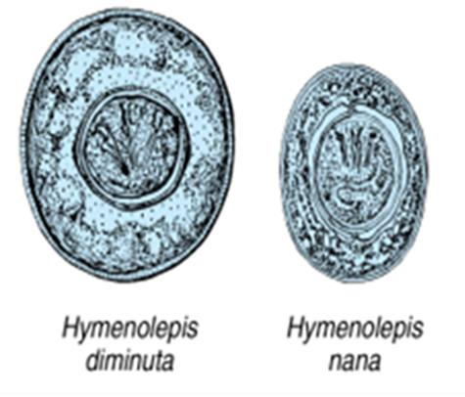
3.Hymenolepis nana =Dwarf TW, tiny intestinal tapeworm
Adult worm is smallest tape worm of man it has length about 25-40 mm. Scolex contain 4 sucker with short rostellum armed with circle of hook. Eggs are oval in shape with hexanth embryo, 3 pairs of hooklet and has polar thinking protect the embryo. H. nana causes Hymenolepiasis
-Life cycle: is direct no intermediate host.
-Infective stage to human: ova by food and water.
-Diagnostic stage to human by ova and gravid segment in stool
Mode of infection
Contaminated food and water with ova or
Auto infection, ova remains and hatches in the intestine.
  Habitat: Adult worm in the small intestine of human.
Symptoms: Rare symptoms include anorexia, vomiting nausea and behavioral
disturbances

Slide 13
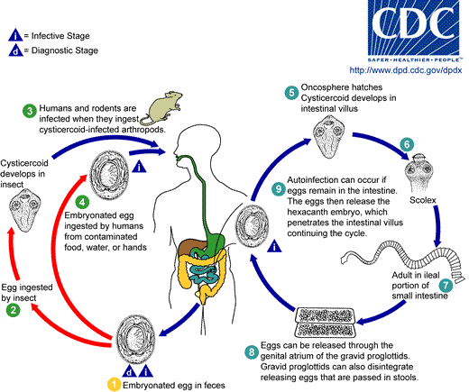

Slide 14
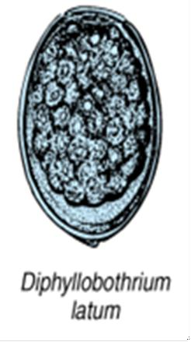
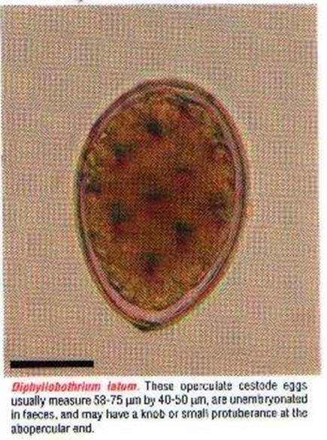
4.Diphyllobotherium latum =Broad fish TW
The length of D.latum about 10m-15m . scolex is spatulate shape ,it have contain 2 long sucking groove.
eggs of D.latum are oval shape & have opericulum at anterior end & have knob in posterior end.
D.latum causes Diphyllobotheriasis, that transmitted by larvae in undercooked or raw fish.
-Infective stage is larva
-Diagnostic stage is eggs or gravid segment in stool
-Pathogenic stage is Adult Worm

Slide 15
Echinococcus granulosis=Dog TW
  E. granulosis causes Echinococcosis, infection produce large hydatid cysts in in the liver, lung, ovary, brain. This disease follows ingestion of egg in dog feces. The human is a dead-end life cycle.
Infective stage to human is : eggs by ingestion food & water.
Mode of infection: contaminated food and water with eggs.
Egg is the infected stage comes from
Ingested of water or vegetable Contaminated by infected dog feces.
handling or caressing infected dog where the hairs contaminated with eggs.
Intermediate host: human, sheep cattle, camels all carry hydatid cyst.
  Habitat: adult worm in the small intestine of dogs.
  Final host: is only the dogs (dogs, wolf, fox) Larval stage (hydatid cyst) in intermediate host.
  Hydatid cyst is found in Humans and animals. Anaphylactic reaction to worm antigens can occur if the cyst ruptures.
Echinococcosis is diagnosed by X ray, CT scan or ultrasound scan or biopsy of infected tissue.
Casoni test for diagnosis of Echinococcus granulosus eggs
  It is world wide specially in dogs regions.

Slide 16
Pathogenesis
After Ingested of eggs which hatch in duodenum or small intestine into embryos which penetrate wall enter portal veins migrate via portal blood supply to organs: lungs, liver, brain thus causing extra intestinal infections.
In these organs, larvae develop into hydatid cysts. The cyst may be large , filled with clear fluid and contain characteristic proto-scolices (immature forms of the head of the parasite). These mature in to developed scolices. Echinococcus forms one large fluid-filled cyst that contains thousands of individual scoleces as well as many daughter cysts within the large cyst.Individual scoleces lying at the bottom of the large cyst are called “hydatid sand”. The outer layer of the cyst is thick, fibrous tissue produced by the host.
The cyst fluid contains parasite antigens, which can sensitize the host.
If the cyst ruptures spontaneously or during trauma or surgical removal, life-threatening anaphylactic shock can occur. Rupture of a cyst can also spread protoscoleces widely.
Symptoms
Rare symptoms because the cyst grow slowly unless it rupture causing Anaphylactic shock due to release of protoscolices and toxins of hydatid cyst.
Pathogenesis If the cyst ruptures, either spontaneously in the body or during surgery, the danger from death from anaphylactic shock is high. Metastatic cystic lesions can also develop in virtually any of the visceral organs if the primary cyst ruptures. If the cyst material seeds the peritoneal lining, massive proliferation can occur with vascular invasion and spread to other organs.

Slide 17
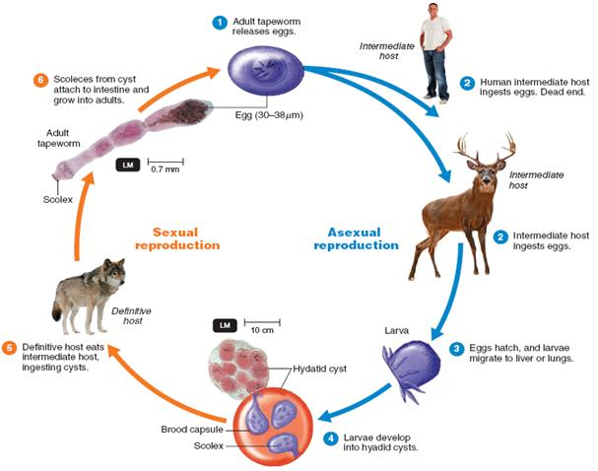

Slide 18
Prevention and Control
control of Cestodaes = Avoid taken uncooked meat containing infective stage in the muscles.
control of Taenia saginata= Avoid taken uncooked beef meat containing
infective stage in the muscles.
control of Taenia solium= Avoid taken uncooked pig meat containing infective stage in the muscles. hygiene, Improvement of water supply and sewage and Good health education.
control of Diphyllobotherium latum = Avoid taken uncooked fish meat
containing infective stage in the muscles.
control of Echinococcus granulosis= Avoid taken contaminated food and water. keep the dogs away with human contact
Treatment of Cestodaes = Praziquantel, Albendazole
Treatment of Taenia saginata= Albendazole Alternatively, niclosamide
Treatment of Taenia solium= Albendazole
Treatment of Diphyllobotherium latum = Albendazole
Treatment of Echinococcus granulosis= Albendazole and surgical excision of cysts.

Slide 19
Trematodes (flukes)
Trematodes are small (about 1 cm), flat, leaf-like worms or flatfish that, depending on the species, infect various organs of the human host (intestinal veins, urinary bladder, liver, or lung). All trematodes use freshwater snails (Biomphalaria) as an intermediate host, human as final host
The sexual stages or adult stages in the (definitive host) and asexual or larval stages in the (intermediate host).
The life cycle stage of the digenetic trematodes that cause "swimmer's itch" is a Miracidium. it is the larval stage of a fluke that is covered with cilia and swims about seeking out a snail to serve as an intermediate host
All are hermaphrodite (monoecious) except Schistosoma in which sexes are separated (dioecious).
The alimentary canal of flukes like an inverted Y. There are three types :
Schistosomes (Blood flukes)
Fasciolopsis buski (giant intestinal fluke) causes Fasciolopsis. Live in
Small intestine
Fasciola hepatica (sheep liver fluke ) causes Fasciolosis. live in Liver. Cause Liver rot (bile ducts, after migration through parenchyma)
Paragonimus westermani (Japanese lung fluke) eggs in passed sputum

Slide 20
Egg miracidia
sporosyst cercariae Adult worm
larva
miracidia enter the snails (mollusks) develop into cercariae
Life cycle of schistosomes
Egg miracidia
sporosyst rediae
larva
cercariae
metacercariae
Adult worm
miracidia enter the snails develop into cercariae
Life cycle of Fasciola hepatica & Fasciolopsis buski

Slide 21
1. Schistosomes (Blood flukes) The disease is transmitted by direct skin penetration (cercaria is infective stage). has three sp.
A.S. haematobium: Shape of egg: oval, contain terminal or polar spine. Resident the vein surrounds the urinary bladder & Present in veins of the vesical and pelvic plexuses. causes urinary bilhariziasis. the main symptoms are hematuria, fibrosis, granulomas. The loss of blood can lead to iron deficiency anemia blocking of urinary tract & bladder cancer. Diagnosis (egg in urine is diagnostic stage).
B. S. msnsoni: Shape of egg large oval, contain lateral spine.
C. S. japonicum (Oriental schistosomiasis or Katayama disease):
The egg: oval contain lateral knob & blunt projection spine.
S. msnsoni & S. japonicum causes intestinal bilhariziasis or Schistosomiasis. Resident in the mesenteric or rectal vein surround small intestine. The eggs causes damage in intestine, liver, gastrointestinal tract causes bleeding diarrhea. Damage to the intestinal wall is caused by the host's inflammatory response to eggs deposited at that site. The eggs also secrete proteolytic enzymes that further damage the tissue. Diagnosis (egg in stool is diagnostic stage).

Slide 22
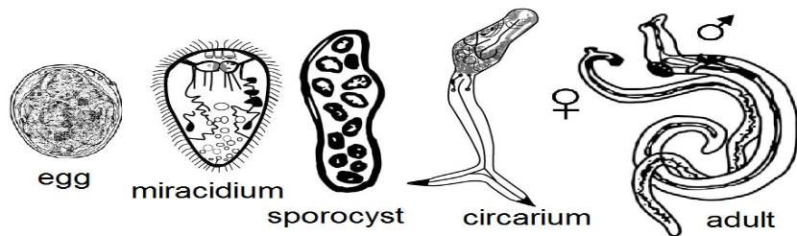
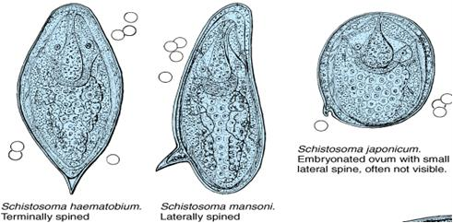

Slide 23
Life cycle of schistosomes
schistosomes have only one intermediate host (the snail). schistosome cercaria acquired directly penetrating the skin of swimmers in contaminated rivers and lakes. After dissemination and development in the human host, adult schistosomes take up residence in various abdominal veins, depending on the species. schistosomes have separate, distinctive sexes. male in which the smaller female resides and continuously mates with the male (Female of Schistosoma settled with male in place Gynecophoric canal. This mating takes place in the human liver. Fertilized eggs penetrate the human host's vascular walls and enter the intestine or bladder, emerging from the body in feces or urine. In fresh water, the organisms infect snails in which they multiply, producing cercaria (the final, free-swimming larval stage (swimmers itch)), which are released into the fresh water to complete the cycle.

Slide 24
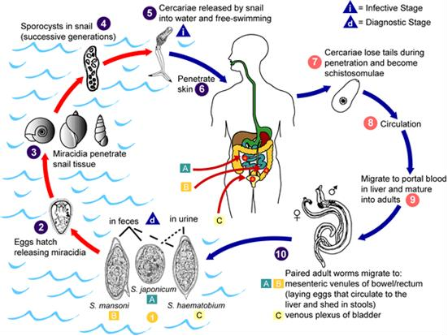

Slide 25
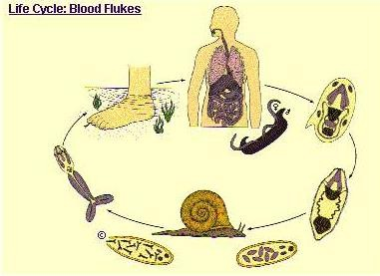
control &Preventionof Schistosomes = Prevention of pollution of water in rivers by human
Urine, Eradication of Mollusks (snail), Avoiding swimming or washing, or bathing in or contact with infected or polluted water.
Treatment of Schistosomes = praziquantel

Slide 26
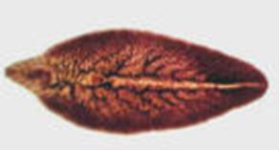
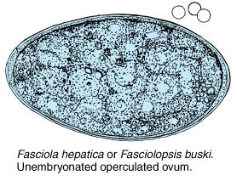
2.Fasciola hepatica (sheep liver fluke)
Adult
The adult Fasciola hepatica worm is flattened, leaf like shape, equipped with shoulders, somewhat oblong. Adult Fasciola hepatica measuring 3cm by 1cm in size, grayish in color. There are two suckers, oral sucker and ventral sucker, they located in cephalic zone. The intestine is branched. The uterus is short and coiled filled with grayish eggs.
The adult flukes are acquired by eating
raw sheep liver. Or by
swallowing metacercariae of the fluke found on water plants, as raw watercress.

Slide 27
Life cycle
Fasciola hepatica, the
disease primarily in
sheep
sheep
liver fluke, causes and other domestic
animals in Latin America, Africa, Europe, and China. Humans are infected by eating watercress (or other aquatic plants) contaminated by larvae (metacercariae) that excyst in the duodenum, penetrate the gut wall, and reach the liver, where they mature into adults. Hermaphroditic adults in the bile ducts produce eggs (unembryonated operculated ovum) , which are excreted in the feces. The eggs hatch in fresh water, and miracidia enter the snails. Miracidia develop into cercariae, which then encyst on aquatic vegetation. Sheep and humans eat the plants, thus completing the life cycle.

Slide 28
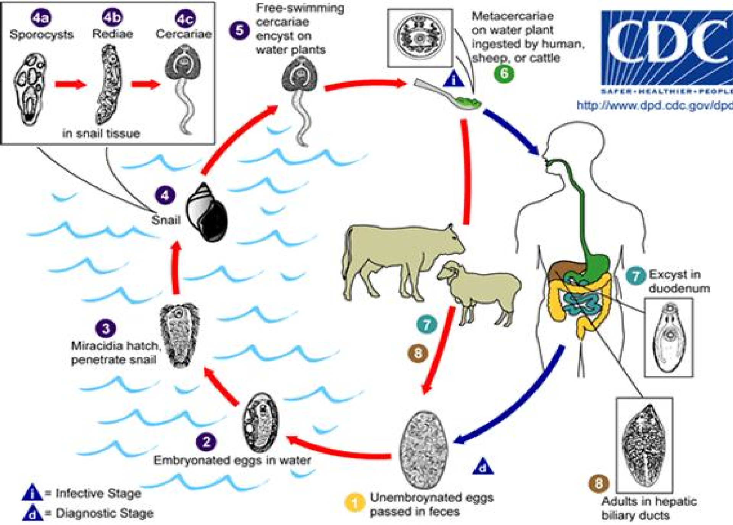


Slide 29
Clinical symptoms of Fascioliasis caused by
Fasciola hepatica
Symptoms are due primarily to the presence of the adult worm in the biliary tract. It is marked by stomach and bowel pain, fever, a liver disease (jaundice), and diarrhea. In early infection, right-upper-quadrant pain, intermittent fever, and hepatomegaly.
Halzoun is a painful pharyngitis caused by the presence of adult flukes on the posterior pharyngeal wall. but most infections are asymptomatic.
Acute fascioliasis: In its severe and its occurs in sheep but rarely in man and requires large numbers of parasites. The larvae migrating & invade the liver and cause a traumatic hepatitis that is frequently fatal. Sometimes the liver capsule may rupture into the peritoneal cavity, causing death from peritonitis. The invasive phase lasts many weeks
Chronic fascioliasis: the latent phase lasting months or even years, may be an obstructive phase causing hepatitis, cholangitis, pancreatitis, and so the flukes may cause ectopic infections, especially in the lungs and subcutaneous tissues.
Diagnosis: eggs in the feces. Adult flukes in the pharynx and larynx can be
removed surgically. There is no serologic test.
control of Fasciola hepatica = Avoid or not eating contaminated aquatic vegetables and water and uncookedor raw liver sheep
Treatment of Fasciola hepatica = Albendazole, sulphoxide Praziquantel and ithionol

Slide 30
Fasciolopsis buski ( intestinal fluke)
It 's causes Fasciolopsis. Humans are infected by eating aquatic vegetation that carries the metacercariae. After excysting in the small intestine, the parasites attach to the mucosa and differentiate into adults. Eggs are passed in the feces; on reaching fresh water, they differentiate into miracidia. The ciliated miracidia penetrate snails and, after several stages, develop into cercariae that encyst on aquatic vegetation. The cycle is completed when plants carrying the cysts are eaten.
Pathologic findings are due to damage of the intestinal mucosa by the adult fluke. Most infections are asymptomatic, but ulceration, abscess formation, and hemorrhage diarrhea .
Diagnosis is based on finding typical eggs in the feces.
Prevention consists of proper disposal of human sewage.
control of Fasciolopsis buski = Avoid taken contaminated food
and water
Treatment of Fasciolopsis buski = praziquantel

