Slide 1






Title
Nuclear Detectors
Prof. Dr. Anees Ali Hassan
Department of Medical Physics; College of Sciences
Al- Mustaqbal University
2024 - 2025

Slide 2

Introduction
Ionizing radiation is rarely detected directly. Instead, detectors usually measure the secondary products arising from the interactions of the radiation with the detector.
There are many types of detectors such as:
Gas-filled detectors consist of a volume of gas between two electrodes
Scintillation detectors, the interaction of ionizing radiation produces visible light.
Semiconductor detectors are especially pure crystals of silicon, germanium, or other materials to which trace amounts of impurity atoms have been added so that they act as diodes.
Personal Dosimeters which is personal and portable to assess the absorbed dose by radiation workers.

Slide 3
Nuclear Detectors
Types of detectors (cont.)
Detectors may also be classified by the type of information produced:
  Detectors, such as Geiger-Mueller (GM) detectors, that indicate the number of interactions occurring in the detector are called counters.
  Detectors that yield information about the energy distribution of the incident radiation, such as NaI scintillation detectors, are called spectrometers.
  Detectors that indicate the net amount of energy deposited in the detector by multiple interactions are called dosimeters.

Slide 4
Nuclear Detectors
Modes of operation
In pulse mode, the signal from each interaction is processed individually.
In current mode, the electrical signals from individual interactions are averaged together, forming a net current signal.

Slide 5
Nuclear Detectors
Detection efficiency
The efficiency (sensitivity) of a detector is a measure of its ability to detect radiation.
Efficiency of a detection system operated is defined as the probability that a particle or photon emitted by a source will be detected .

Slide 6
Nuclear Detectors
Geometric efficiency
The quotient: number of photons reaching the detector over the number of photons emitted from the sample.
Increasing geometric efficiency

Slide 7

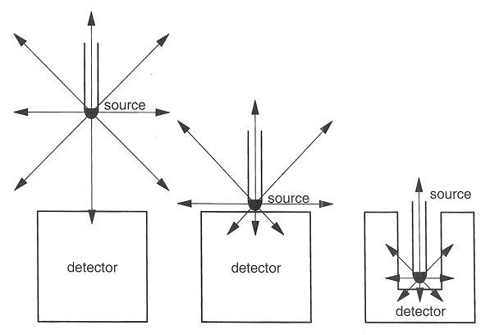
Nuclear Detectors

Slide 8

Gaseous Detectors
Overview
Interaction with Matter
Types of Interactions:
  Excitation
  Ionization
Media in which the interactions occur:
  Solid
  Liquid
  Gas

Slide 9
Gaseous Detectors
Instruments based on the direct collection of the ionization electrons and ions produced in a gas by passing radiation were the first electrical devices developed for radiation detection.
Because of the greater mobility of electrons and ions, a gas is the obvious medium to use for the collection of ionization from radiation.

Slide 10

General features of gaseous detectors
Rugged and simple to operate.
Cheap and easy to maintain.
Low density.
Inefficient for gammas
Efficient for charged particles and slow neutrons.
Higher dead time than solid/liquid detectors.

Slide 11
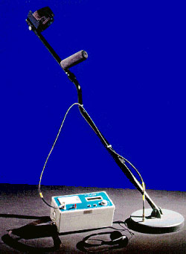
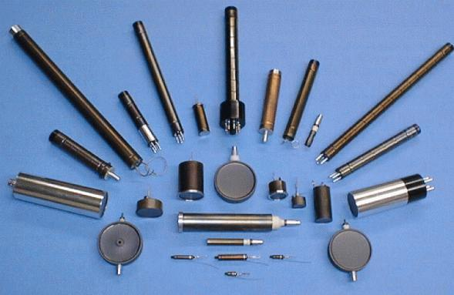
There are three original gas devices: Ionization chamber, Proportional counter and Geiger Mueller counter, serve as a good illustration of the application of gas ionization phenomena in this class of instruments.
These detectors are actually the same device working under different operating parameters.

Slide 12
Gas-Filled Detectors - Components
Variable voltage source.
Gas-filled counting chamber.
Two coaxial electrodes well insulated from each other.
Electron-pairs.
  produced by radiation in fill gas. تنتج عن الإشعاع في الغاز المملوء.
  move under influence of electric field. تتحرك تحت تأثير المجال الكهربائي
  produce measurable current on electrodesتنتج تيارًا قابلًا للقياس على الأقطاب الكهربائية
  transformed into pulse. يتحول الى نبضة

Slide 13
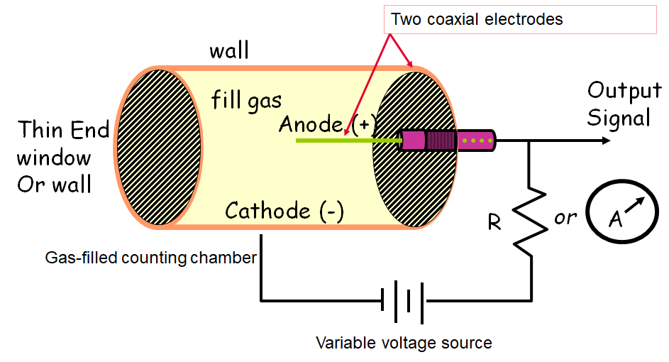
Gas-Filled Detectors - one example

Slide 14
If radiation now penetrates the cylinder, a certain number of electron-ion pairs will be created, either directly, if the radiation is a charged particle, or indirectly through secondary reactions if the radiation is neutral.
As a charged particle passes through a gas, interactions create both excited molecules and ionized molecules along its path. After a neutral molecule is ionized, the resulting positive ion and free electron are called an ion pair and it serves as the basic constituent of the electrical signal developed by the detector.
The mean number of pairs created is proportional to the energy deposited in the counter. Under the action of the electric field, the electrons will be accelerated towards the anode and the ions towards the cathode where they are collected.
Average value required for creating an electron-ion pair is important since it determines the efficiency and energy resolution of the detector.

Slide 15
“W” Factor
 | W value (eV/ion pair)
Gas | Fast Electrons | Alphas
CH₄ | 30.2 | 29.0
O₂ | 32.2 | 32.2
He | 32.5 | 31.7
Air | 35.0 | 35.2
N₂ | 35.8 | 36.0
H₂ | 38.0 | 37.0
In most gases, the energy needed to ionize the least tightly bound electrons is known as W Factor, the “average "energy is typically 30 – 35 eV/ion pair

Slide 16
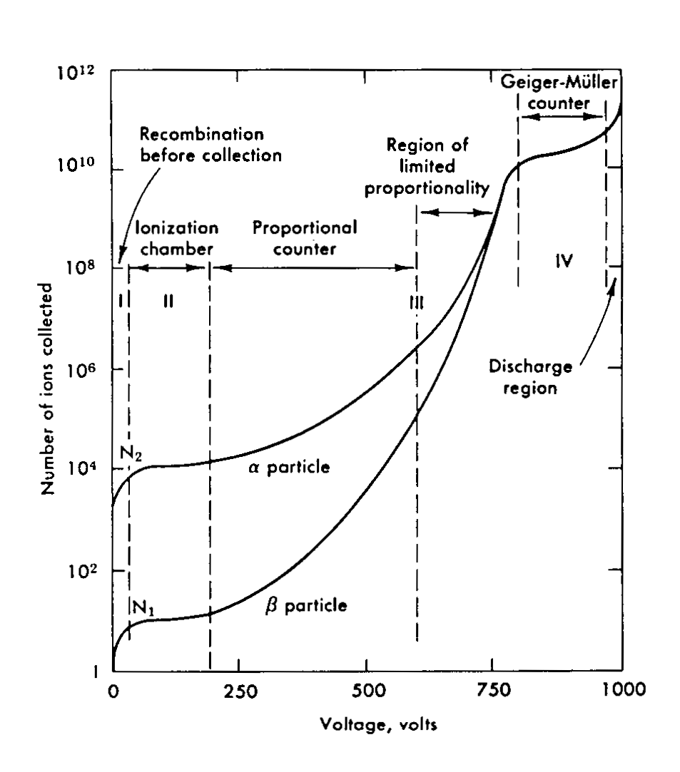
The signal observed depends on the field intensity which is illustrated in the figure which plots the total charge collected as a function of V.

Slide 17

Thank you for your kind attention

