Slide 1






Title
Scintillation Detectors
Prof. Dr. Anees Ali Hassan
Department of Medical Physics; College of Sciences
Al- Mustaqbal University
2024 - 2025

Slide 2

Scintillation Detectors
The scintillation detectors consist of two parts, the scintillator material and the photomultiplier tube (PMT).
The scintillator material is solid, liquid or gas. It is characterized by the production of photons (fluorescence) when it absorbs the nuclear radiation. The photon is produced by removing the excitation that occurs in the material after its absorption of the nuclear radiation.
The photomultiplier tube (PMT) which is in front of the crystal (scintillator material), consists of a photocathode and many dynodes.

Slide 3
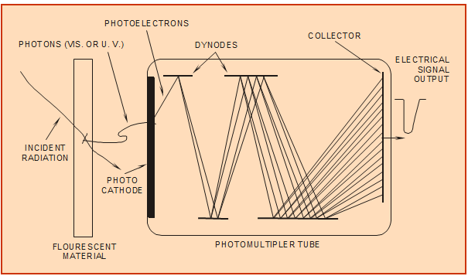
Scintillation Detectors
The resulting photon in the crystal when it falls on the photocathode leads to the production of an electron. The dynodes then amplify the number of electrons produced from the photocathode. The resulting pulse from the anode of the photomultiplier is an indicator of the nuclear radiation that interacted with the scintillator.
Scintillation Detector (gamma)

Slide 4
Scintillation Detectors
The amplitudes of the output voltage pulses are proportional to the energy deposited by charged particles produced in the scintillation material. A gamma ray penetrating the scintillator material may give up its energy to the scintillator material through photoelectric interactions, Compton scattering and pair production reactions. If all of the incident gamma-ray energy is deposited in the scintillator material, the number of scintillation photons produced is proportional to the incident gamma-ray energy. Thus, by measuring the distribution of pulse sizes or the pulse height distribution (PHD) produced by the scintillation detector, the energy distribution of the incident gamma rays can be determined. Thus, one of the most important applications of scintillation detectors is gamma-ray spectroscopy.

Slide 5
Scintillation Detectors
There are two types of scintillation detectors: (1) solid crystals of inorganic material such as NaI(TI), (2) plastics and liquids consisting of organic material.
Organic scintillators have a faster response i.e. slow decay time (required time to remove the excitation resulting from the absorption of nuclear radiation).ازالة الاثارة من امتصاص الاشعاع النووي وانتاج الكترون ضوئي
Low light output (Photo conversion efficiency is the rate of conversion the energy of the incident radiation into photons). كفاءة التحويل الضوئي تحويل الشعاع النووي الممتص الى فوتون
Low density (low density requires large sizes of material to contain the radiation to be detected.
While, inorganic scintillators have a slow response.
Higher light output.
Higher density.

Slide 6
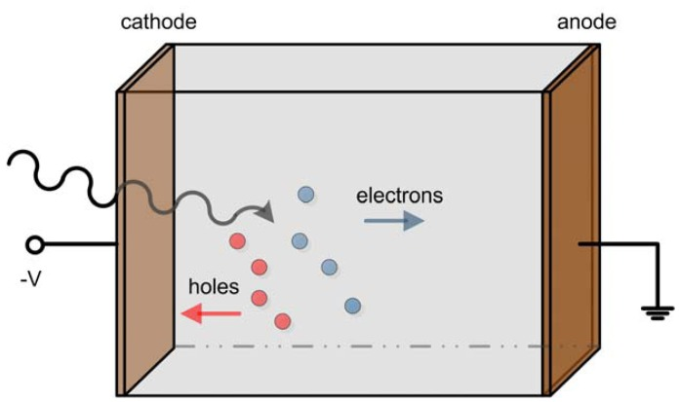
Semiconductors Detectors
When the nuclear radiation falls on the semiconductor detector, electrons and gaps are released in the depletion region, and with the presence of the potential between the two electrodes of the detector, the electrons move towards the anode and the holes towards the cathode, producing an electric pulse similar to what happens in gas detectors.

Slide 7
Semiconductors Detectors
One of the advantages of these detectors is their high density, compared to gas detectors. The high density provides a large stopping power for nuclear radiation in small sizes. The range of 10 MeV of alpha particles in Si is 75 μm compared to 10 cm in air.
The only high-density solid materials that can be used in nuclear detectors are semiconductors because of the low energy gap in them. As for the dielectric materials, they cannot be used in the detectors because of the impossibility of being affected by nuclear radiation due to the high energy gap.
Increasing the temperature decreases the electron movement. Thus, low temperatures are preferred in semiconductor detectors to provide a high coefficient of movement. The liquid nitrogen temperature (- 180 c) is suitable for some detectors.

Slide 8
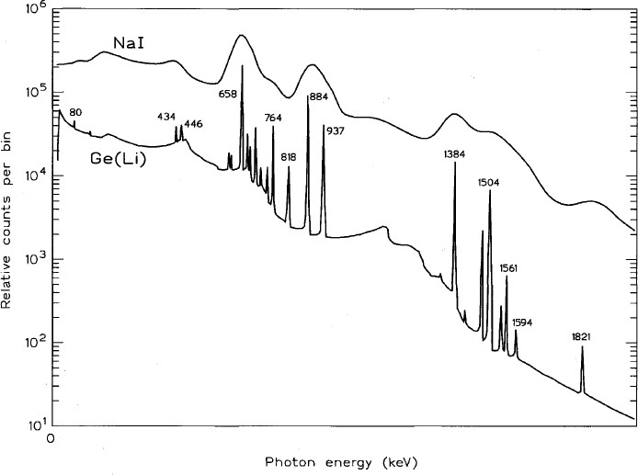
Semiconductors Detectors
There are two main types of germanium semiconductor detectors: (1) Ge(Li) a germanium crystal doped with lithium ions, and (2) the more recent (HPGe) high purity germanium crystal.
Germanium detectors, having exceptional energy resolution and efficient for detecting photons. The performance of these detectors is often compared to NaI(Tl). Because of the higher atomic number, NaI(Tl) detectors often have a higher efficiency for high energy gamma rays than do germanium detectors, but a much poorer energy resolution.

Slide 9
Semiconductors Detectors
Silicon Semiconductor Detectors
Si(Li) detectors are commonly used in alpha and beta particle spectrometers. They also offer an inexpensive option for x-ray spectroscopy.
Since Si(Li) detectors have a much lower atomic number than NaI(TI), and (HPGe) their relative efficiency is significantly lower for electromagnetic radiation.
However, for x-ray or gamma ray energies less than about 30 keV, commercially available Si(Li) detectors are enough to provide performance which is superior to NaI(TI), and HPGe.
Cadmium Zinc Telluride Detectors
Cadmium zinc telluride (CZT) is a new high-resolution and high-atomic number semiconductor detector material.
CZT detectors offer an excellent option for low energy x-ray spectroscopy where cooling is not possible. Keeping the detector at about -30 °C, is adequate to achieve optimum energy resolution. By contrast, HPGe detectors must be cooled at liquid nitrogen temperatures to achieve optimum resolution.

Slide 10
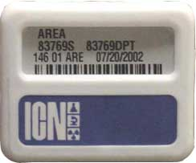
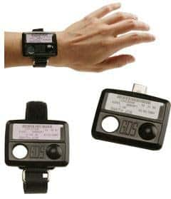
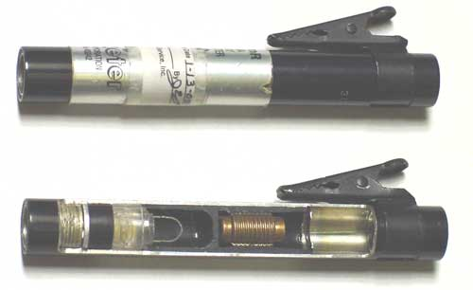
Personal Dosimeters
Film Badge: Personnel dosimetry film badges are commonly used to measure and record radiation exposure due to gamma rays, X-rays and beta particles. The detector is, as the name implies, a piece of radiation sensitive film. The film is packaged in a light proof, vapor proof envelope preventing light, moisture or chemical vapors from affecting the film. This film used from week to 4 weeks.
Thermo luminescent dosimeters (TLD): are often used instead of the film badge. Like a film badge, it is worn for a period of time (usually 3 months or less) and then must be processed to determine the dose received, if any. Thermo luminescent dosimeters can measure doses as low as 1 millirem, but under routine conditions their low-dose capability is approximately the same as for film badges.
The pocket ionization chamber (PIC): is an ion chamber, in the form of a cylinder about the size of a fountain pen. A charge is placed on the electrodes of the ion chamber and the corresponding voltage is displayed through an eyepiece using an electroscope. As the ion chamber receives radiation exposure, the electrodes are discharged and the voltage change of the electroscope is presented in a reticule scaled to radiation dose or exposure. The PIC is sensitive only to gamma radiation.

Slide 11
Nuclear Detectors
NUCLEAR DETECTORS
General purpose device
Medicine: diagnostics; computer tomography (CT scan)
Industry: level gauging; radioactive waste assay
Environment: survey; geological applications
Physics: nuclear, high energy, particle physics

Slide 12

Thank you for your kind attention

