Slide 1
Immune System
1st Course
Lecture : 1
Dr. Bashar Hadi Al-Aaraji

Slide 2
What is the Immune System?
The immune system is your body’s first-line defense against invaders like germs.
It helps protect you from getting sick and promotes healing when you’re unwell or injured.
It is a large network of organs, white blood cells, proteins and chemicals working together to protect you.

Slide 3
How the Immune System Works?
Tells the difference between self and non-self cells.
Activates and mobilizes to kill harmful germs.
Ends an attack once the threat is gone.
Learns about germs and develops antibodies.
Sends out antibodies to destroy future invaders.

Slide 4
Types of immunity
Innate Immunity Vs Acquired Immunity
Innate: Born with it, immediate response, no memory.
Acquired: Also called ( Adaptive or Specific ) Develops after exposure, memory, basis for vaccines.

Slide 5
Organization & Anatomy of the Immune System
Distributed throughout the body.
Organs, tissues, and cells work together to keep you healthy.

Slide 6
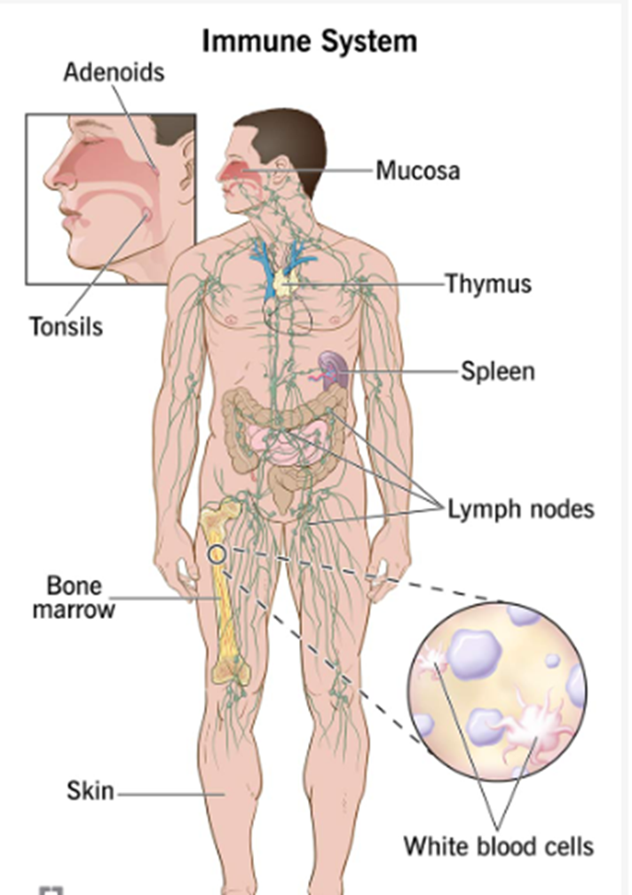

Slide 7
Main Components of the Immune System:
WBCs: These immune system cells attack and eliminate harmful germs to keep you healthy.
Antibodies: These proteins protect you from invaders by binding to them and initiating their destruction.
Cytokines: These proteins serve as chemical messengers that tell your immune cells where to go and what to do.
Complement system : This is a group of proteins that teams up with other cells in your body to defend against invaders and promote healing from an injury or infection.
Lymph nodes
Spleen: This organ stores white blood cells that defend your body from invaders. It also filters your blood, recycling old and damaged cells to make new ones.

Slide 8
7. Tonsils and adenoids: Located in your throat and nasal passage, tonsils and adenoids can trap invaders (like bacteria or viruses) as soon as they enter your body.
8. Thymus: This small organ helps T-cells (a specific type of white blood cell) mature before they travel elsewhere in your body to protect you.
9. Bone marrow: This soft, fatty tissue inside your bones is like a factory for your blood cells. It makes the blood cells your body needs to survive, including white blood cells that support your immune system.
10. Skin: Your skin is a protective barrier that helps stop germs from entering your body. It produces oils and releases other protective immune system cells.
11. Mucosa: This three-layered membrane lines cavities and organs throughout your body. It secretes mucus that captures invaders, like germs, for your body to then clear out.

Slide 9
Functions of the Immune System
Keeping invaders (like germs) out of your body.
Destroying invaders.
Limiting how much harm invaders can do inside your body.
Healing damage to your body.
Adapting to new challenges and threats.

Slide 10
Invaders the Immune System Protects Against
Bacteria
Viruses
Fungi
Parasites
Cancer cells

Slide 11
When the Immune System Malfunctions
Too weak to fight invaders.
Too strong responses against harmless or self-antigens.

Slide 12
Weak vs Overactive Immune System
Weak: More susceptible to infections (e.g., diabetes, cancer).
Overactive: Overreacts → Autoimmune diseases or allergies.

Slide 13
Disorders Affecting the Immune System
Allergies
Autoimmune diseases (e.g., lupus, rheumatoid arthritis)
Primary immunodeficiency diseases: (These inherited conditions prevent your immune system from working properly )
Infectious diseases (e.g., HIV, Mononucleosis )
Cancer (e.g., leukemia, lymphoma)
Sepsis

Slide 14
Signs & Symptoms of Immune Disorders
Fatigue
Unexplained fever
Unexplained weight loss
Night sweats
Itchy skin
Aching muscles
Numbness in fingers/toes
Trouble concentrating
Hair loss
Rashes or redness
Swollen lymph nodes

Slide 15
Tests for Immune System Health
Antibody test
Complete blood count
Complement blood test (e.g., C3 proteins)

Slide 16
Medications That Weaken the Immune System
Corticosteroids
Immuno-suppressants
Chemotherapy
Cancer treatment

Slide 17
Boosting the Immune System Naturally
Eat healthy foods
Exercise regularly
Maintain healthy weight
Get enough sleep
Stay up-to-date on vaccines
Avoid smoking & tobacco

Slide 18
Conclusion
The immune system is like a home security system.
It guards against intruders, sounds alarms, and helps repair damage.
But it can malfunction, leading to disease.
Regular checkups help detect and treat problems early.

Slide 19


