Slide 1
ADRNAL GLAND
LEC .5 DR. SHAIMAA MUNTHER

Slide 2
Adrenal Anatomy & Physiology
The adrenals are endocrine organs that sit on top of each kidney
There are 2 adrenal glands that lie anteriorly to kidneys.
Each is embedded in a capsule of fat.
Each adrenal gland is composed of 2 endocrine organs, one surrounding the other:
An adrenal cortex
An adrenal medulla.
Notes:
The adrenal glands are a frequently-overlooked part of the endocrine system. The endocrine system is composed of glands which produce hormones (chemical messengers) that act upon cells and tissue.

Slide 4
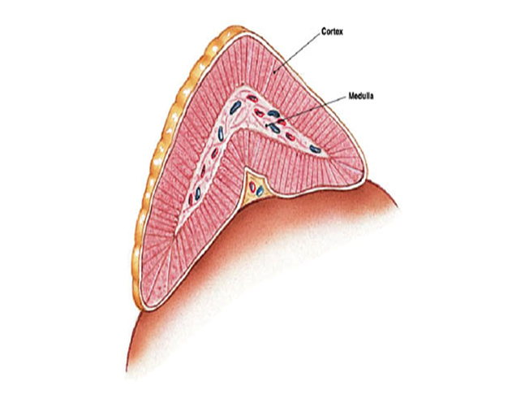
Adrenal Anatomy & Physiology
Each adrenal gland has two parts
Adrenal Medulla (inner area)
Secretes catecholamines which mediate stress response (help prepare a person for emergencies).
Norepinephrine
Epinephrine
Dopamine
Adrenal Cortex (outer area, encloses Adrenal Medulla)
Secretes steroid hormones
Glucocorticoids: exert a widespread effect on metabolism of carbohydrates and proteins
Mineralocorticoids: are essential to maintain sodium and fluid balance
Sex hormones (secondary source)
Notes:
The adrenal medulla comprises approximately 28% of the total adrenal mass. Although we think of the ‘stress’ catacholamines as being necessary for ‘fight or flight’, they are actually circulating in our bodies, in minute quantities, at all times, and act in concert with other hormones and the vagus nerve to support daily activities. The adrenal medulla secretes other hormones, however they are not relevant to our discussions here.

Slide 5
Adrenal Medulla & Adrenal Cortex
Glucocorticoids
Mineralocorticoid
EP
Medulla
Cortex
NE
Sex hormons
Dopamin

Slide 6
Adrenal Medulla
Adrenal medulla is a post ganglionic neurons , lost their axons and become secretary cells .
Stimulated by nerve impulse from preganglionic neurons reaching it via splanchnic gangilia .
The main function of adrenal medulla hormones ( catecholamines ) mostly to prepare the body for emergency state called " Fight or Flight " response
Adrenal medulla composed as 28% of the total gland cells composed of two types of cells :
1- Epinephrine secreting cells ( 90%)
2- Norepinephrine secreting cells (10%)
Notes:
The other less common secretions as polypeptides like opoids (metenkephalins ) and adrenomodulline .
Arterial blood reaching gland from many small branches of phrenic and renal arteries and aorta , reaching the capsul of the gland from which blood flows from cortex through the sinusoids of the medulla, return to the circulation through adrenal vein.

Slide 7
Notes:
In human , the main hormone is epinephrine (EP) synthesized from precursor amino acid ( Tyrosin )

Slide 8
Regulatory Control of Adrenal Medulla Secretions
Nervous stimulation : In medulla, NE, EP , are stored in granules as bounded to ATP and chromogen A .
Secretion is initiated by ACH released from the pre gangilionic neurons activate Ca ⁺² cation channels triggering exocytosis from the granules into the blood.
At physiological state (basal state), catecholamines are low ,while under emergency state , the increased sympathetic discharge cause increased catecholamine secretion leading to a state called " Fight or Flight " characterized by accelerated heart beat, raised B.P to provide better perfusion of vital organs and muscle

Slide 9
Physiological Effects of Catecholamines
Metabolic effects by increasing glucose release into circulation as it cause an increase in glycogenlysis by the liver and skeletal muscle & an increasing FFA mobilization from adipose tissue.
Vasoconstriction in most organs (via α1 receptor) , over balanced by vasodilation in skeletal muscle and liver (via α 2 receptor).
Cardia tonic effects by increased heart contraction and rate(via β receptor) while EP, stimulate baro & carotid receptors leading to bradycardia that lead to reduced cardiac out put .
An increased metabolic rate through cutaneous vasoconstriction leading to decreased heat loss and rising body temperature or through increasing muscular activity , or both .
Control insulin and glucagon secretion
CNS effects involve increased alertness ,anxiety and fear .

Slide 10
Adrenal cortex
About 80% of the adrenal gland is composed of the cortex (outer part of the gland) which has three layers or zones:
Zona Glomerulosa : Outer layer constitutes 15% of the total mass of the cortex.
Zona Fasciculate : Middle layer constitutes 50% of the total mass
Zona Reticularis : Inner layer constitutes 7% of total mass of the gland .
All three layers secrete corticosteroids of which cholesterol is the common precursor.
On the basis of their primary actions, the adrenal steroids can be divided into 3 categories:
Mineralocorticoids (aldosterone), which influences mineral or electrolyte balance; from z. glomerulosa
Glucocorticoids (cortisol), which plays a role in glucose metabolism and proteins and lipids; from z. fasciculate
Sex hormones ( identical to those produced by the gonads) ,from z. reticularis

Slide 12
Hormones of Adrenal Cortex ( Adrenocortical Hormones )
Adrenocortical hormones are natural hormones biosynthesized from precursor cholesterol LDL .
Mineralocorticoids : Aldosterone synthesized and secreted by glomerulosa zone .
Glucocorticoids : Mainly cortisol and corticosterone, with cortisol is the predominant one in a ratio (7:1)
Androgens:Dehydroepiandrosterone (DHEA) and androstendione .

Slide 13
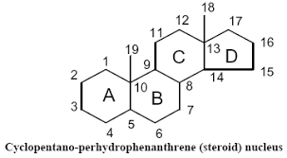
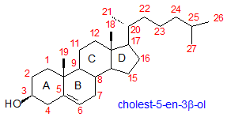
Steroidal structure

Slide 14
Mineralocorticoids
Aldosteron: is the primary mineralocorticoid hormone secreted from adrenal cortex that is essential for maintenance of Na+ and electrolyte balance.
Its primary site of action is the distal tubules of the kidney nephron where it promotes Na+ retention into the blood and enhances K+ elimination into the urine filtrate.
If Na+ is retained, H20 is osmotically attracted to Na+ and therefore is retained as well. This increase in water in the blood causes an increased blood volume. This is important in the long-term regulation of blood pressure.
Without mineralocorticoids, death will occur due to large loss of plasma volume that would be lead to circulatory shock.

Slide 15
Physiological Effects of Aldosterone
Effects on electrolyte :
Aldesteron increased Na+ reabsorbtion and Cl⁻ From urine , sweat and saliva the action is especially on kidney collecting ducts exchanged for K+, thus results in K+ diuresis and an increasing in urine acidity .
Effects on water :
Retaining of Na+ and Cl⁻ , reduces osmotic pressure in the tubule resulting in water osmosis and increased ECF volume by 10-15% which may lead to increased cardiac out put .

Slide 16
Mechanism of Action
Aldosterone acts on the distal tubule of the nephron to increase sodium reabsorption. The mechanism of action involves an increase in the number of sodium-permeable channels on the luminal surface of the distal tubule and an increase in the activity of the Na+–K+ ATPase pump on the surface of the tubule.
Sodium diffuses down its concentration gradient out of the lumen and into the tubular cells. The pump then actively removes the sodium from cells of the distal tubule and into the extracellular fluid so that it may diffuse into the surrounding capillaries and return to the circulation.
Due to its osmotic effects, the retention of sodium is accompanied by the retention of water. In other words, wherever sodium goes, water follows. As a result, Aldosterone is very important in regulation of blood volume and blood pressure. The retention of sodium and water expands the blood volume and, consequently, increases mean arterial pressure.
The retention of sodium is coupled to the excretion of potassium. For every three Na+ ions reabsorbed, two K+ ions and one H+ ion are excreted.

Slide 17
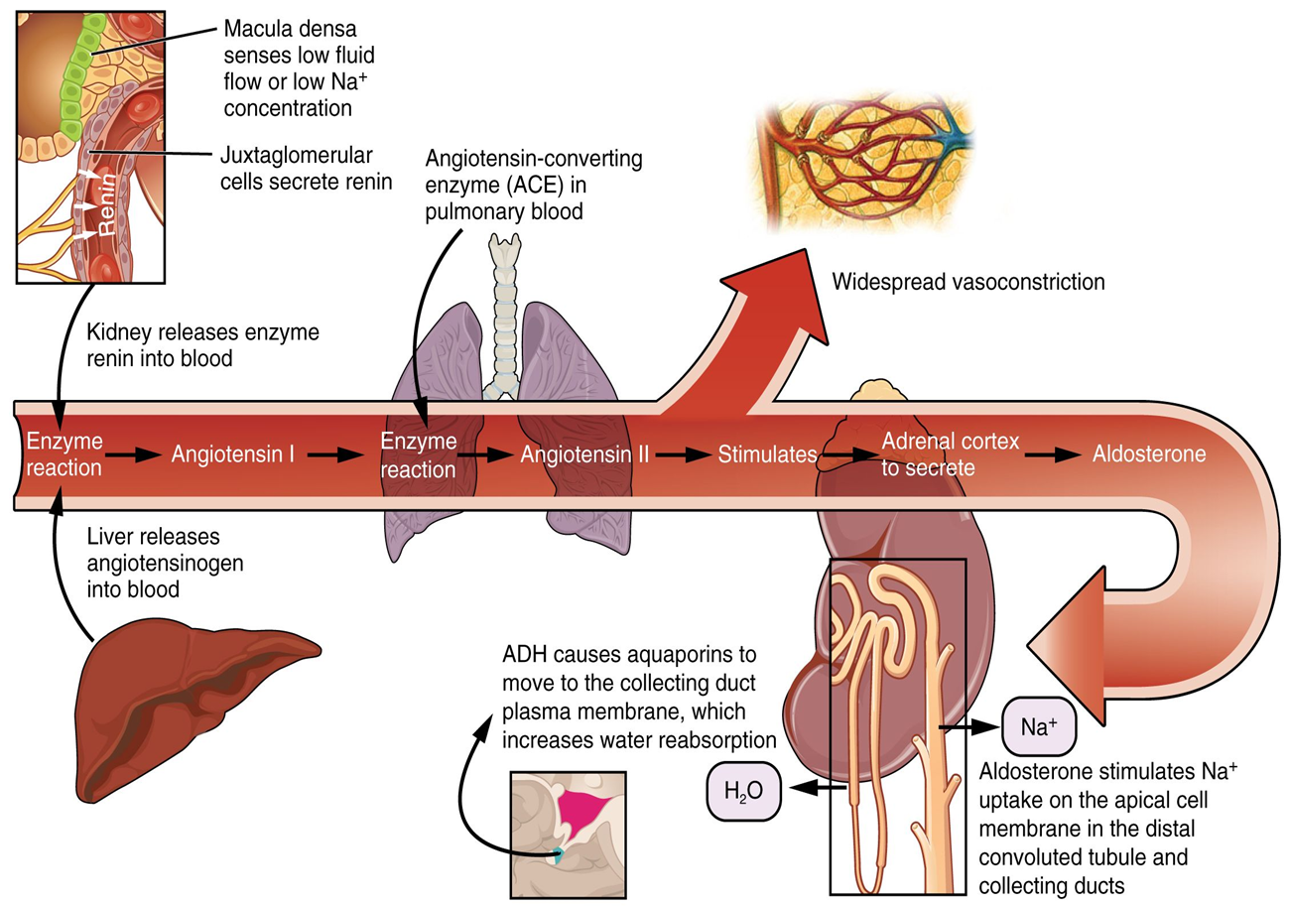
Aldosterone Biosynthesis
Aldosterone synthesis and secreation occur in the zona glomerulosa by aldosterone synthase ,under the influence of ACTH and Angiotensin II .

Slide 18
Regulation of Aldosterone Secretion
Aldosterone is released due to:
Activation of the renin-angiotensin system in the kidneys which is related to a decrease in Na+ and decrease in BP.
Direct stimulation of the adrenal cortex by increase in blood K+ concentration (hyperkaleamia) or decreased Na+ & ECF volume
This zone is relatively independent of the anterior pituitary hormone influence of ACTH. It may have a weak effect in releasing aldosterone but in general it does not.
Notes:
Regulation of
Because this process requires renin in order to occur, it is important to
understand the factors involved in its release from the kidney. These factors
include:
• Decrease in blood volume
• Decrease in blood pressure
• Sympathetic stimulation
A decrease in blood volume or blood pressure may result in a decrease in
the blood flow to the kidney. The kidney monitors renal blood flow by way
of stretch receptors in the vessel walls. A decrease in renal blood flow stimulates
the release of renin. The subsequent secretion of aldosterone causes
retention of sodium and water and, therefore, an increase in blood volume
and blood pressure back to normal. An increase in renal blood flow tends
to cause the opposite effect.
Sympathetic nerve activity causes an increase in blood pressure through
many mechanisms, including an increase in cardiac activity and vasoconstriction.
Activation of the sympathetic system also causes the stimulation
Of B1-adrenergic receptors on the renin-producing cells, which promotes
Rennin release .

Slide 19
Feed back control of aldosterone

Slide 20
Glucocorticoids
Glucocorticoids ( CORTISOL & CORTICOSTERONE ) are found in all tissues. The overall effects of these hormones ( metabolic effects ) include:
Increase in blood glucose
Increase in protein catabolism (especially muscle)
Increase in lipolysis & Increase free fatty acids in blood
Cortisol increases blood glucose by several mechanisms of action including:
Decrease in glucose utilization by many peripheral tissues (especially muscle and adipose tissue)
Increase in availability of gluconeogenic substrates
Increase in hepatic gluconeogenesis
Cortisol-induced lipolysis not only provides substrates for gluconeogenesis (formation of glucose from noncarbohydrate sources) but it also increases the amount of free fatty acids in the blood. As a result, the fatty acids are used by muscle as a source of energy and glucose is spared for the brain to use to form energy.

Slide 21
Synthetic Steroids
Steroids intended for pharmacological use in diseases obtained by structural modification of the natural steroids to give more potent with long duration steroids as :
Dexamethasone
Prednisolone
Methylprednisolone
Cortisone

Slide 22
Physiological Actions of Glucocorticoids
1- Metabolism:
Enhanced glucose release from liver by gluconeogenesis and reduced peripheral tissue utilization of glucose ( Anti Insuline effects )
Enhanced amino acids mobilization from proteins stores , which are return to liver converted to glucose .
Enhanced FFA formation from lipids from their stores in muscle and and fat tissues which are return to liver converted to glucose .

Slide 23
Physiological Actions of Glucocorticoids
2- Hormonal control :
Glucocrticoids have anti insulinemic action , also enhanced glucagone effects on gluconeogenesis by the liver .
Counteracting stress condition through stimulation of the sympathetic activity leading to vasoconstriction effects .

Slide 24
Physiological Actions of Glucocorticoids
3- Minerals and water balance :
Cortisol maintain blood volume by Na/H₂O retention by the kidney and reducing blood flow to the renal ( decreased GFR) or due to elevation of vasopressin (ADH) leading to state of water intoxication and hypertension in excessive dose .
On Ca+² level :
Bone: cortisol lowers plasma Ca+² level by inhibiting osteoclast ( bone resorption ) and osteoblasrtic cell activity (bone building )
Intestine : cortisol reduce the reabsorption of Ca+² by inhibiting formation of Vit. D .
kidney: cortisol increase Ca+² and phosphate excretion by the kidney

Slide 25
Physiological Actions of Glucocorticoids
4- Effects on blood pictures :
Inhibiting lymphocyte formation , suppress immune system (required in case of immune diseases as organ transplantation rejection )
Neutrophils count rise
Basophiles and eosinophilies reduced count
RBCs count rise

Slide 26
Regulation of Glucocorticoids
Role of ACTH : Glucocorticoids released from the gland under the influence of ACTH from Anterior Pituitary gland controlled by CRH factor released from Hypothalamus which is stimulated by :
Its circadian rhythm
Stress conditions
Negative-feedback inhibition by Cortisol

Slide 27
Regulation of Glucocorticoids
Circadian rhythm : Corticotropin-releasing hormone (CRH) secreted from the hypothalamus stimulates the release of ACTH from the adenohypophysis. This pituitary hormone then stimulates the release of cortisol from the adrenal cortex.
The hormones of this hypothalamic–pituitary–adrenocortical axis exhibit marked diurnal variation. This variation is due to the diurnal secretion of CRH.
The resulting secretion of ACTH increases at night and peaks in the early morning ,just before rising (4 A.M. to 8 A.M.).
The levels of ACTH then gradually fall during the day to a low point late in the evening, between 12 P.M. and 4 P.M.
This rhythm is influenced by many factors, including light–dark patterns, sleep–wake patterns, and eating. After an individual changes time zones, it takes about 2 weeks for this rhythm to adjust to the new time schedule.

Slide 28
Regulation of Glucocorticoids
Stressful conditions : These include, the state of any change from basal body environment such as trauma , emotional stress( anxiety fear ) which stimulate the sympathetic N.S leading to homeostatic reaction to restore normal body state through enhancing FFA mobilization and other energy sources to repair the damage and remove stressor under the influence of cortisol released also inhibiting lysosomal membrane discharge preventing cellular damage .

Slide 29
Regulation of Glucocorticoids
Glucocorticoid feed back inhibition :
Cortisol is an important component of the body’s response to physical and psychological stress.
Nervous signals regarding stress are transmitted to the hypothalamus and the release of CRH is stimulated. The resulting increase in cortisol increases levels of glucose, free fatty acids, and amino acids in the blood, providing the metabolic fuels that enable the individual to cope with the stress.
A potent inhibitor of this system is cortisol itself. This hormone exerts a negative-feedback effect on the hypothalamus and the pituitary, thus inhibits the secretion of CRH and ACTH, respectively.

Slide 30
Regulation of Glucocorticoids
Cortisol exerts a negative feedback effect on the release of ACTH and CRH inhibiting their release proportional to circulating cortisol level .
Such effect occur as a complication of steroid therapy used for long period of treatment with anti-inflammatory doses of glucocorticoids and stopped suddenly causing inability of ACTH production and release .
Such effect avoided by slow decreasing the dose over long period until stopped completely.

Slide 31
Negative feed back control
Notes:
When administered in pharmacological concentrations (greater than physiological), cortisol and its synthetic analogs (hydrocortisone, prednisone) have :
potent anti-inflammatory and immunosuppressive effects. In fact, these steroids inhibit almost every step of the inflammatory response resulting in the decreased release of vasoactive and chemoattractive factors, decreased secretion of lipolytic and proteolytic enzymes, decreased extravasations of leukocytes to areas of injury, and, ultimately, decreased fibrosis.
Typically, the inflammatory response is quite beneficial in that it limits
the spread of infection. However, in many clinical conditions, such as rheumatoid arthritis and asthma, the response becomes a destructive process. Therefore, although glucocorticoids have no effect on the underlying cause of disease, the suppression of
Inflammation by these agents is very important clinically .
Corticosteroids also exert inhibitory effects on the overall immune process. These drugs impair the function of the leukocytes responsible for antibody production and destruction of foreign cells.
As a result, corticosteroids are also used therapeutically in the prevention of organ transplant rejection

Slide 32
Adrenal Androgens
Adrenal Androgens The predominant androgens produced by the adrenal Cortexes are dehydroepiandrosterone (DHEA) and androstenedione.
These steroid hormones are weak androgens; however, in peripheral tissues they can be converted to more powerful androgens, such as testosterone, or even to estrogens.
The quantities of these hormones released from the adrenal cortex are very small. Therefore, the contribution of this source of these hormones to androgenic effects in the male is negligible compared to that of the testicular androgens. However, the adrenal gland is the major source of androgens in females.
These hormones stimulate pubic and axillary (underarm) hair development in pubertal females. In pathological conditions in which adrenal androgens are overproduced, masculinization of females may occur.

Slide 33
Pathologies associated with Adrenal cortex hormone secretion
1. Over secretion of Adrenal Cortex Hormones:
primary Hyperaldosteronism ( Conn’s syndrome) – hypersecreting adrenal tumor of zona glomerulosa; ↑ aldosterone with no negative feedback. High Na+ and H2O retention(hypernatremia) and low plasma K+(hypokalemia) which leads to ↑↑ BP
secondary Hyperaldosteronism – produced by any condition that causes a chronic reduction in arterial blood flow to the kidneys, thereby excessively activating the renin-angiotensin system. Ex. Is atherosclerotic narrowing of the renal arteries. Similar results as in #1 above.
Cushing’s Disease – Hypersecretion of cortisol, so see exaggerated effects of cortisol which includes glucose excess (hyperglycemia) and protein shortage. The excess glucose is deposited as fat so see “moon face”, “buffalo hump” (fat above the shoulder blades), spindly legs, fat in facial area or strange redistribution of fat. Diabetogenic effect. Glycosuria occurs and the conditions called an adrenal diabetes. Could be due to a) over secretion of CRH or ACTH causing overstimulation of the adrenal cortex; or, b)adrenal tumors that uncontrollably secrete cortisol independent of ACTH; or, c)ACTH-secreting tumors located in places other than the pituitary, most commonly the lung.

Slide 34
Pathologies Associated with Adrenal cortex Hormone Secretion
4. Adrenal Androgen Hypersecretion – excess adrenal androgen secretion could either be a virilizing adenoma in females with too much testosterone produced. Will give the female overdeveloped male characteristics such as hirsutism, deepening voice and more muscular arms and legs. In males, it may show up as a feminizing adenoma with too much estrogen but is very rare. This would give males more female characteristics such as breasts that are more developed. If ↑androgens occur in prepubertal boys, it may cause premature secondary sex characteristics such as deep voice, beard, enlarged penis and a sex drive. This is not a true puberty. There will be no sperm production or other gonadal activity because the testes are still not functioning. If it occurs in adult males, no effect will be seen. Inherited condition.

Slide 35
Pathologies Associated with Adrenal cortex Hormone Secretion
B) Insufficiency of Adrenal Cortex Hormones
Primary adrenal insufficiency – called Addison’s Disease – Hyposecretion of cortisol but all hormones of the cortex are under secreting. Most commonly due to idiopathic atrophy of the adrenal gland. Could be an antibody (autoimmune) that is attacking the adrenal cortex. Hypoglycemic,cortisol ↓ as well as aldosterone↓, ACTH ↑(darkens skin due to ↑MSH as well from the same precursor and cell), lethargy, poor response to stress, mimics depression and misdiagnosed at times. Will see hyperkalemia and hyponatremia with hypotension and if aldosterone low enough, can be very life-threatening.
Secondary adrenal insufficiency – This may be due to a pituitary or hypothalamus abnormality with only a decrease in cortisol. ACTH does not cause the release of aldosterone No ACTH →↓cortisol only

